Slide 1
Dear presenter,
This PowerPoint file is intended as a master presentation file from which you can form your own unique presentations. It is therefore not intended to be presented from beginning to end unless you find yourself in a very unique situation where doing so would be most beneficial for your specific audience.
When forming a unique presentation based on these slides, please consider such time-related factors as…
- your unique audience and their specific needs
- the level of influence you have with the specific group
- the time available (allowing time for questions - about one slide for every 5 minutes available)
- the distractions within the presentation environment
For your preparation, you will find The 3 Colors of Community book page references in the notes section on each slide.
Also, as part of your presentation, be prepared with your own personal stories from using The 3 Colors of Community.
Thanks for your important ministry.
Blessings
NCD International

Slide 2

The promise of Matthew 18:20
Where two or three
are gathered
small group
(= loving the Lord
with your head,
hands, and heart)
in my name
holistic
there I am among
them
Christ’s presence/
heaven
Holistic small group
= a gathering in Christ's name
= a window to heaven
Notes:
Pages 4-6 of The 3 Colors of Community contain the teaching associated with this slide.

Slide 3

The deepest level of the Trinitarian Compass
is not
is not
is not
Holy Spirit
Father
Son
is
God
is
is
Notes:
Pages 8-10 of The 3 Colors of Community contain the teaching associated with this slide.

Slide 4

What makes a small group holistic?
hands
head
heart
What do
you think?
holistic
small groups
How do
you feel?
What will
you do?
Notes:
Pages 11-14 of The 3 Colors of Community contain the teaching associated with this slide.

Slide 5
What makes a small group holistic?
hands
head
heart
Effective
structures
Inspiring
worship
Gift-based
ministry
Empowering leadership
Passionate
spirituality
Need-oriented evangelism
Loving relationships
Notes:
Pages 11-14 of The 3 Colors of Community contain the teaching associated with this slide.

Slide 6

What makes a small group holistic?
VITA CONTEMPLATIVA
VITA ACTIVA
Effective
structures
Inspiring
worship
Gift-based
ministry
Empowering leadership
Passionate
spirituality
Need-oriented evangelism
Loving relationships
Notes:
Pages 11-14 of The 3 Colors of Community contain the teaching associated with this slide.

Slide 7
Sin—breach of community
relationship to yourself
relationship to others
relationship to God
“Love the lord your God
…and love your neighbor
…as you love yourself.”
Luke 10:27
Notes:
Pages 15-17 of The 3 Colors of Community contain the teaching associated with this slide.

Slide 8
The Seven Deadly Sins and Christian Community
relationship to yourself
relationship to others
relationship to God
gluttony
Effective
structures
lust
envy
Inspiring
worship
Gift-based
ministry
Empowering leadership
pride
Passionate
spirituality
Need-oriented evangelism
sloth
greed
Loving relationships
anger
Notes:
Pages 18-22 of The 3 Colors of Community contain the teaching associated with this slide.

Slide 9
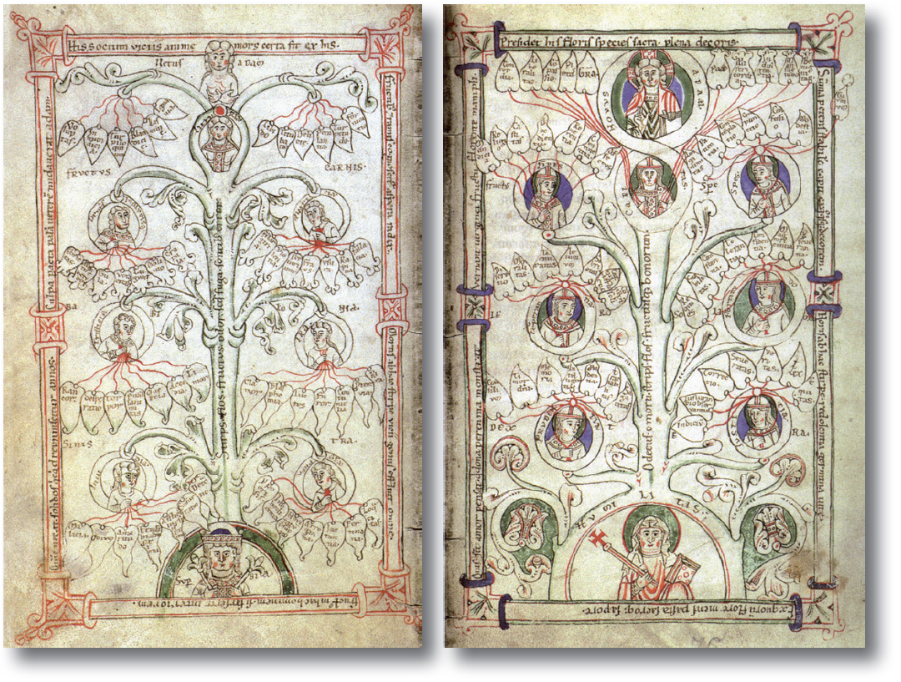
The Seven Deadly Sins and Christian Community
Notes:
Pages 18-22 of The 3 Colors of Community contain the teaching associated with this slide.

Slide 10
Eastern and Western views of sin
Western paradigm
Eastern paradigm
sin as breaking laws
sin as sickness
cure: punishment
cure: healing
church as courtroom
church as hospital
Notes:
Pages 23-26 of The 3 Colors of Community contain the teaching associated with this slide.

Slide 11
Eastern and Western views of sin
Christ’s work:
victory over
EVIL
&
DEATH
opposite of
GOOD
opposite of
LIFE
emphasis of the Western tradition
emphasis of the Eastern tradition
resulting in the
GOOD
LIFE
Notes:
Pages 23-26 of The 3 Colors of Community contain the teaching associated with this slide.

Slide 12
Harnessing the energies behind the deadly sins
Path of
denial
Energy
Sin
Path of compromise
Submit!
power
pride
hero worship
Abstain!
pleasure
gluttony
consumerism
Conform!
identity
envy
egalitarianism
Renounce!
sustenance
greed
materialism
Calm down!
justice
anger
judgmentalism
Act!
renewal
sloth
entertainment
Cleanse!
intimacy
lust
permissiveness
Notes:
Pages 27-30 of The 3 Colors of Community contain the teaching associated with this slide.

Slide 13
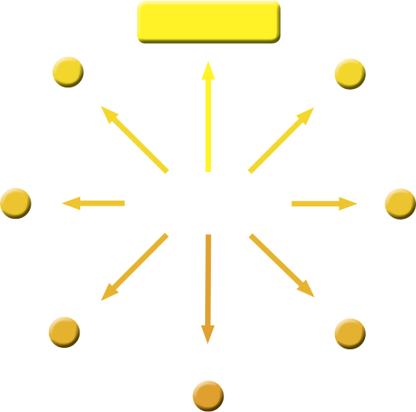



Harnessing the energies behind the deadly sins
COMMUNAL
QUALITY
unless you re-direct your energy
will energize
ENERGY
will lead to sin
SIN
Notes:
Pages 27-30 of The 3 Colors of Community contain the teaching associated with this slide.

Slide 14
Why it’s not enough to say “no” to sin
Energy
Sin
Biblical
model
Redirection
of energies
Communal Qualities
power
pride
Request of James and John
Mark 10:35-45
Greatness through servanthood
Empowering leadership
pleasure
gluttony
The believer’s freedom
1 Corinthians 10:23-33
What is
beneficial?
Effective structures
identity
envy
One body, many parts
1 Corinthians 12:14-27
Everybody is
needed
Gift-based ministry
sustenance
greed
Feeding the five thousand
Mark 6:32-44
Multiplication through giving
Need-oriented evangelism
justice
anger
Clearing of the temple
John 2:13-17
Zeal for God’s cause
Loving relationships
renewal
sloth
Rest for the weary
Matthew 11:28-30
Finding rest by taking the yoke
Passionate spirituality
intimacy
lust
Anointing by a sinful woman
Luke 7:36-39
Relating affection to Jesus
Inspiring
worship
Notes:
Pages 31-34 of The 3 Colors of Community contain the teaching associated with this slide.

Slide 15
Christian consumers or disciples?
Energy
Sin
Structural presence
of sin
power
pride
Status symbols
pleasure
gluttony
Industrial animal agriculture
identity
envy
Glorification of the average
sustenance
greed
Shareholder value
justice
anger
Culture of moral outrage
renewal
sloth
Wellness instead of training
intimacy
lust
Selling with sex
Notes:
Pages 35-38 of The 3 Colors of Community contain the teaching associated with this slide.

Slide 16

A path away from pride
Notes:
Pages 40-47 of The 3 Colors of Community contain the teaching associated with this slide.

Slide 17

A path away from pride
EMPOWERING LEADERSHIP
unless you invest your influence in others
will energize
Desire for POWER
will lead to pride
PRIDE
Notes:
Pages 40-47 of The 3 Colors of Community contain the teaching associated with this slide.

Slide 18
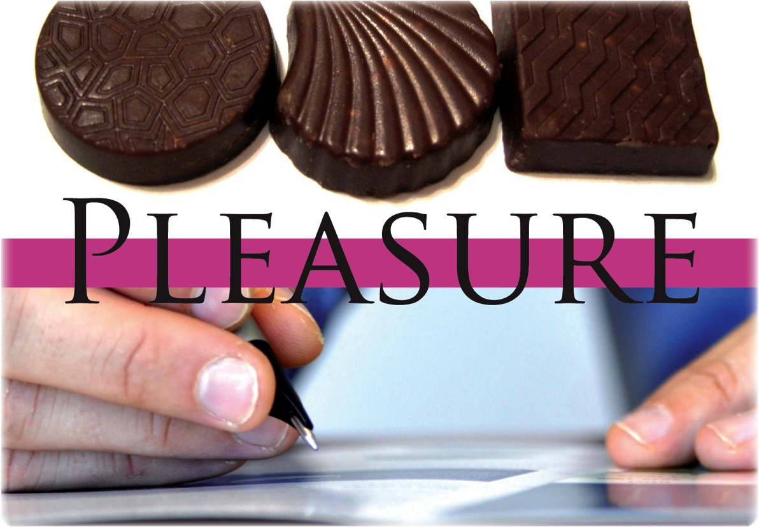
A path away from gluttony
Notes:
Pages 48-55 of The 3 Colors of Community contain the teaching associated with this slide.

Slide 19
A path away from gluttony
EFFECTIVE STRUCTURES
unless you bring balance in your life
will energize
Desire for PLEASURE
will lead to gluttony
GLUTTONY
Notes:
Pages 48-55 of The 3 Colors of Community contain the teaching associated with this slide.

Slide 20
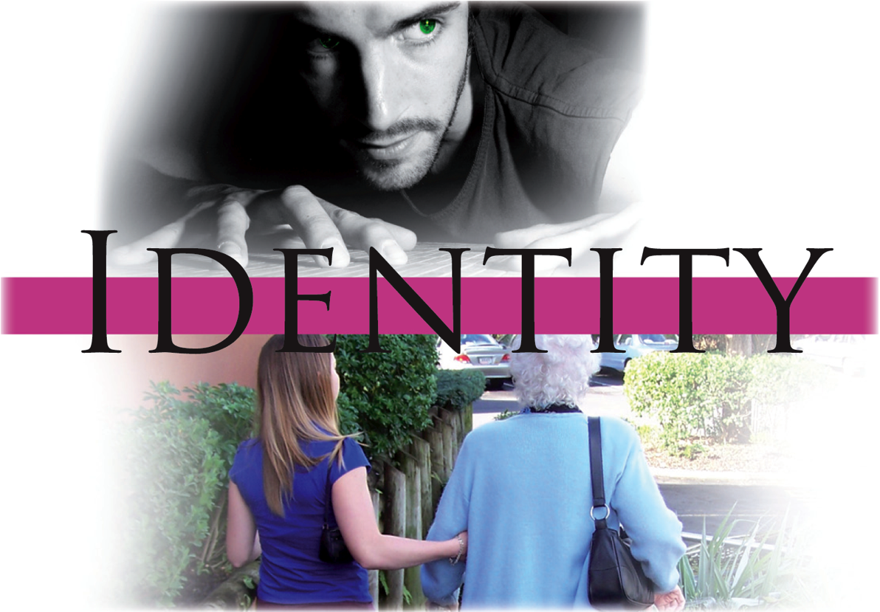
A path away from envy
Notes:
Pages 56-63 of The 3 Colors of Community contain the teaching associated with this slide.

Slide 21
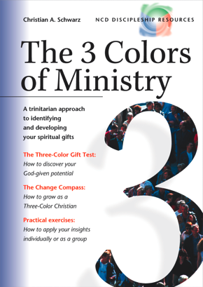
A path away from envy
GIFT-BASED MINISTRY
unless you recognize your dependency on others
will energize
Desire for IDENTITY
will lead to envy
ENVY
Notes:
Pages 56-63 of The 3 Colors of Community contain the teaching associated with this slide.

Slide 22

A path away from greed
Notes:
Pages 64-71 of The 3 Colors of Community contain the teaching associated with this slide.

Slide 23
A path away from greed
NEED-ORIENTED EVANGELISM
unless you share what you have received
will energize
Desire for SUSTENANCE
will lead to greed
GREED
Notes:
Pages 64-71 of The 3 Colors of Community contain the teaching associated with this slide.

Slide 24
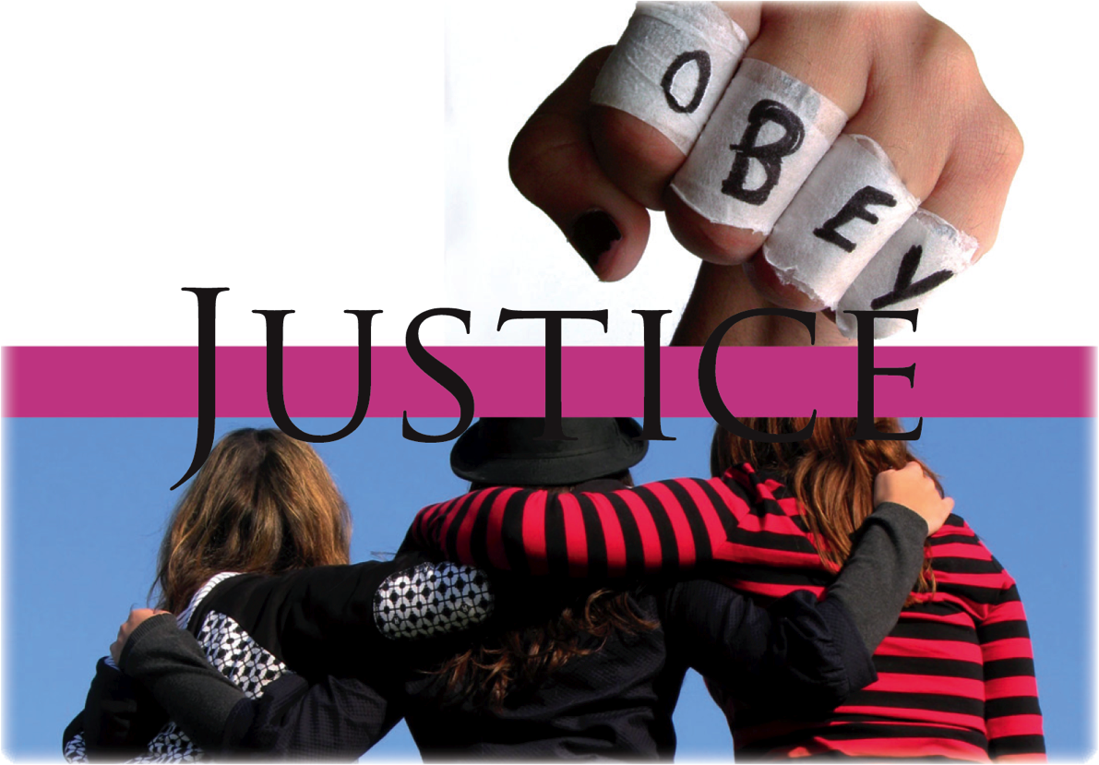
A path away from anger
Notes:
Pages 72-79 of The 3 Colors of Community contain the teaching associated with this slide.

Slide 25

A path away from anger
LOVING RELATIONSHIPS
unless you balance justice and grace
will energize
Desire for JUSTICE
will lead to anger
ANGER
Notes:
Pages 72-79 of The 3 Colors of Community contain the teaching associated with this slide.

Slide 26

A path away from sloth
Notes:
Pages 80-87 of The 3 Colors of Community contain the teaching associated with this slide.

Slide 27
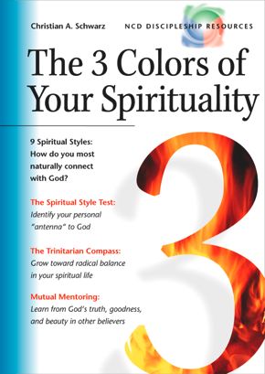
A path away from sloth
PASSIONATE SPIRITUALITY
unless you seek to fully experience God
will energize
Desire for RENEWAL
will lead to sloth
SLOTH
Notes:
Pages 80-87 of The 3 Colors of Community contain the teaching associated with this slide.

Slide 28

A path away from lust
Notes:
Pages 88-95 of The 3 Colors of Community contain the teaching associated with this slide.

Slide 29
A path away from lust
INSPIRING WORSHIP
unless you worship God with all your senses
will energize
Desire for INTIMACY
will lead to lust
LUST
Notes:
Pages 88-95 of The 3 Colors of Community contain the teaching associated with this slide.

Slide 30
The Communal Test
Vulnerability: Pride
Energy for:
Empowering leadership
Vulnerability: Gluttony
Energy for:
Effective structures
Vulnerability: Envy
Energy for:
Gift-based ministry
Vulnerability: Greed
Energy for:
Need-oriented evangelism
Vulnerability: Anger
Energy for:
Loving relationships
Vulnerability: Sloth
Energy for:
Passionate spirituality
Vulnerability: Lust
Energy for:
Inspiring worship
power
Always start with your
strongest energy
pleasure
identity
sustenance
justice
renewal
intimacy
intimacy
Notes:
Pages 96-106 of The 3 Colors of Community contain the teaching associated with this slide.

Slide 31
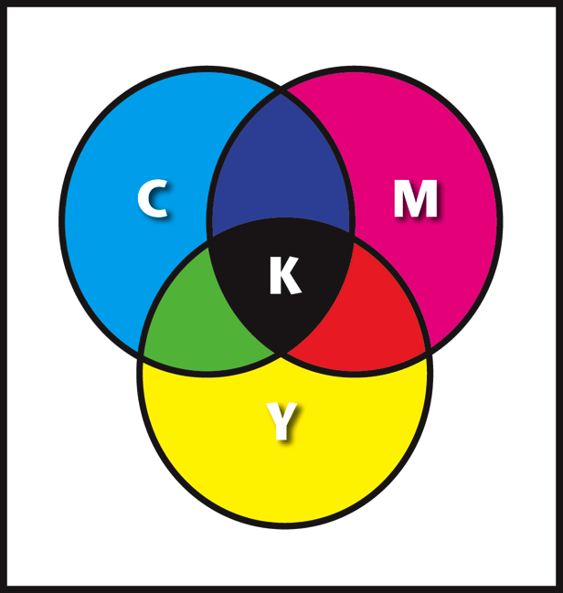
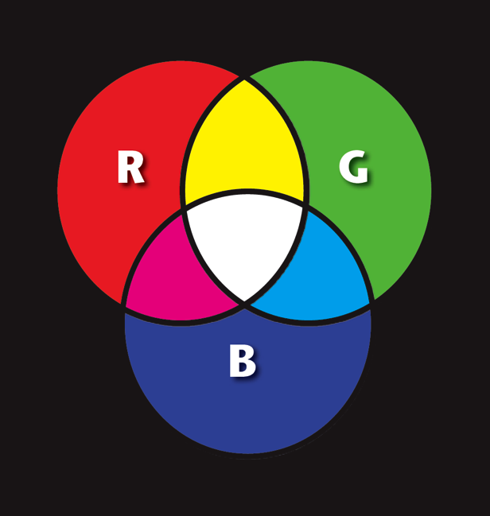
Sin as the absence of light
Object colors
The colors of light
Notes:
Pages 108-111 of The 3 Colors of Community contain the teaching associated with this slide.

Slide 32
Addressing the deadly sins within a small group
Vulnerability: Pride
Energy for:
Empowering leadership
Vulnerability: Gluttony
Energy for:
Effective structures
Vulnerability: Envy
Energy for:
Gift-based ministry
Vulnerability: Greed
Energy for:
Need-oriented evangelism
Vulnerability: Anger
Energy for:
Loving relationships
Vulnerability: Sloth
Energy for:
Passionate spirituality
Vulnerability: Lust
Energy for:
Inspiring worship
power
pleasure
identity
sustenance
justice
renewal
intimacy
intimacy
Notes:
Pages 112-116 of The 3 Colors of Community contain the teaching associated with this slide.

Slide 33
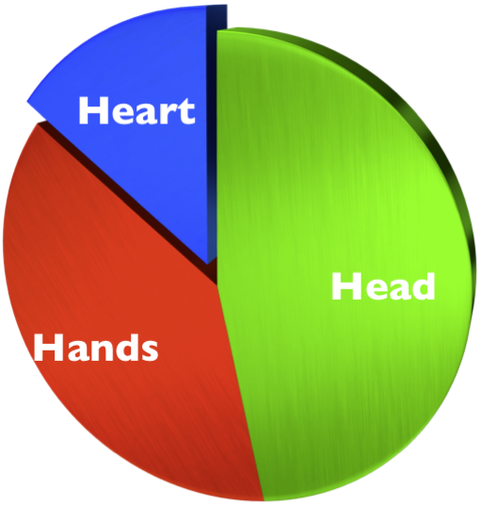
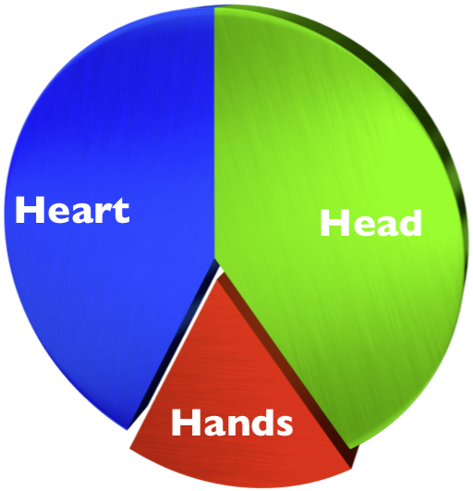
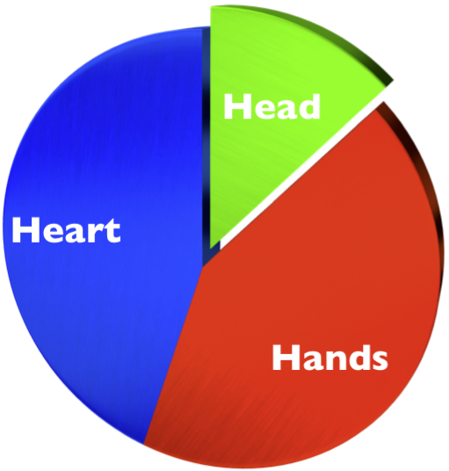
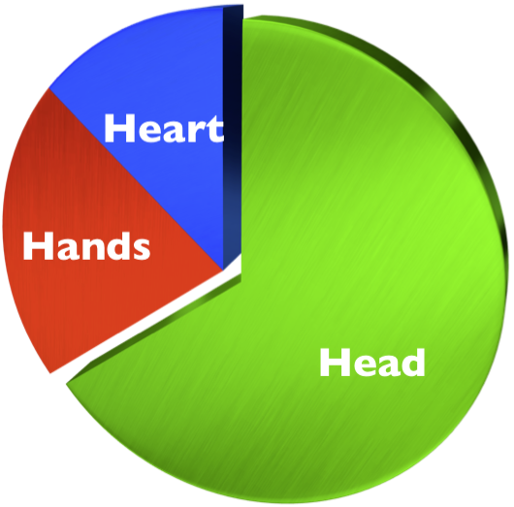
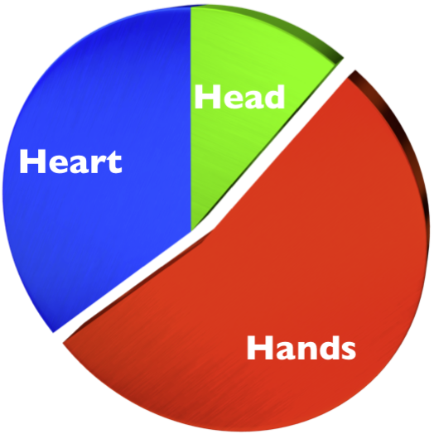
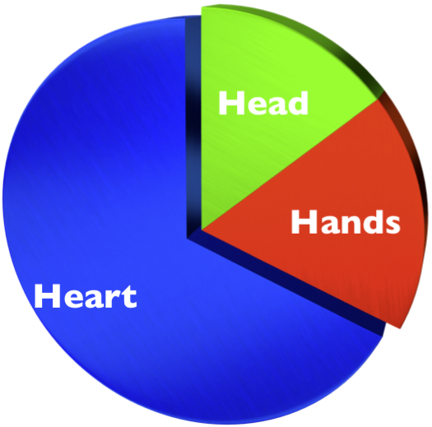
Addressing the deadly sins within a small group
A group with strong head energies (green)
A group with strong hands energies (red)
A group with strong heart energies (blue)
A group with strong head-hands energies (green-red)
A group with strong head-heart energies (green-blue)
A group with strong heart-hands energies (blue-red)
Notes:
Pages 112-116 of The 3 Colors of Community contain the teaching associated with this slide.

Slide 34
Spiritual Change Talk
Experience
Do
Perceive
Test
Plan
Understand
Experi-
mentation questions
Vision
questions
Capacity
questions
Spiritual
Change
Progression
questions
Strategy
questions
Training
questions
Notes:
Pages 117-120 of The 3 Colors of Community contain the teaching associated with this slide.

Slide 35

Identifying the different voices within you
IDENTIFICATION
This voice is part of me…
My concepts are superior to others
I am committed to empowering
other people
…but it is only part of me
DISIDENTIFICATION
Proud
voice
Empower-
ing voice
Notes:
Pages 121-126 of The 3 Colors of Community contain the teaching associated with this slide.

Slide 36
Identifying the different voices within you
Our approach to leadership is far superior to others
I love to ridicule guru leaders
Message
Network Leader
Anti
Guru
My measure of success is the maturity of my coachees
God has called me to be an international leader
I am proud of my own anti-status-symbols approach
Why doesn’t the whole world listen to me?
The Anointed One
The Frustrat-
ed
Coach
“David”
I wished I had the legal power to make NCD compulsory
I am committed to empowering
other people
People are old enough to make their own decisions
I am committed to help others fulfill their visions
Name
Fanatic
Bible
Student
Laid-back
Empow-
erer
Notes:
Pages 121-126 of The 3 Colors of Community contain the teaching associated with this slide.

Slide 37
Understanding your inner voices
Our approach to leadership is far superior to others
I love to ridicule guru leaders
Pride
Pride
Message
Network Leader
Anti
Guru
My measure of success is the maturity of my coachees
God has called me to be an international leader
I am proud of my own anti-status-symbols approach
Why doesn’t the whole world listen to me?
Empowering leadership
Pride
Pride
Pride
The Anointed One
The Frustrat-
ed
Coach
“David”
I wished I had the legal power to make NCD compulsory
I am committed to empowering
other people
People are old enough to make their own decisions
I am committed to help others fulfill their visions
Name
Pride
Empowering leadership
Empowering leadership
Empowering leadership
Fanatic
Bible
Student
Laid-back
Empow-
erer
Notes:
Pages 127-130 of The 3 Colors of Community contain the teaching associated with this slide.

Slide 38



Forming your Inner Team
Our approach to leadership is far superior to others
I love to ridicule guru leaders
Pride
Pride
Message
Network Leader
Anti
Guru
My measure of success is the maturity of my coachees
God has called me to be an international leader
I am proud of my own anti-status-symbols approach
Why doesn’t the whole world listen to me?
Empowering leadership
Pride
Pride
Pride
The Anointed One
The Frustrat-
ed
Coach
“David”
I wished I had the legal power to make NCD compulsory
I am committed to empowering
other people
People are old enough to make their own decisions
I am committed to help others fulfill their visions
Name
Pride
Empowering leadership
Empowering leadership
Empowering leadership
Fanatic
Bible
Student
Laid-back
Empow-
erer
Notes:
Pages 131-135 of The 3 Colors of Community contain the teaching associated with this slide.

Slide 39
Establishing more holistic groups
hands
head
heart
Effective
structures
Inspiring
worship
Gift-based
ministry
Empowering leadership
Passionate
spirituality
Need-oriented evangelism
Loving relationships
Notes:
Pages 136-140 of The 3 Colors of Community contain the teaching associated with this slide.

Slide 40
Christian community
—a glimpse of heaven
HEAVEN
Good
Life
Sin
Sickness
Evil
Death
HELL
Notes:
Pages 141-144 of The 3 Colors of Community contain the teaching associated with this slide.

Slide 41
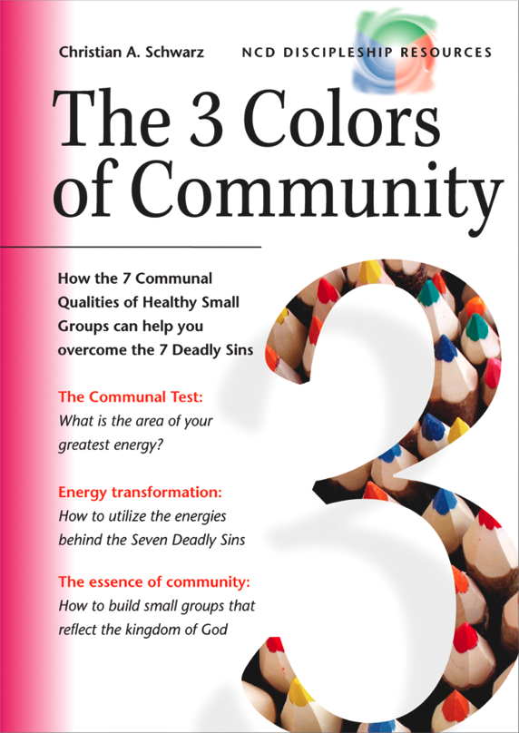
Small group and larger group volume discounts apply on the book.
Or you can get started straight away by taking the online eTest.
See the web site for details.
Notes:
The cover of The 3 Colors of Community.

