Slide 1
Dear presenter, This PowerPoint file is intended as a master presentation file from which you can form your own unique presentations. It is therefore not intended to be presented from beginning to end unless you find yourself in a very unique situation where doing so would be most beneficial for your specific audience. When forming a unique presentation based on these slides, please consider such time-related factors as… - your unique audience and their specific needs - the level of influence you have with the specific group - the time available (allowing time for questions - about one slide for every 5 minutes available) - the distractions within the presentation environment For your preparation, you will find The 3 Colors of Love book page references in the notes section on each slide. Also, as part of your presentation, be prepared with your own personal stories from using The 3 Colors of Love. Thanks for your important ministry. Blessings NCD International

Slide 2
Three dimensions of God’s love
For the word of the Lord is right and true; he is faithful (´æmunah) in all he does. The Lord loves righteousness (sedaqah) and justice; the earth is full of his unfailing love (hæsæd).
Psalm 33:4-5
Your love (hæsæd), O Lord, reaches to the heavens, your faithfulness (´æmunah) to the skies. Your righteousness (sedaqah) is like the mighty mountains, your justice like the great deep.
Psalm 36:5-6
I do not hide your righteousness (sedaqah) in my heart; I speak of your faithfulness and salvation. I do not conceal your love (hæsæd) and your truth (´æmunah) from the great assembly.
Psalm 40:10
Is your love (hæsæd) declared in the grave, your faithfulness (´æmunah) in destruction? Are your wonders known in the place of darness, or your righteousness (sedeqah) deeds in the land of oblivion?
Psalm 88:11-12
The Lord has made his salvation known and revealed his righteousness (sedaqah) to the nations. He has remembered his love (hæsæd) and his faithfulness (´æmunah) to the house of Israel.
Psalm 98:2-3
I know, O Lord, that your laws are righteous (sedaqah), and in faithfulness (´æmunah) you have afflicted me. May your unfailing love (hæsæd) be my comfort.
Psalm 119:75-76
Notes:
Pages 20-22 of The 3 Colors of Love contain the teaching associated with this slide.

Slide 3
Three dimensions of God’s love
justice
grace
truth
(sedeqah)
(hæsæd)
(´æmunah)
love
Notes:
Pages 20-22 of The 3 Colors of Love contain the teaching associated with this slide.

Slide 4
Three dimensions of God’s love
justice
God’s compassionate love in action
compassion
truth
God’s trustworthy love in action
trustworthiness
grace
God’s accepting love in action
acceptance
Notes:
Pages 20-22 of The 3 Colors of Love contain the teaching associated with this slide.

Slide 5
God is light
the light of grace
the light of justice
the light of truth
God
= love
=light
Notes:
Pages 23-25 of The 3 Colors of Love contain the teaching associated with this slide.

Slide 6
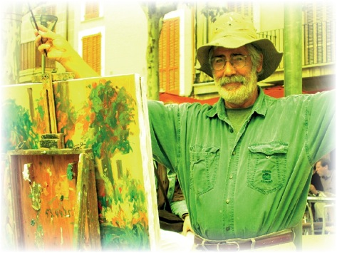
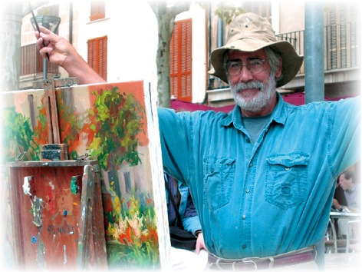
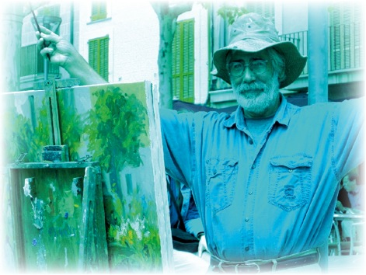
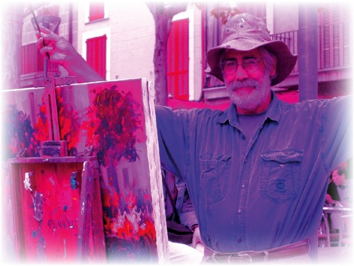
God is light
Notes:
Pages 23-25 of The 3 Colors of Love contain the teaching associated with this slide.

Slide 7
What is darkness?
injustice
deception
mercilessness
grace
truth
justice
LOVE
Notes:
Pages 26-27 of The 3 Colors of Love contain the teaching associated with this slide.

Slide 8
The color green: justice
Notes:
Pages 30-31 of The 3 Colors of Love contain the teaching associated with this slide.

Slide 9
The color red: truth
Notes:
Pages 32-33 of The 3 Colors of Love contain the teaching associated with this slide.

Slide 10
The color blue: grace
Notes:
Pages 34-35 of The 3 Colors of Love contain the teaching associated with this slide.

Slide 11
Primary and secondary virtues
fairness
politeness
honesty
acceptance
trustworthiness
compassion
LOVE
Notes:
Pages 41-43 of The 3 Colors of Love contain the teaching associated with this slide.

Slide 12
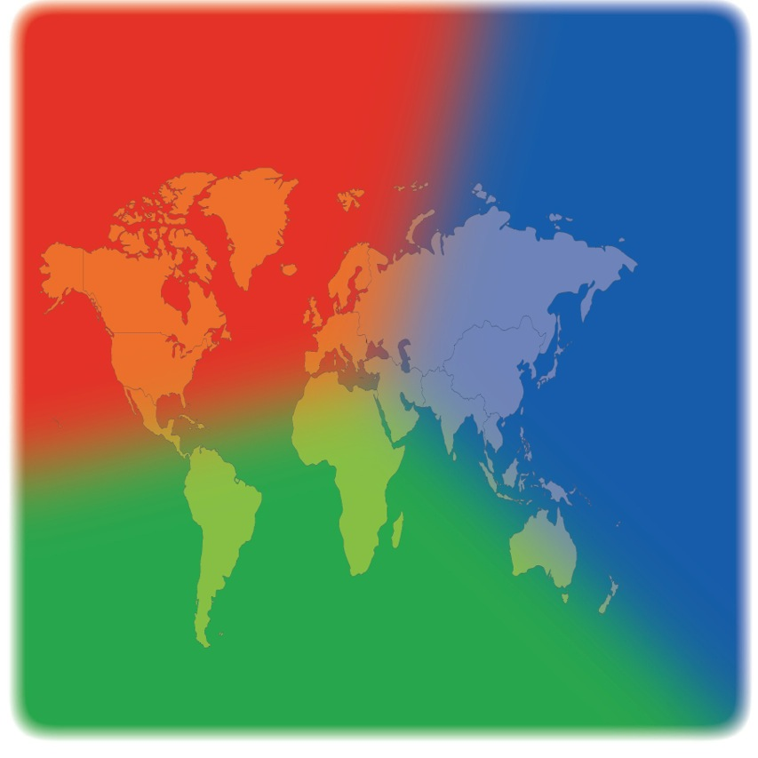
Strengths and liabilities of different cultures
hypocrisy
imperialism
anarchy
justice
truth
grace
Notes:
Pages 44-45 of The 3 Colors of Love contain the teaching associated with this slide.

Slide 13
Two different approaches to conflict
Feelings
Thoughts
Deeds
I don’t like Leo
“I hope I won’t meet him”
I avoid him
Loving
thoughts
Loving
deeds
Loving
feelings
God loves Leo, and I decide to love him, too.
I approach Leo and have a friendly chat with him.
I notice that Leo no longer seems to be so hard to like
Notes:
Pages 46-47 of The 3 Colors of Love contain the teaching associated with this slide.

Slide 14
Understanding the fruit of the Spirit
Galatians 5:22-23 as we find it in most of our Bibles today (left Greek, right English):
,
But the fruit of the Spirit is love, joy, peace, patience, kindness, goodness, faithfulness, gentleness, self-control.
,
,
,
,
,
,
,
.
The original text, however, had no punctuation marks:
But the fruit of the Spirit is love joy peace patience kindness goodness faithfulness gentleness self-control
A different way of punctuating this verse would be to put a colon after “love”:
:
But the fruit of the Spirit is love: joy, peace, patience, kindness, goodness, faithfulness, gentleness, self-control.
,
,
,
,
,
,
,
.
Notes:
Pages 56-59 of The 3 Colors of Love contain the teaching associated with this slide.

Slide 15
Understanding the fruit of the Spirit
injustice
deception
mercilessness
peace
joy
kindness
goodness
faithfulness
self-control
patience
gentleness
grace
truth
justice
LOVE
Notes:
Pages 56-59 of The 3 Colors of Leadership contain the teaching associated with this slide.

Slide 16
The spiritual color wheel
kindness
peace
faithfulness
gentleness
joy
patience
goodness
self-control
… does not delight in evil
… keeps no record of wrongs
… is not self seeking
… always protects
… is patient
… always perseveres
… always trusts
… always hopes
LOVE
… is kind
… never fails
… is not proud
… is not rude
… does not boast
… is not easily angered
… rejoices with the truth
… does not envy
Notes:
Pages 60-61 of The 3 Colors of Leadership contain the teaching associated with this slide.

Slide 17
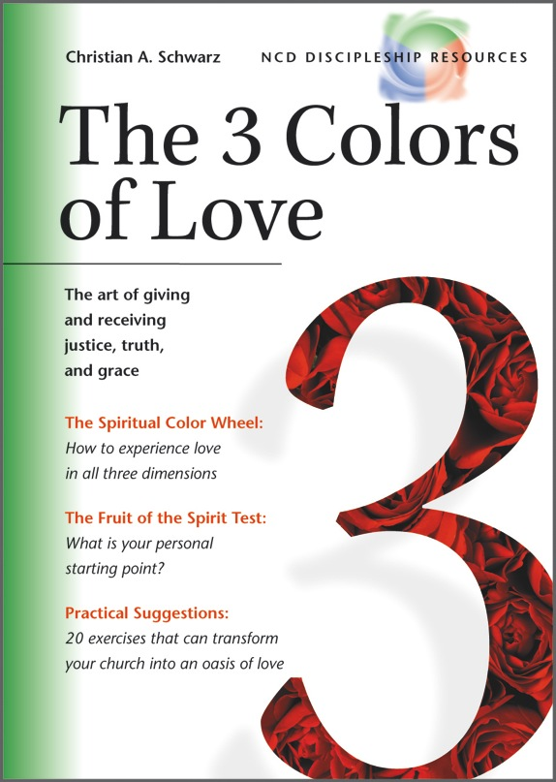
Small group and larger group volume discounts apply on the book.
See the web site for details.
3colorsoflove.org
Notes:
The cover of The 3 Colors of Ministry.

Slide 18
Fruit of the Spirit index
Patience
Joy
Peace
Faithfulness
Goodness
Kindness
Self-control
Gentleness

Slide 19
The fruit of patience: Enduring Love
If patience is your current weakness, you tend to expect results too quickly, which negatively affects both your relationship with yourself and with others. You will mature in love as you learn to give yourself and others time to grow naturally, which includes making mistakes and learning from them.
Understanding the term
The Greek word makrothymia contemplates a persistence that is not easily put off by unfavorable circumstances. It is based on the patience of God, which never gives up on anyone.
Patience must not be confused with fatalism, i.e. simply accepting things as they are. On the contrary, patience, as described in the Bible, is active. It is a perseverance that works toward seeing God’s will become reality. In this process, however, it has an eye for the right timing. In the New Testament, patience is often mentioned in close relationship to kindness and gentleness (as has also been done in our color wheel).
Literally, makrothymia means holding back the thymos, anger, for a long time. It is the opposite of oxythymia, violent anger. People who display patience are able to combine determination and mercy.
Patience must not be confused with fatalism. Rather, it is a perseverance that combines determination with mercy.
Return to fruit of the Spirit index
More⇛
Notes:
Page 71 of The 3 Colors of Love contains the teaching associated with this slide.

Slide 20
The fruit of patience: Enduring Love
Color Segment
On the spiritual color wheel (page 59), patience has been placed in the justice segment (green), slightly overlapping with grace (blue). The dimension of grace that is contained in patience is urgently needed when people are striving for justice.
Key Bible passage: James 5:7-9
“Be patient, then, brothers, until the Lord’s coming. See how the farmer waits for the land to yield its valuable crop and how patient he is for the autumn and spring rains. You too, be patient and stand firm, because the Lord’s coming is near. Don’t grumble against each other, brothers, or you will be judged.”
For further study
Matthew 18:21-35; Romans 9:22-23; 1 Corinthians 13:4; Colossians 3:12-14; 1 Thessalonians 5:14-15; 2 Timothy 3:10-12; 2 Timothy 4:1-8; Hebrews 6:10-20; James 1:2-4; James 5:7-12; 2 Peter 3:4-16
Return to fruit of the Spirit index
⇚Back
Notes:
Page 71 of The 3 Colors of Love contains the teaching associated with this slide.

Slide 21
The fruit of joy: Rejoicing love
If joy is your weakness, it would encourage both you and others if you could be more enthusiastic about the Lord and the ministry he has given you. You need to learn not to let your moods be so influenced by your environment.
Understanding the term
The Greek term chara refers to a happiness that is based on the “joy of the Lord,“ and is therefore independent of the situation you happen to be in. Joy has nothing to do with a hedonistic striving after fun. It’s more of a “happiness in” than a “happiness about.” It doesn’t ignore the sorrows and pains of life. In fact, the Bible frequently emphasizes that we can have joy in the midst of suffering.
However, biblical joy should not be confused with the Stoic ideal of an emotionless state of being. In both the Old and the New Testaments, joy is definitely a term that is loaded with emotion. The Gospels teach us with the brightest colors what joy is all about. The more this fruit grows, the better we will be able to share the joy that we have experienced, with others.
The term chara is closely related to the New Testament term for grace, charis. In effect, we can view the whole gospel as a “word of joy.” Luke in particular makes joy the underlying theme of his gospel.
Joy is a happiness that is based on the “joy of the Lord.” Therefore it is independent of the situation you happen to be in.
Return to fruit of the Spirit index
More⇛
Notes:
Page 72 of The 3 Colors of Love contains the teaching associated with this slide.

Slide 22
The fruit of joy: Rejoicing love
Color Segment
Joy is as much an expression of truth (see 1 Cor. 13:6) as of grace (see above). Therefore we have placed it on our spiritual color wheel (page 59) between the red and blue color segments.
Key Bible passage: Luke 10:17-20
“The seventy-two returned with joy and said, ‘Lord, even the demons submit to us in your name.’ He replied, ‘I saw Satan fall like lightning from heaven. I have given you authority to trample on snakes and scorpions and to overcome all the power of the enemy; nothing will harm you. However, do not rejoice that the spirits submit to you, but rejoice that your names are written in heaven.’”
For further study
John 15:9-11; Acts 5:41-42; Romans 14:17; Philippians 4:1-4; Colossians 1:24; Hebrews 10:34; James 1:2
Return to fruit of the Spirit index
⇚Back
Notes:
Page 72 of The 3 Colors of Love contains the teaching associated with this slide.

Slide 23
The fruit of peace: Reconciling love
If peace is your current weakness, you should deliberately strive for reconciliation in the relationships around you. However, it may well be that you have to work on improving your own primary relationships before seeking to bring about reconciliation between others.
Understanding the term
In the New Testament, the Greek term eirene in most cases acquires nuances from the Hebrew word shalom, which is far wider in scope. It includes both the state of being reconciled with God and one’s wholeness in all aspects of life, from which peace with others flows.
It is no accident that the Bible begins and ends with the great vision of shalom. In the creation narrative, God brings order and harmony out of chaos. In the book of Revelation, people from all nations form a loving community in “the holy city, the new Jerusalem” (Rev. 21).
In Psalm 85:10 shalom is placed in the midst of our three key terms for understanding love: justice, truth, and grace. “Grace and truth meet together; justice and peace kiss each other.” In Matthew 5:9 Jesus blesses the peacemakers and promises them that they will be called “sons of God.”
Peace, in the biblical sense, contemplates a far broader reality than our common usage of the English term. It aims at the well-being of an individual or community in all aspects of life.
Return to fruit of the Spirit index
More⇛
Notes:
Page 73 of The 3 Colors of Love contains the teaching associated with this slide.

Slide 24
The fruit of peace: Reconciling love
Color Segment
Peace is an expression of justice (see Isa. 32:17), but it has a tendency toward truth as well. Therefore, on our spiritual color wheel (page 59), we have placed it inside the green segment, bordering the red segment.
Key Bible passage: Romans 12:16-18
“Live in harmony with one another. Do not be proud, but be willing to associate with people of low position. Do not be conceited. Do not repay anyone evil for evil. Be careful to do what is right in the eyes of everybody. If it is possible, as far as it depends on you, live at peace with everyone.”
For further study
Mark 9:50; John 14:27; Romans 5:1-2; 2 Corinthians 13:11; Ephesians 2:14-17; Philippians 4:7; Hebrews 12:11-15; James 3:18
Return to fruit of the Spirit index
⇚Back
Notes:
Page 73 of The 3 Colors of Love contains the teaching associated with this slide.

Slide 25
The fruit of faithfulness: Reliable love
If faithfulness should be your weakest area, you could make great progress in your growth process by learning to be more reliable in terms of your commitments. This would make you more trustworthy in the eyes of other people.
Understanding the term
The word for “faithfulness“ in the Greek text, pistis, is the same word that is otherwise often translated as “faith.“ In the New Testament, faithfulness includes reliability and trustworthiness—you trust others, and, in turn, earn their trust. The parable of the talents (Matt. 25:14-30) is a prime example of the sort of faithful stewardship that God expects of us.
In the Bible, faithfulness is always a relational term, it is concerned with commitments toward other people. It’s unfaithful not to use the gifts that God has given us (Luke 19:20-22). In the same way, it can be unfaithful to commit ourselves to so many tasks that we cannot follow through adequately. Good stewardship implies the ability to say “no.”
As we have seen before (page 32), in the Old Testament “faithfulness” is another translation of the Hebrew word for “truth.” The reliability embodied by this term is at the core of a genuinely biblical concept of truth.
Faithfulness means practicing the “good stewardship” that Jesus expects of his disciples.
Return to fruit of the Spirit index
More⇛
Notes:
Page 74 of The 3 Colors of Love contains the teaching associated with this slide.

Slide 26
The fruit of faithfulness: Reliable love
Color Segment
Since “faithfulness” and “truth” are synonyms in the Old Testament, we have placed faithfulness at the center of the red segment.
Key Bible passage: Luke 16:10-12
“Whoever can be trusted with very little can also be trusted with much, and whoever is dishonest with very little will also be dishonest with much. So if you have not been trustworthy in handling worldly wealth, who will trust you with true riches? And if you have not been trustworthy with someone else’s property, who will give you property of your own?”
For further study
Luke 12:42-48; Luke 16:1-8; Romans 4:17-20; 1 Corinthians 4:1-2; 2 Timothy 2:13; Hebrews 10:23
Return to fruit of the Spirit index
⇚Back
Notes:
Page 74 of The 3 Colors of Love contains the teaching associated with this slide.

Slide 27
The fruit of goodness: Correcting love
If goodness is currently a weakness for you, you definitely could be “harder“ on yourself and others. As far as God‘s standards are concerned, a certain amount of strictness can well reflect a spirit of love.
Understanding the term
The English word “goodness“ can portray a false understanding of the term, since we tend to think of it as “mildness.“ The Greek term, agathosyne, means something very different.
Just as dikaiosyne (justice) is the noun derived from the adjective dikaios (just), agathosyne is the noun derived from the adjective agathos (good). In other words, the term means striving for the standards that God has defined as “good.” It is an attitude of opposition to all forms of evil—in our own lives as well as in the lives of others.
Goodness, in the biblical sense, is an expression of God’s correcting love. It identifies an evil situation and tries to bring about change. Jesus’ cleansing of the temple (see passage below), is a prime example of agathosyne in action.
Goodness, in Greek, has a very different meaning from our present use of the term. It means striving for the standards that God has defined as good.
Return to fruit of the Spirit index
More⇛
Notes:
Page 75 of The 3 Colors of Love contains the teaching associated with this slide.

Slide 28
The fruit of goodness: Correcting love
Color Segment
The fruit of goodness (understood in the biblical sense) is an expression of justice. We have therefore placed it at the center of the green segment.
Key Bible passage: Mark 11:15-17
“On reaching Jerusalem, Jesus entered the temple area and began driving out those who were buying and selling there. He overturned the tables of the money changers and the benches of those selling doves, and would not allow anyone to carry merchandise through the temple courts. And as he taught them, he said, ‘Is it not written: ‘My house will be called a house of prayer for all nations‘? But you have made it a den of robbers.‘“
For further study
Matthew 5:17-20; Mark 10:18; Romans 12:2; Romans 15:14; Ephesians 5:1-9; 2 Thessalonians 1:6-12
Return to fruit of the Spirit index
⇚Back
Notes:
Page 75 of The 3 Colors of Love contains the teaching associated with this slide.

Slide 29
The fruit of kindness: Amiable love
If kindness is lacking in your life, you should try to project a more winsome attitude. It’s especially important that you develop an eye for the little things that bring joy to other people’s lives.
Understanding the term
Kindness—in Greek chrestotes—can express itself through many simple details of life and relationships: being interested in others, giving gifts, showing attention, listening to people, remembering names, etc.
Kindness radiates an atmosphere that is at the very center of the term “grace.” As this fruit grows in the life of people, they will be able to radiate God’s grace even without using words.
When Paul integrated kindness into his description of love, he was doing more than merely borrowing the term from similar lists of virtues that were widespread at that time. Rather, he was responding to God’s kindness, which he had experienced so overwhelmingly in his own life (Rom. 11:22).
Kindness radiates an atmosphere that is at the very center of the term “grace.” It expresses itself in the many small details of life.
Return to fruit of the Spirit index
More⇛
Notes:
Page 76 of The 3 Colors of Love contains the teaching associated with this slide.

Slide 30
The fruit of kindness: Amiable love
Color Segment
Since kindness expresses an “atmosphere of grace,” we have placed it at the center of the blue segment.
Key Bible passage: Luke 10:30-35
“A man was going down from Jerusalem to Jericho, when he fell into the hands of robbers. They stripped him of his clothes, beat him and went away, leaving him half dead. A priest happened to be going down the same road, and when he saw the man, he passed by on the other side. So too, a Levite, when he came to the place and saw him, passed by on the other side. But a Samaritan, as he traveled, came where the man was; and when he saw him, he took pity on him. He went to him and bandaged his wounds, pouring on oil and wine. Then he put the man on his own donkey, took him to an inn and took care of him. The next day he took out two silver coins and gave them to the innkeeper. ‘Look after him,’ he said, ‘and when I return, I will reimburse you for any extra expense you may have.’”
For further study
2 Corinthians 6:6; Ephesians 2:4-7; Ephesians 4:29-32; Colossians 3:12-14; Titus 3:4-8
Return to fruit of the Spirit index
⇚Back
Notes:
Page 76 of The 3 Colors of Love contains the teaching associated with this slide.

Slide 31
The fruit of self-control: Disciplined love
If self-control should be a weakness for you, the pursuit of greater consistency in your personal life might be the most important step you can take toward becoming a more loving person. If you paid more attention to discipline, it would benefit both you and others.
Understanding the term
The Greek word egkrateia means sobriety, restraint, and moderation in all areas of life. It includes far more than is implied by the term “temperance,“ which is used in some of the older translations (even if this is one variety of self-control). The basic meaning of self-control is “having power over yourself.”
The term is semantically related to the word askeo, from which our word “ascetic” stems. The literal meaning of askeo is simply train. Training includes abstaining from many things in order to reach a specific goal (1 Cor. 9:24-27).
Self-control is not an end in itself, even if throughout church history many people have understood it that way. Rather, its goal is to serve other people better.
Self-control means sobriety and moderation in all areas of life. It’s always targeted at achieving a specific goal.
Return to fruit of the Spirit index
More⇛
Notes:
Page 77 of The 3 Colors of Love contains the teaching associated with this slide.

Slide 32
The fruit of self-control: Disciplined love
Color Segment
Self-control is strongly related to the steadfastness and reliability that characterizes the red color segment as a whole.
Key Bible passage: 1 Corinthians 9:24-27
“Do you not know that in a race all the runners run, but only one gets the prize? Run in such a way as to get the prize. Everyone who competes in the games goes into strict training. They do it to get a crown that will not last; but we do it to get a crown that will last forever. Therefore I do not run like a man running aimlessly; I do not fight like a man beating the air. No, I beat my body and make it my slave so that after I have preached to others, I myself will not be disqualified for the prize.”
For further study
Acts 24:25; 1 Corinthians 6:12-20; 1 Corinthians 7:7-9; Galatians 5:19-26; 2 Timothy 3:1-5; Titus 1:7-8; 2 Peter 1:5-7
Return to fruit of the Spirit index
⇚Back
Notes:
Page 77 of The 3 Colors of Love contains the teaching associated with this slide.

Slide 33
The fruit of gentleness: Humble love
If gentleness is a weakness in your life, other people sometimes perceive you as self-righteous. A big step toward becoming a more loving person might be to pay less attention to your own rights.
Understanding the term
The Greek term for gentleness, praytes, means the opposite of argumentative, self-righteous stubbornness. Gentle people don’t find it difficult to submit to God and to others. They don’t easily react in an angry way. Instead, they tend to be mild, tolerant, and humbly disposed toward others.
Gentleness, as a matter of principle, refrains from using any kind of force against sinners. According to 1 Timothy 3:3, leaders in particular should be characterized by gentleness.
Jesus gave a model for the kind of gentleness that he expects of us when he washed his disciples’ feet, as recorded in John 13. At the end of this passage, Jesus said, “Now that I, your Lord and Teacher, have washed your feet, you also should wash one another’s feet. I have set you an example that you should do as I have done for you” (John 13:14-15).
Gentleness is the opposite of self-righteous stubbornness. Gentle people can easily submit to God and to others.
Return to fruit of the Spirit index
More⇛
Notes:
Page 78 of The 3 Colors of Love contains the teaching associated with this slide.

Slide 34
The fruit of gentleness: Humble love
Color Segment
Since gentleness is a spiritually motivated mildness, as opposed to the “tougher” aspects of love that we can find in the red segment, we have placed it at the center of the blue segment (grace).
Key Bible passage: Galatians 6:1-3
“If someone is caught in a sin, you who are spiritual should restore him gently. But watch yourself, or you also may be tempted. Carry each other’s burden, and in this way you will fulfill the law of Christ. If anyone thinks he is something when he is nothing, he deceives himself.”
For further study
Matthew 5:5; Matthew 11:28-30; John 8:3-11; Ephesians 4:1-3; 2 Timothy 2:24-26; Titus 3:1-2; James 1:19-21; 1 Peter 3:15-17
Return to fruit of the Spirit index
⇚Back
Notes:
Page 78 of The 3 Colors of Love contains the teaching associated with this slide.

