Slide 1
Developing Christian Community —How consumers become disciples

Slide 2
Small groups—defined
A small group is...
a group that is small.

Slide 3
head
hands
heart
What do you think?
holistic small groups
How do you feel?
What will you do?

Slide 4
head
hands
heart
Effective structures
Inspiring worship
Gift-based ministry
Empowering leadership
Passionate
spirituality
Need-oriented evangelism
Loving relationships

Slide 5
head
hands
heart
Effective structures
Gluttony
Inspiring worship
Lust
Gift-based ministry
Envy
Empowering leadership
Pride
Passionate
spirituality
Sloth
Need-oriented evangelism
Greed
Loving relationships
Anger

Slide 6
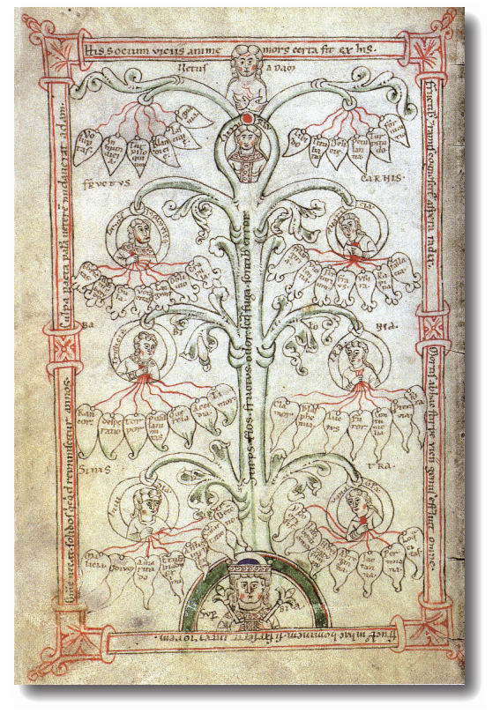
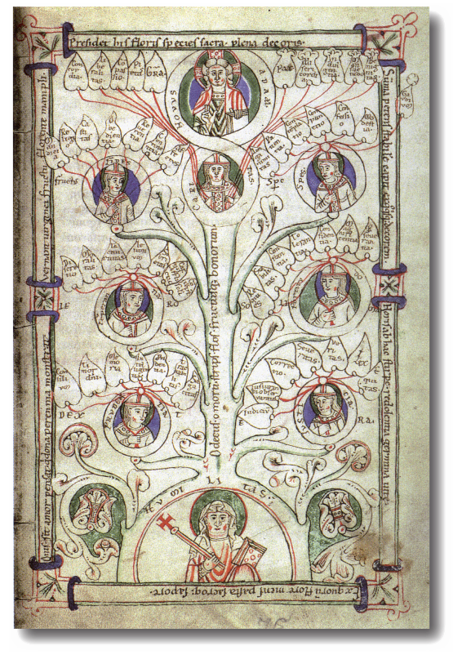
The nature of typologies
The tree of vices (left) and the tree of virtues (right), from: De fructibus carnis et spiritus, Salzburg, 12th century.

Slide 7
relationship to yourself
relationship to others
relationship to God
“Love the Lord your God
… and love your neighbour
… as you love yourself.”
Luke 10:27

Slide 8
The communal test
Vulnerability: Pride
Energy for:
Empowering leadership
Vulnerability: Gluttony
Energy for:
Effective structures
Vulnerability: Envy
Energy for:
Gift-based ministry
Vulnerability: Greed
Energy for:
Need-oriented evangelism
Vulnerability: Anger
Energy for:
Loving relationships
Vulnerability: Sloth
Energy for:
Passionate spirituality
Vulnerability: Lust
Energy for:
Inspiring worship
power
pleasure
identity
sustenance
justice
renewal
intimacy
intimacy

Slide 9
The “Energies” in Scripture
Eph. 4:16: “... from whom the whole body, being fitted and held together by what every joint supplies, according to the proper working (ἐνέργειαν) of each individual part, causes the growth of the body for the building up of itself in love.”
Phil. 2:13: “For it is God who is at work (ἐνεργῶν) in you, both to will and to work (ἐνεργεῖν) for his good pleasure.”
2 Thess. 2:9: “That is, the one whose coming is in accord with the activity (ἐνέργειαν) of Satan, with all power and signs and false wonders…”
1 Cor. 12:6: “There are varieties of effects (ἐνεργημάτων), but the same God who works all things in all persons.”
Galatians 3:5: “Does he who provides you with the Spirit and works (ἐνεργῶν) miracles among you, do it by the works of the law, or by hearing with faith?”
Ephesians 3:7: “... of which I was made a minister, according to the gift of God's grace which was given to me according to the working (ἐνέργειαν) of his power.”
Col. 1:29: “For this purpose also I labor, striving according to His power (ἐνέργειαν), which mightily works (ενεργουμένην) within me.”
Phil. 2:13: “For it is God who works (ἐνεργῶν) in you to will and to act (ἐνεργεῖν) according to his good purpose.”
Romans 7:5: “For while we were in the flesh, the sinful passions, which were aroused by the law, were at work (ἐνηργεῖτο) in the members of our body to bear fruit for death.”
2 Cor. 4:12: “So death works (ἐνεργεῖται) in us, but life in you.”

Slide 10
Eastern and Western Paradigms
Western paradigm
Eastern paradigm
sin as breaking laws
sin as sickness
cure: punishment
cure: healing
church as courtroom
church as hospital

Slide 11
Eastern and Western Paradigms
Christ’s work:
victory over
EVIL
&
Death
opposite of the GOOD
opposite of
LIFE
emphasis of the Western tradition
emphasis of the Eastern tradition
resulting in the GOOD LIFE

Slide 12
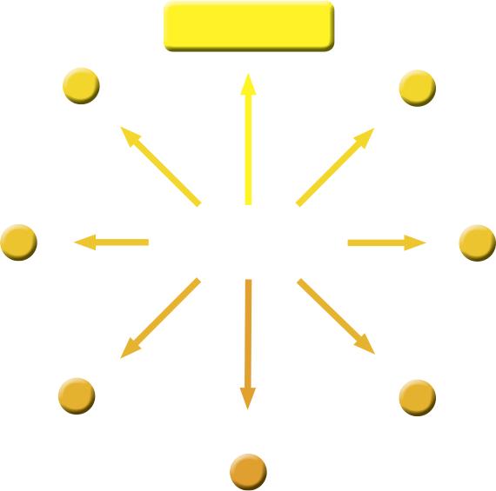
COMMUNAL
QUALITY
ENERGY
SIN

Slide 13
COMMUNAL
QUALITY
unless you re-direct your energy
ENERGY
SIN

Slide 14
EMPOWERING LEADERSHIP
POWER
PRIDE

Slide 15
EMPOWERING LEADERSHIP
unless you invest your influence in others
POWER
PRIDE

Slide 16
LOVING
RELATIONSHIPS
JUSTICE
ANGER

Slide 17
LOVING
RELATIONSHIPS
unless you balance justice and grace
JUSTICE
ANGER

Slide 18
PASSIONATE
SPIRITUALITY
RENEWAL
SLOTH

Slide 19
PASSIONATE
SPIRITUALITY
unless you seek to fully experience God
RENEWAL
SLOTH

Slide 20
The Communal Test
Vulnerability: Pride
Energy for:
Empowering leadership
Vulnerability: Gluttony
Energy for:
Effective structures
Vulnerability: Envy
Energy for:
Gift-based ministry
Vulnerability: Greed
Energy for:
Need-oriented evangelism
Vulnerability: Anger
Energy for:
Loving relationships
Vulnerability: Sloth
Energy for:
Passionate spirituality
Vulnerability: Lust
Energy for:
Inspiring worship
Always start with your
strongest energy
power
pleasure
identity
sustenance
justice
renewal
intimacy
intimacy

Slide 21
heart
hands
head

Slide 22
Share in “same energy” groups of 2-4:
1. Without doing the Communal Test, would you have been aware that this is your greatest energy?
2. How do you presently express your greatest energy in your small group, family, workplace, church, etc.?
3. How could you improve that in the future?
4. How could your group benefit from that contribution?

Slide 23
When we follow the path of Isolation...
If we fail to redirect our energies
our week will be
SINDAY
MOURNDAY
TEARSDAY
WASTEDAY
THIRSTDAY
FIGHTDAY
SHATTERDAY
7 days outside community make
ONE WEAK

Slide 24
Two wrong paths
Path of
denial
Energy
Sin
Path of compromise
Submit!
power
pride
hero worship
Abstain!
pleasure
gluttony
consumerism
Conform!
identity
envy
egalitarianism
Renounce!
sustenance
greed
materialism
Calm down!
justice
anger
judgmentalism
Act!
renewal
sloth
entertainment
Cleanse!
intimacy
lust
permissiveness

