Slide 1
The Fruit of Empowerment
—what we can expect within one year

Slide 2

The promise of
Matthew 18:20
Where two or three
are gathered
small group
(= loving the Lord
with your head,
hands, and heart)
in my name
holistic
there I am among
them
Christ’s presence/
heaven
Holistic small group
= a gathering in Christ's name
= a window to heaven

Slide 3
Eastern and Western Paradigms
Christ’s work:
victory over
EVIL
&
DEATH
opposite of the
GOOD
opposite of
LIFE
emphasis of the Western tradition
emphasis of the Eastern tradition
resulting in the
GOOD LIFE

Slide 4
HEAVEN
Good
Life
Sin
Sickness
Evil
Death
HELL

Slide 5
The communal test
Vulnerability: Pride
Energy for:
Empowering leadership
Vulnerability: Gluttony
Energy for:
Effective structures
Vulnerability: Envy
Energy for:
Gift-based ministry
Vulnerability: Greed
Energy for:
Need-oriented evangelism
Vulnerability: Anger
Energy for:
Loving relationships
Vulnerability: Sloth
Energy for:
Passionate spirituality
Vulnerability: Lust
Energy for:
Inspiring worship
power
pleasure
identity
sustenance
justice
renewal
intimacy
intimacy

Slide 6
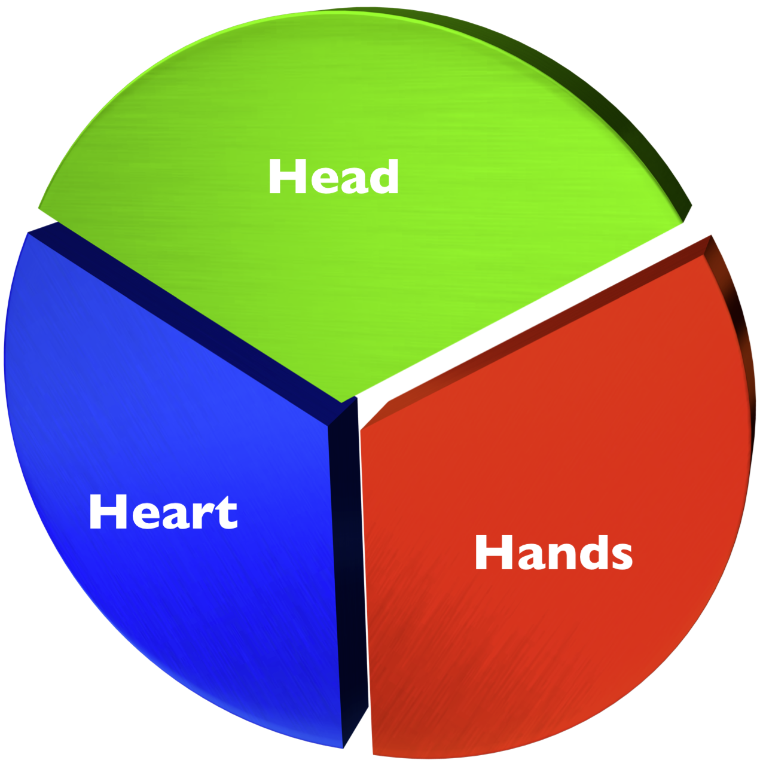

Slide 7
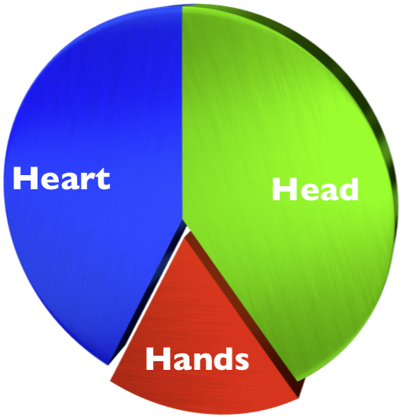
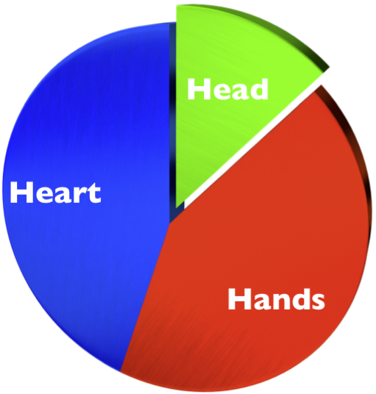
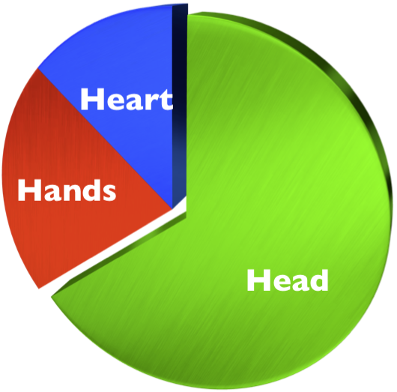
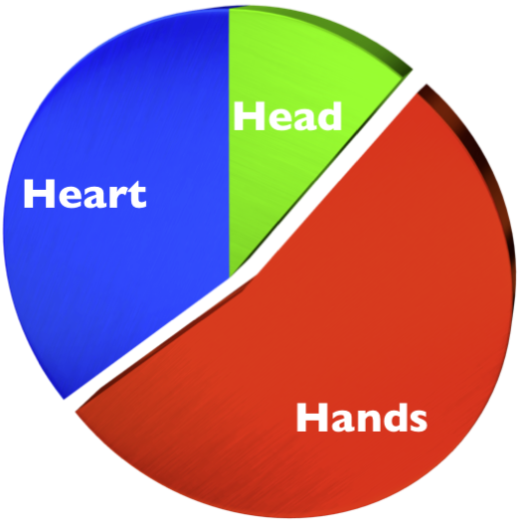
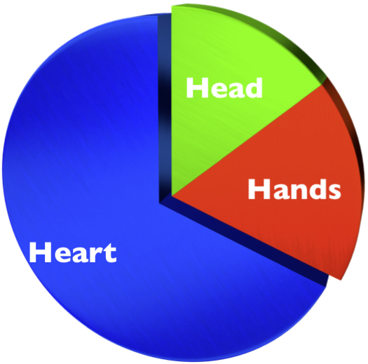
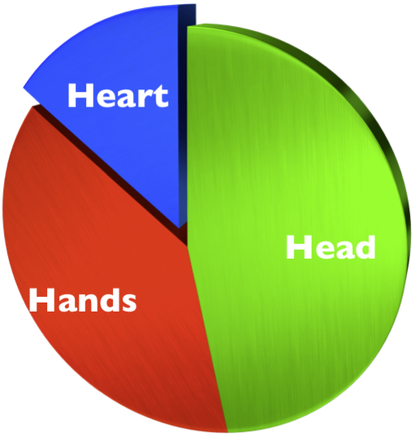
Strong “head” energies
Strong “hands” energies
Strong “heart” energies
Strong “head-hands” energies
Strong “head-heart” energies
Strong “heart-hands” energies

Slide 8
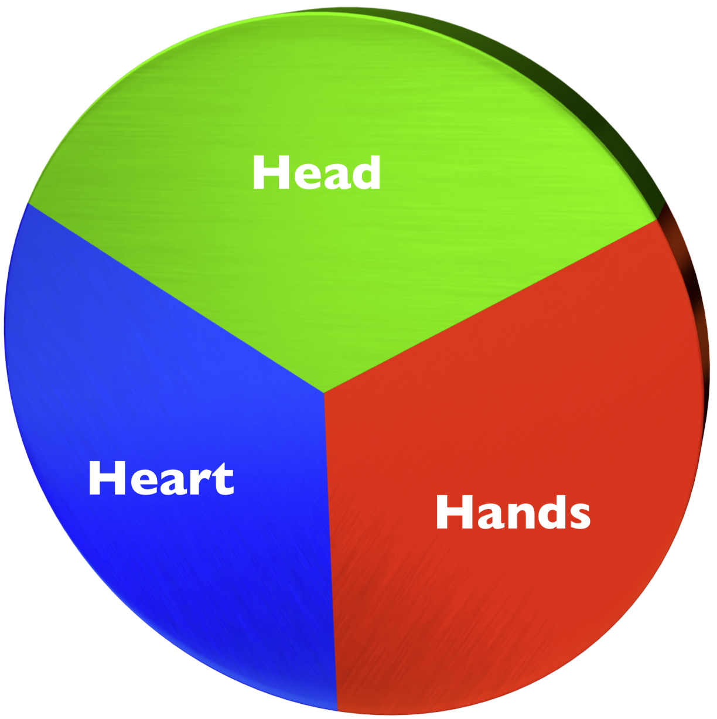

Slide 9


VITA CONTEMPLATIVA
VITA ACTIVA
Effective
structures
Inspiring
worship
Gift-based
ministry
Empowering leadership
Passionate
spirituality
Need-oriented evangelism
Loving relationships

Slide 10
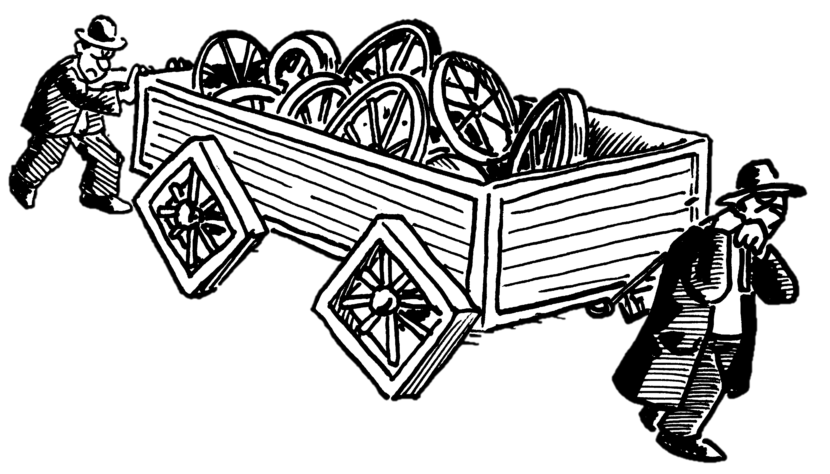
Harnessing the energies that are within your church

Slide 11
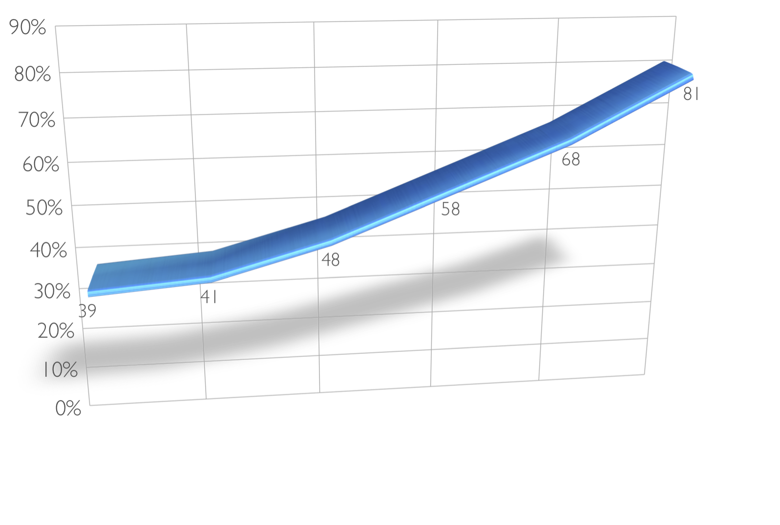
NCD health and financial giving
Percentage
of small group and worship service attending church members who give 10% or more of their gross income in offerings for church support, missions, etc.
Above
average
Well above
average
Very much
above average
Very much
below average
Well below
average
Below
average
NCD scores
(Quality Index)

Slide 12
The people God uses
Jacob was a cheater,
Peter had a temper,
David had an affair,
Noah got drunk,
Jonah ran from God,
Paul was a murderer,
Miriam was a gossiper,
Martha was a worrier,
Thomas was a doubter,
Elijah was depressed,
Moses stuttered,
Zacchaeus was short,
Abraham was old,
and Lazarus was dead.
God doesn’t call the empowered, he empowers the called.

Slide 13
How does God do it?
And what is our part in this strategy of God?

Slide 14
The Leading and the
Empowering wing
Empowering wing
Leading wing

Slide 15
Focus your energies
Do first things...
first.
And second things...
not at all.
The principle of
intentional neglect

Slide 16
Within one year
1. Identify potential leaders
a. People that have “power” as their highest or second-highest energy
b. People who have one of the four leadership gifts (leadership, organization, apostle, shepherding)
c. People who have identified one of the leadership gifts as a “latent” gift
2. Start Spiritual Change Talk with them
3. Identify the energies in all of your small groups
4. Help people relate their energies to kingdom-building areas
5. Enjoy the results!

Slide 17

The fruit of empowerment
“traditional”
approach
NCD
approach

Slide 18
Intentional
neglect

Slide 19
God

