Slide 1
What new perspectives does the biblical energy paradigm open up?
An Introduction to ESP Training NCD Webinar, December 7, 2022 Start at 6:00PM CET

Slide 2
What is assumed
A basic familiarity with the biblical energy paradigm
Visit me at: esp-training.org

Slide 3
Basic introduction to the Energy Paradigm
• Available as Hardcover edition through NCD America
• Available as e-Books through Amazon
Visit me at: esp-training.org

Slide 4
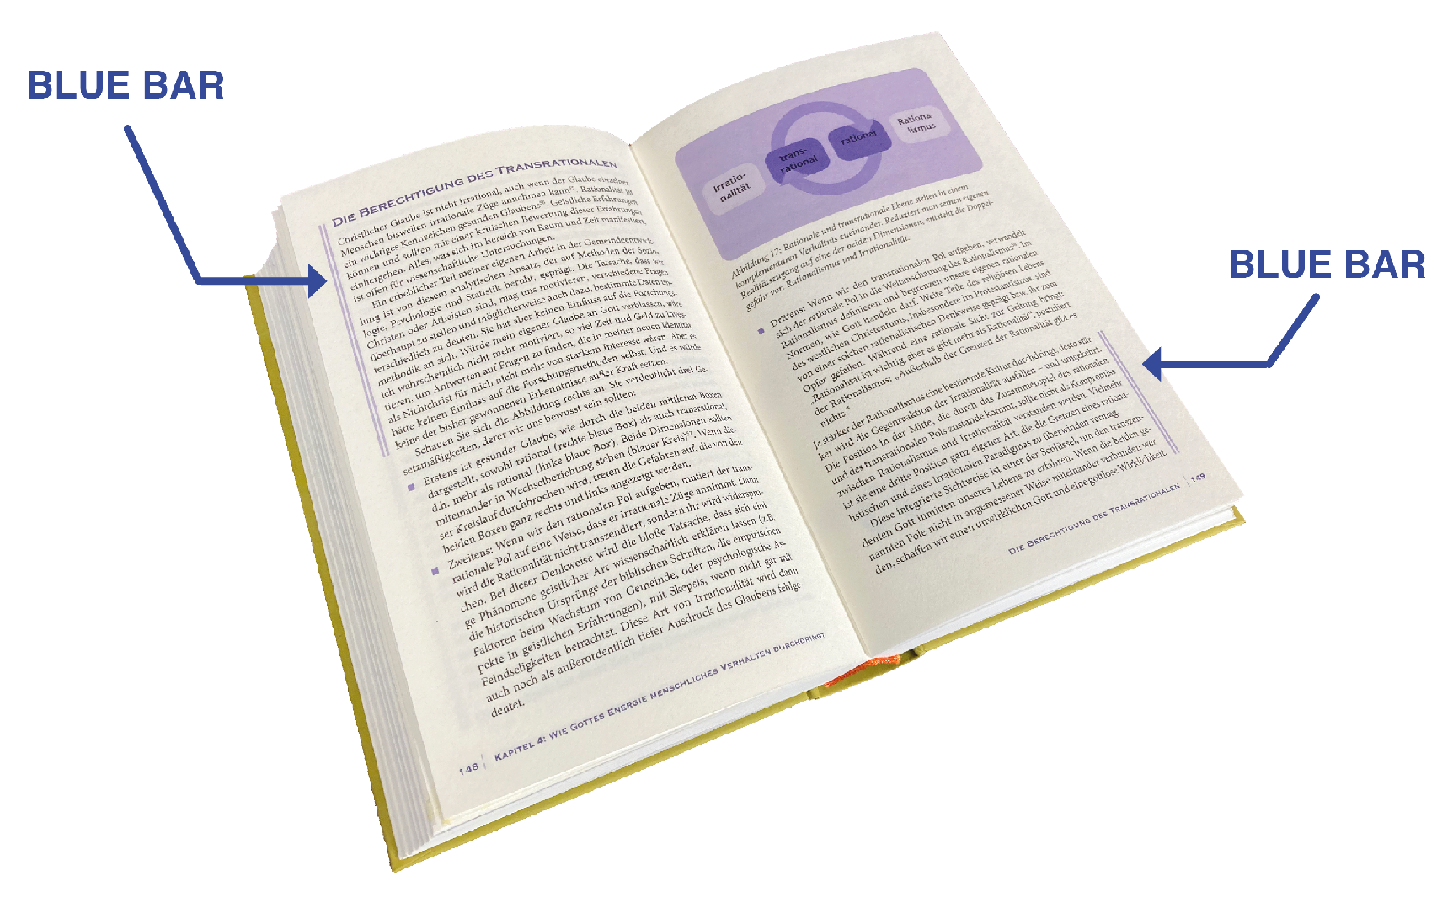
The Blue Bar Concept:
A book within a book
Visit me at: esp-training.org

Slide 5
What is assumed
A basic understanding of the biblical energy paradigm
No reservations toward that part of the biblical teaching
Visit me at: esp-training.org

Slide 6
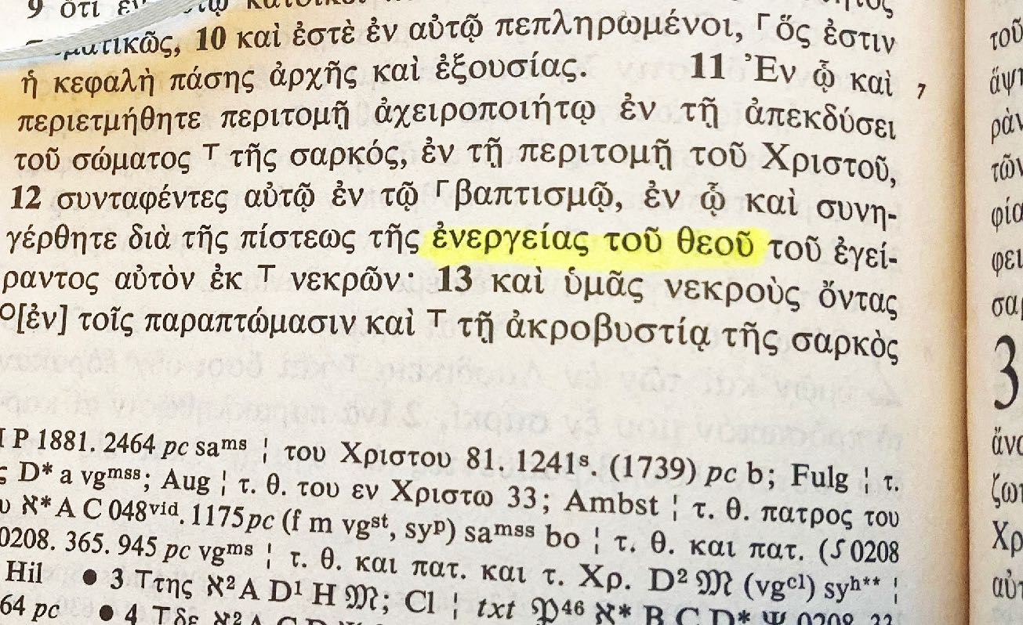
“enérgeia tou theou”
i.g., Philippians 2:12
Visit me at: esp-training.org

Slide 7
A Key Concept in the New Testament
Noun “energy”: ἐνέργεια or ἐνέργημα
Adjective “energy-filled”: ἐνεργής
Verb “to energize”: ἐνεργέω
10x
3x
21x
Visit me at: esp-training.org

Slide 8
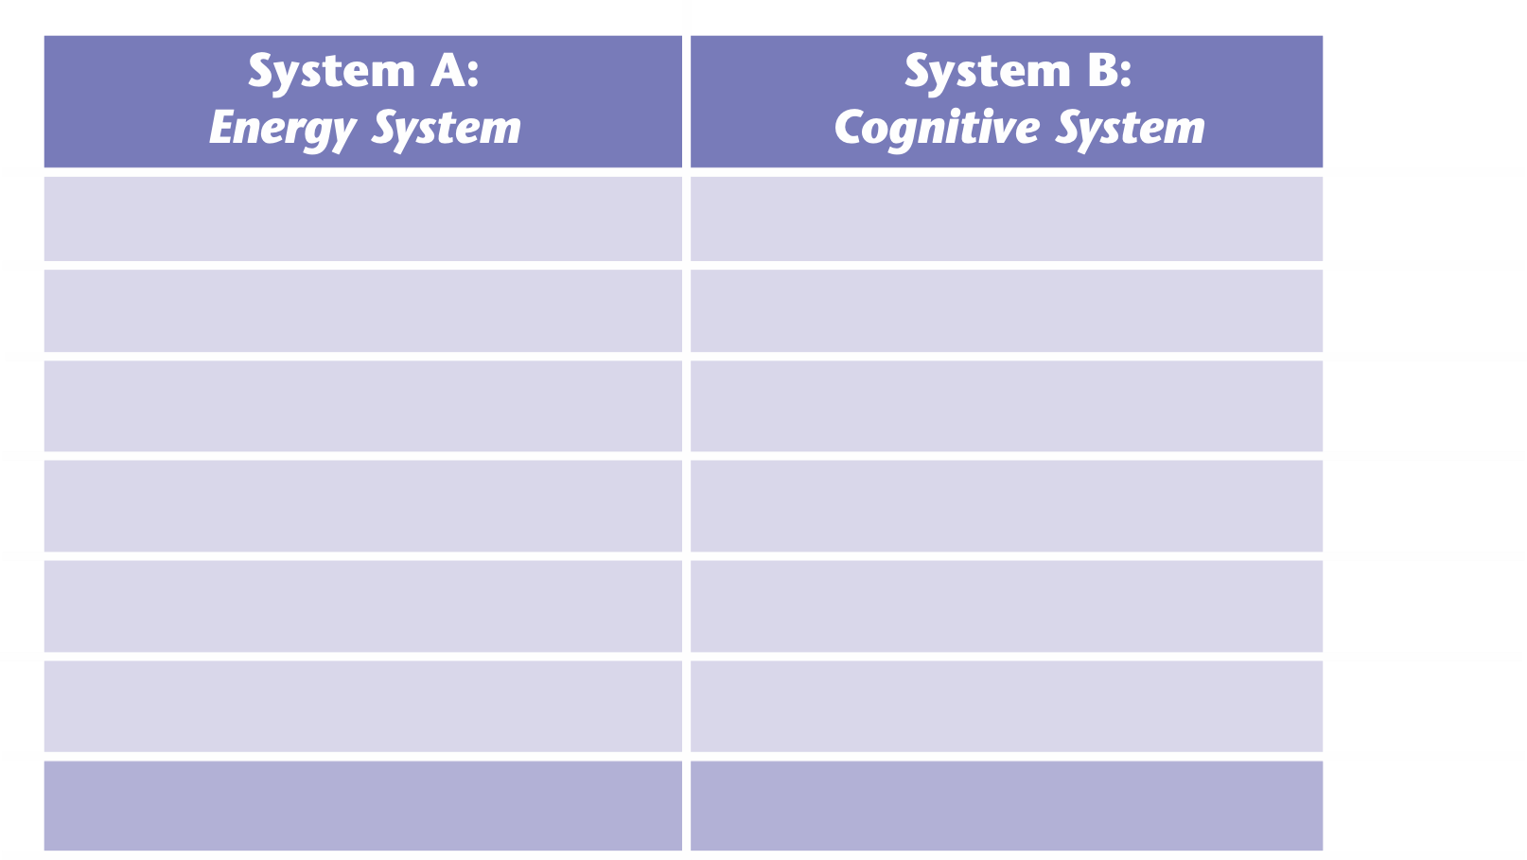
Visit me at: esp-training.org

Slide 9
Example
Philippians 2:13
For it is God who is the energizer (ἐνεργῶν | energón | KJV: who works) in you both to will and to energize (ἐνεργεῖν | energeín | KJV: to do) in order to fulfill his good pleasure.
Visit me at: esp-training.org

Slide 10
Example
Philippians 2:13
For it is God who is the energizer (ἐνεργῶν | energón | KJV: who works) in you both to will and to energize (ἐνεργεῖν | energeín | KJV: to do) in order to fulfill his good pleasure.
Visit me at: esp-training.org

Slide 11
Example 5
Philippians 2:13
For it is God who is the energizer (ἐνεργῶν | energón | KJV: who works) in you both to will and to energize (ἐνεργεῖν | energeín | KJV: to do) in order to fulfill his good pleasure.
Visit me at: esp-training.org

Slide 12
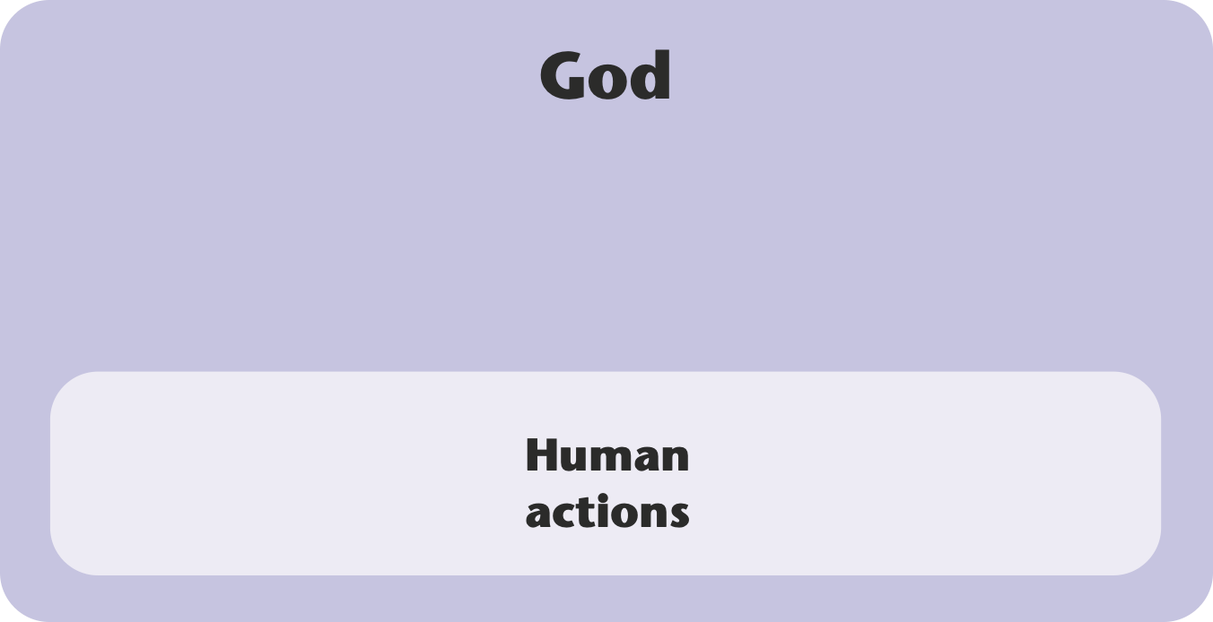
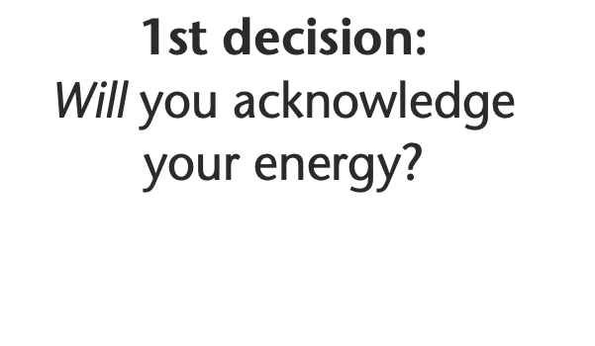
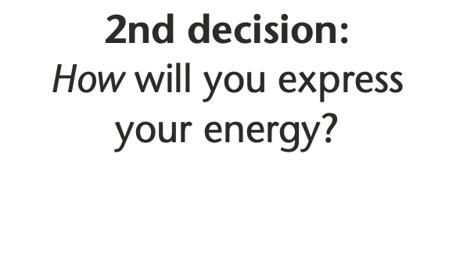
Visit me at: esp-training.org

Slide 13
Intrinsic motivation results from a synchronization of the Cognitive System with the Energy System
Synchronization
3 possibilities
1. Energy System surrenders to the Cognitive System
2. Cognitive System surrenders to the Energy System
3. Energy System supplies raw material that the Cognitive System uses to direct this energy most constructively
Visit me at: esp-training.org

Slide 14
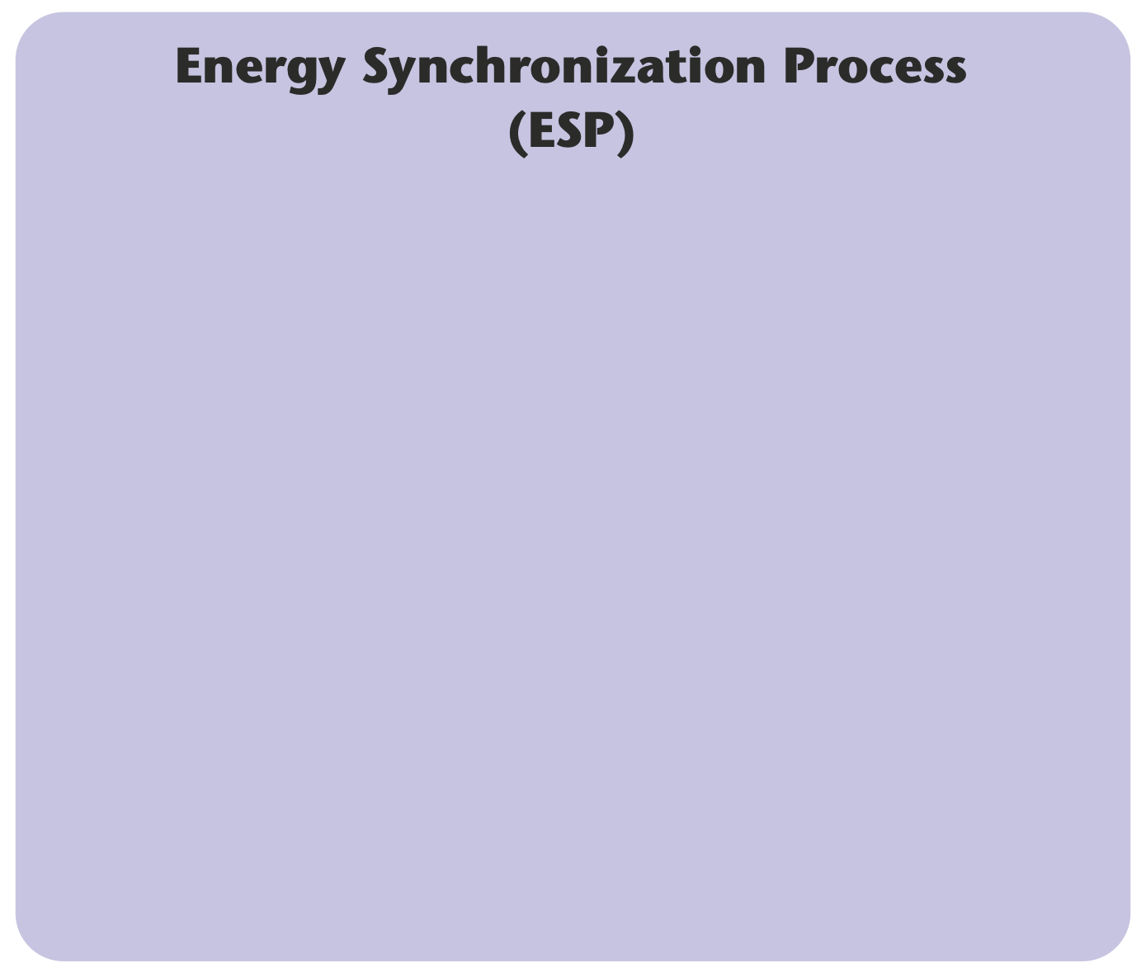
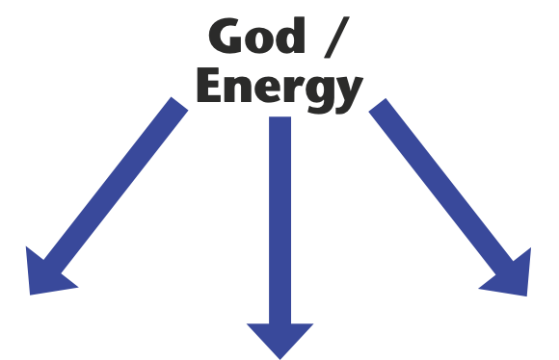
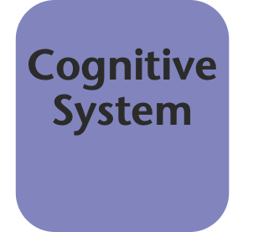
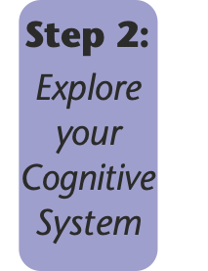
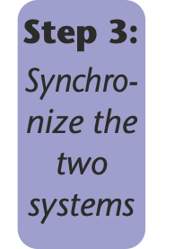
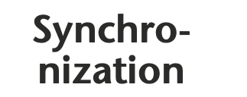
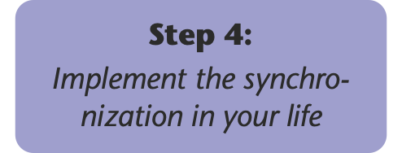
Visit me at: esp-training.org

Slide 15
Core features of ESP
“all by itself”
rather than
building on will-power
future-focused
rather than
preoccupied with the past
empirically grounded
rather than
hypothetical/speculative
empowering/enlightening
rather than
esoteric
Scripture-related
rather than
anti-religous
delivered 1:1
rather than
standardized
sharing encouraged
rather than
knowledge protected
7 sessions of 75 minutes, coaching-style
personal assignments between meetings
€980 for the whole process (€140 per session = €112 per hour)
Free pre-training session
delivered through Zoom
Visit me at: esp-training.org

Slide 16
Three unique benefits of the biblical energy paradigm
1
Releasing intrinsic motivation
Visit me at: esp-training.org

Slide 17
being motivated
≠ being cognitively convinced
Visit me at: esp-training.org

Slide 18
Extrinsic and intrinsic motivation
Extrinsic motivation
Intrinsic motivation
depends on constant external energy supply
based on God’s energy within a person
demands a lot of will power/ self-discipline
perceived as something that flows from within
preoccupied with dynamics of the Cognitive System
flows from the Energy System
must be constantly increased
existing energy is sufficient
works in areas of minor
importance
needed for significant developments
utilizes external incentives
results in inner rewards
Visit me at: esp-training.org

Slide 19
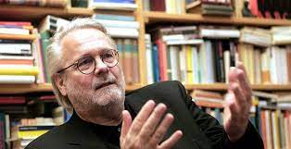
Neurobiologist Gerhard Roth:
“Material rewards such as pay, income, bonuses, and privileges have an (almost) universal and rapid effect because they are most likely to promise ‘livelihood security,’ but this effect is usually reduced by half with each repetition, i.e., negatively exponential, or even faster (negatively hyperbolic).”
Visit me at: esp-training.org

Slide 20
Extrinsic and intrinsic motivation
Extrinsic motivation
Intrinsic motivation
depends on constant external energy supply
uses God’s energy within a person
demands a lot of will power/ self-discipline
experienced as something that flows from within
is preoccupied with dynamics of the Cognitive System
flows from the Energy System
must be constantly increased
existing energy is sufficient
sufficient in areas of minor
importance
needed for significant developments
utilizes external incentives
results in inner rewards
growth by human effort
“all by itself” growth
Visit me at: esp-training.org

Slide 21
Visit me at: esp-training.org

Slide 22
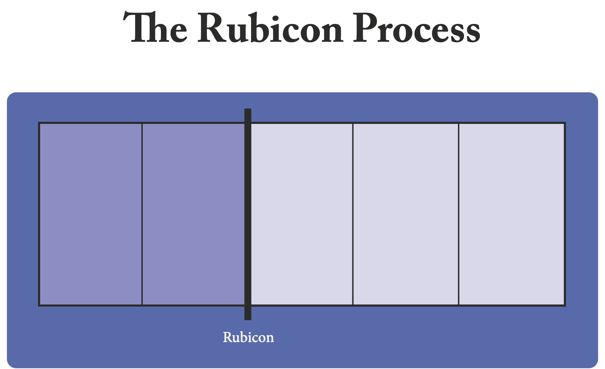
unconscious needs
conscious motives
“all by itself” feeling
automatizing the process
enhancing the effects
Energy System
Cognitive System
Visit me at: esp-training.org

Slide 23
Two systems in the human brain
Visit me at: esp-training.org

Slide 24
Assessment of somatic markers
Visit me at: esp-training.org

Slide 25
Assessment of somatic markers
Visit me at: esp-training.org

Slide 26
Outsmarting the Cognitive System through the Idea Basket technique

Slide 27
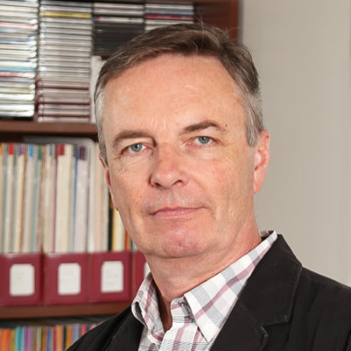
Personal experiences
Bill Bickle
Visit me at: esp-training.org

Slide 28
Three unique benefits of the biblical energy paradigm
2
Applying to Christians and non-Christians alike
Visit me at: esp-training.org

Slide 29
Common ground (e.g.,
experience of God’s energy)
Purely immanent interpretation of one’s experiences
Biblical interpretation of one’s experiences
Person A
Person B
Visit me at: esp-training.org

Slide 30
Transpersonal
not: personal minus
but: personal plus
Visit me at: esp-training.org

Slide 31
Personal experiences
Martin Thoms
Visit me at: esp-training.org

Slide 32
Three unique benefits of the biblical energy paradigm
3
Moving beyond the cognitive and rational
Visit me at: esp-training.org

Slide 33
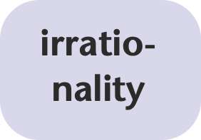
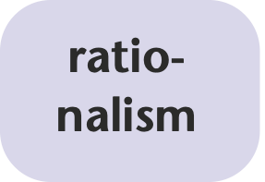
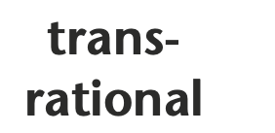
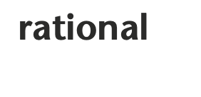
Visit me at: esp-training.org

Slide 34
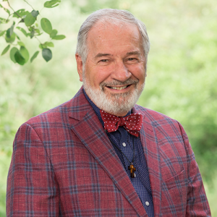
Personal experiences
Frank Guinta
Visit me at: esp-training.org

Slide 35
More information and registration at
esp-training.org

