Slide 1



What happens when you enter the room?
Adam Johnstone, Lara Johnstone & Callum Greenaway

Slide 2
Every moment, you’re either
inspiring those around you or
draining life from them.
There is no middle ground.

Slide 3






What do you bring to the room?
Inspiration

Slide 4
Hope
Capacity
Resilience

Slide 5




Bringing hope to the room
Hope

Slide 6




Bringing capacity to the room
Capacity

Slide 7




Bringing resilience to the room
Resilience

Slide 8
What happens when lots of people enter the room?

Slide 9



The 3 Colors of Worship

Slide 10
Group discussion
How could this 3 color paradigm of every moment inspiration change the way people think about inspiring worship?

Slide 11
More and better worship gatherings… naturally
What if people recognised every gathering as an opportunity for inspiration?
The 3 Colors of Worship

Slide 12
In the next 24 hours…
In the next 24 hours, you and everyone you work with will repeatedly either inspire or drain life
from those around you.
Which will it be?

Slide 13
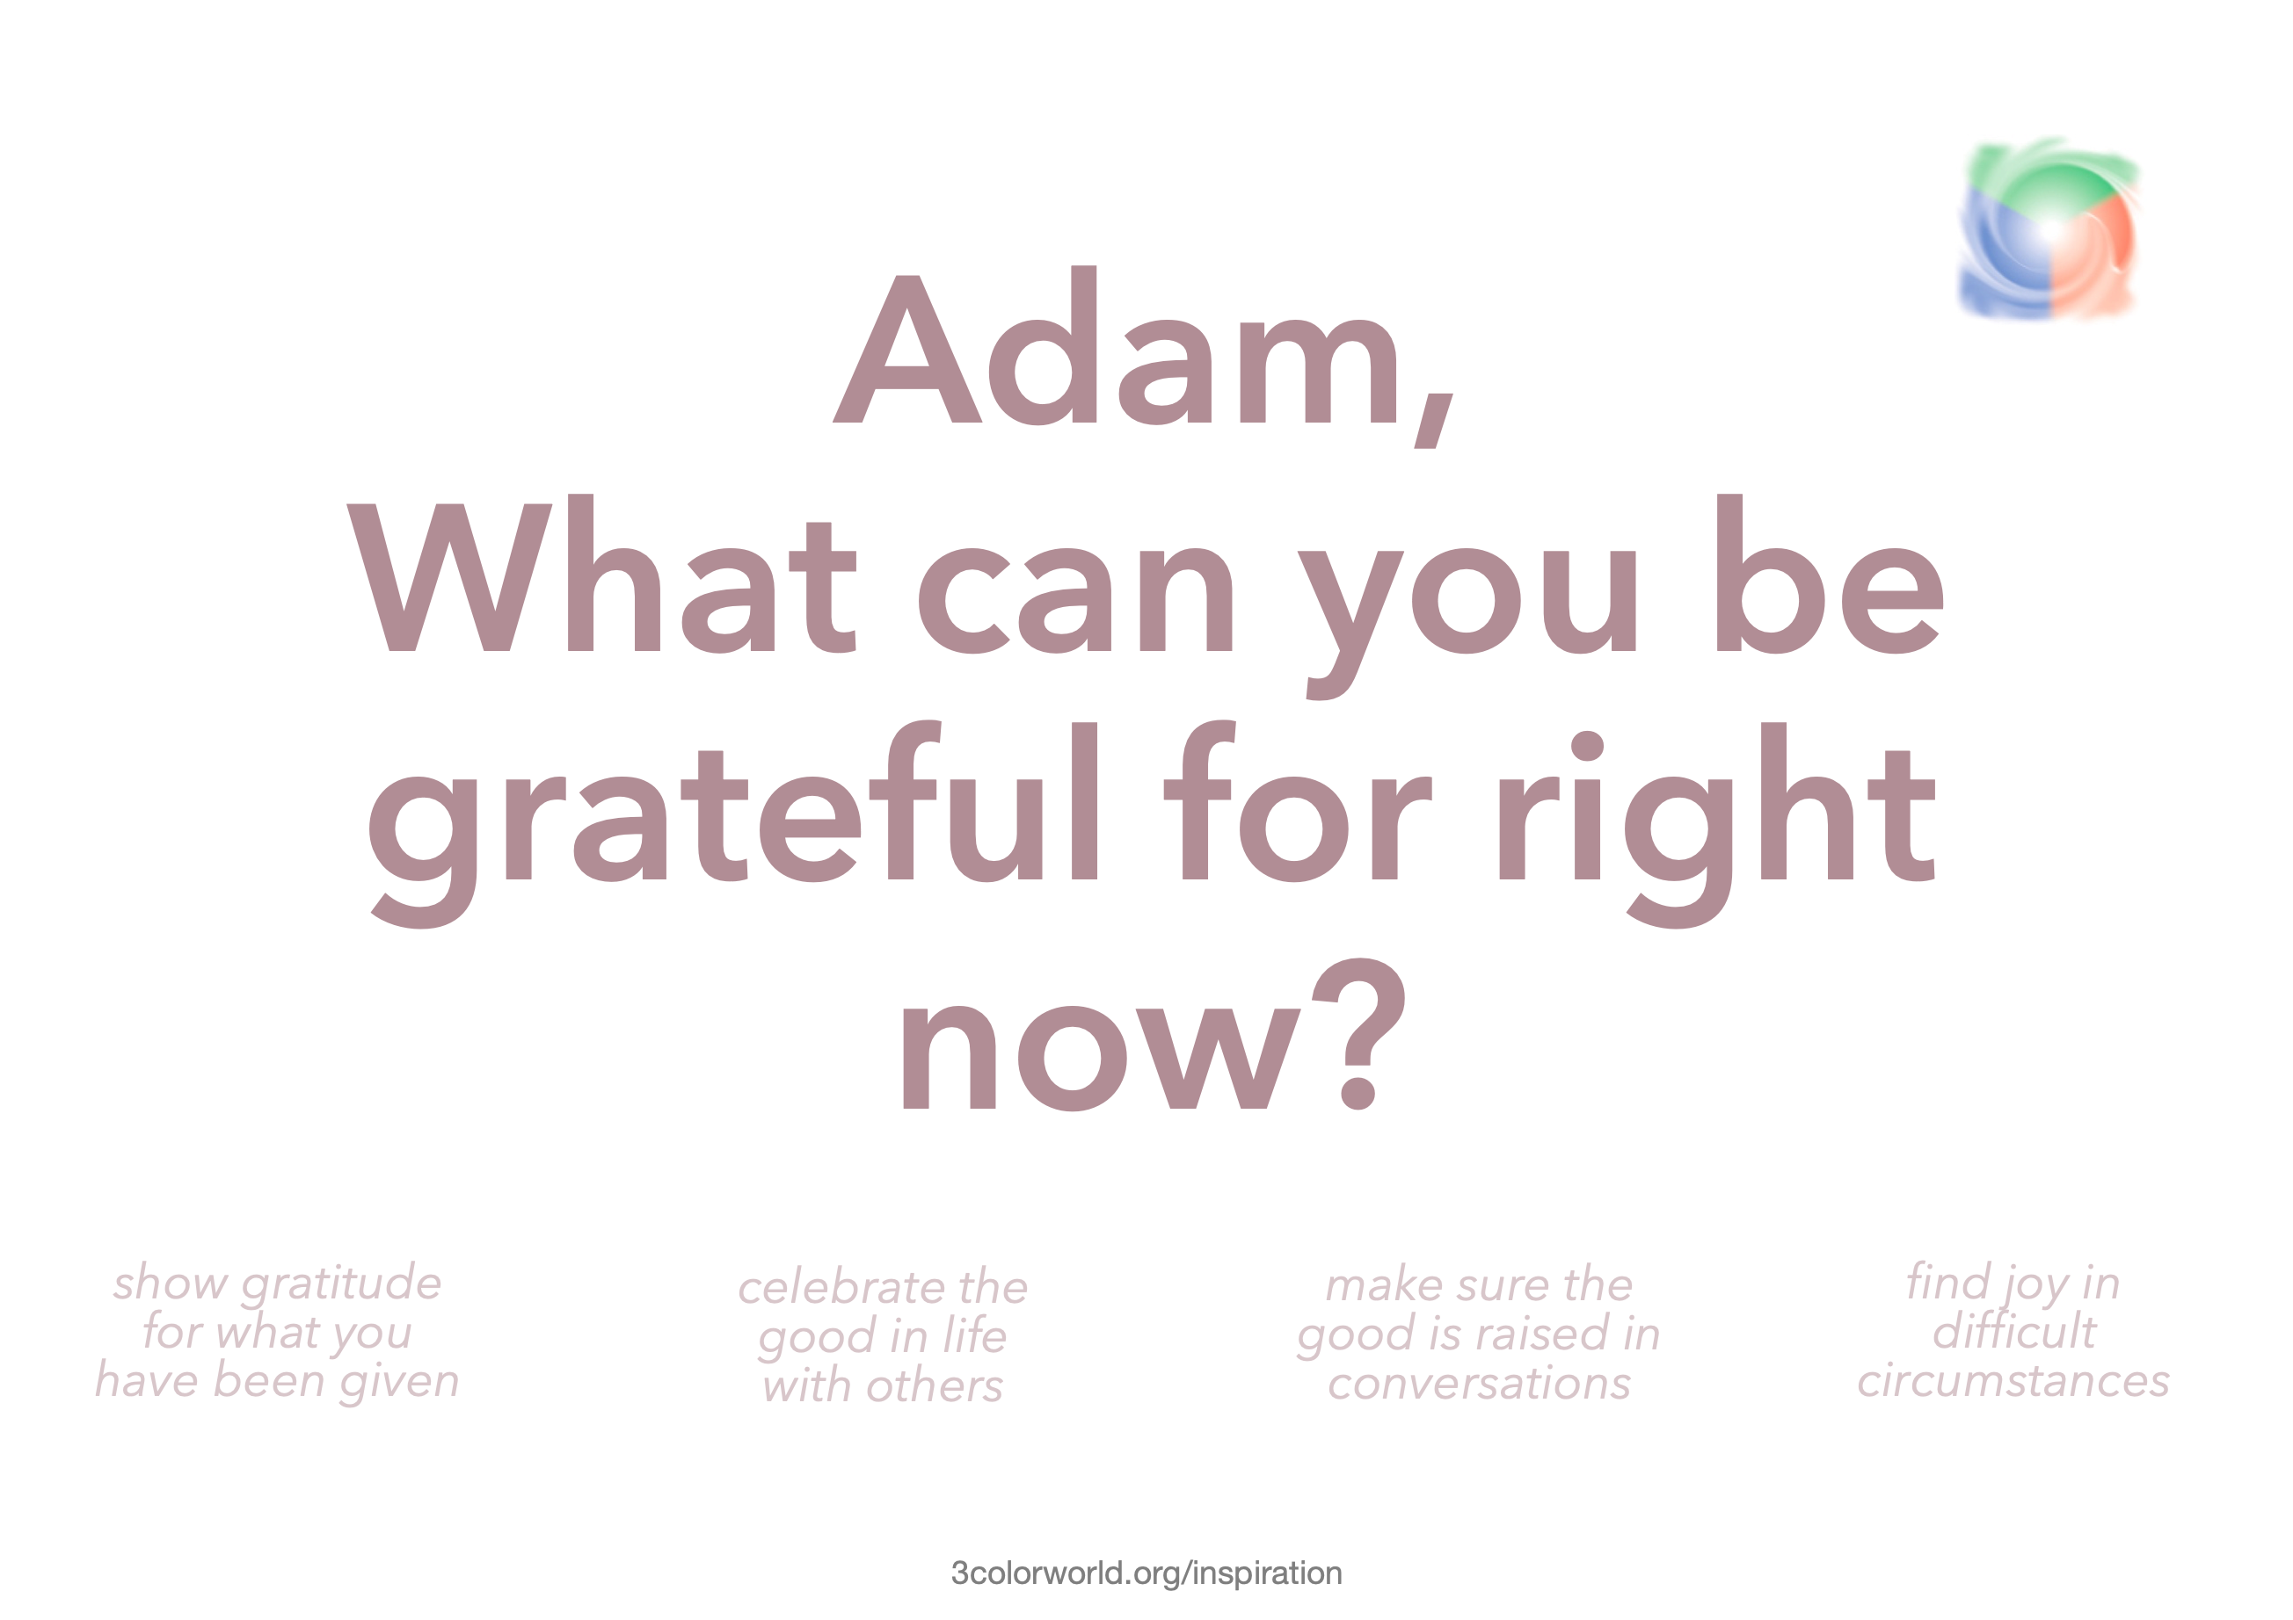
The toolbox
Interactive personal and group result profiles
Prompt question

Slide 14
The toolbox
Interactive personal and group result profiles
Prompt question
Your Inspiration network
Song database
Scripture database
Quote database
4 week Inspiration trainer training
Dedicated Inspiration support team

Slide 15
Right now
You can…
  1. Help out with the Inspiration research phase
        3colorworld.org/inspiration/research
  2. Follow the Inspiration project on
        Facebook: facebook.com/3ColorInspiration
  3. Support Callum and Lara
        facebook.com/callumandlara

Slide 16
What happens when you enter the room?
Inspiration
Thoughts and questions

