Slide 1
Let’s speak honestly about the church
Representing reality in a world of fake news and foggy language
Adam Johnstone — NCD International

Slide 2
“Let your yes be yes and your no be no.”
~Jesus

Slide 3
Today we will look at a range of NCD-related topics that could be presented much more clearly within the church.

Slide 4
As we look at each topic,
ask yourself,
“Is this an area in which I need to speak more clearly and honestly when working with churches?”

Slide 5
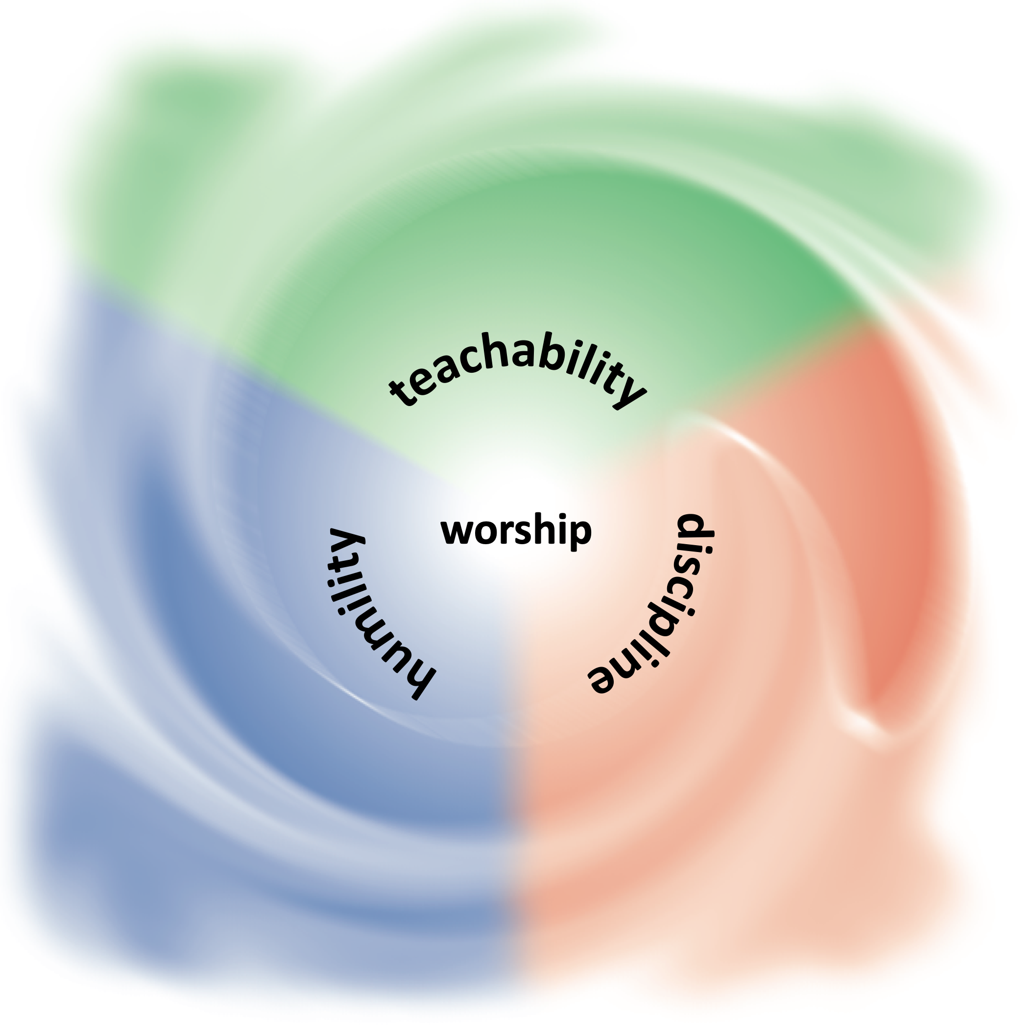
The realities behind hope

Slide 6
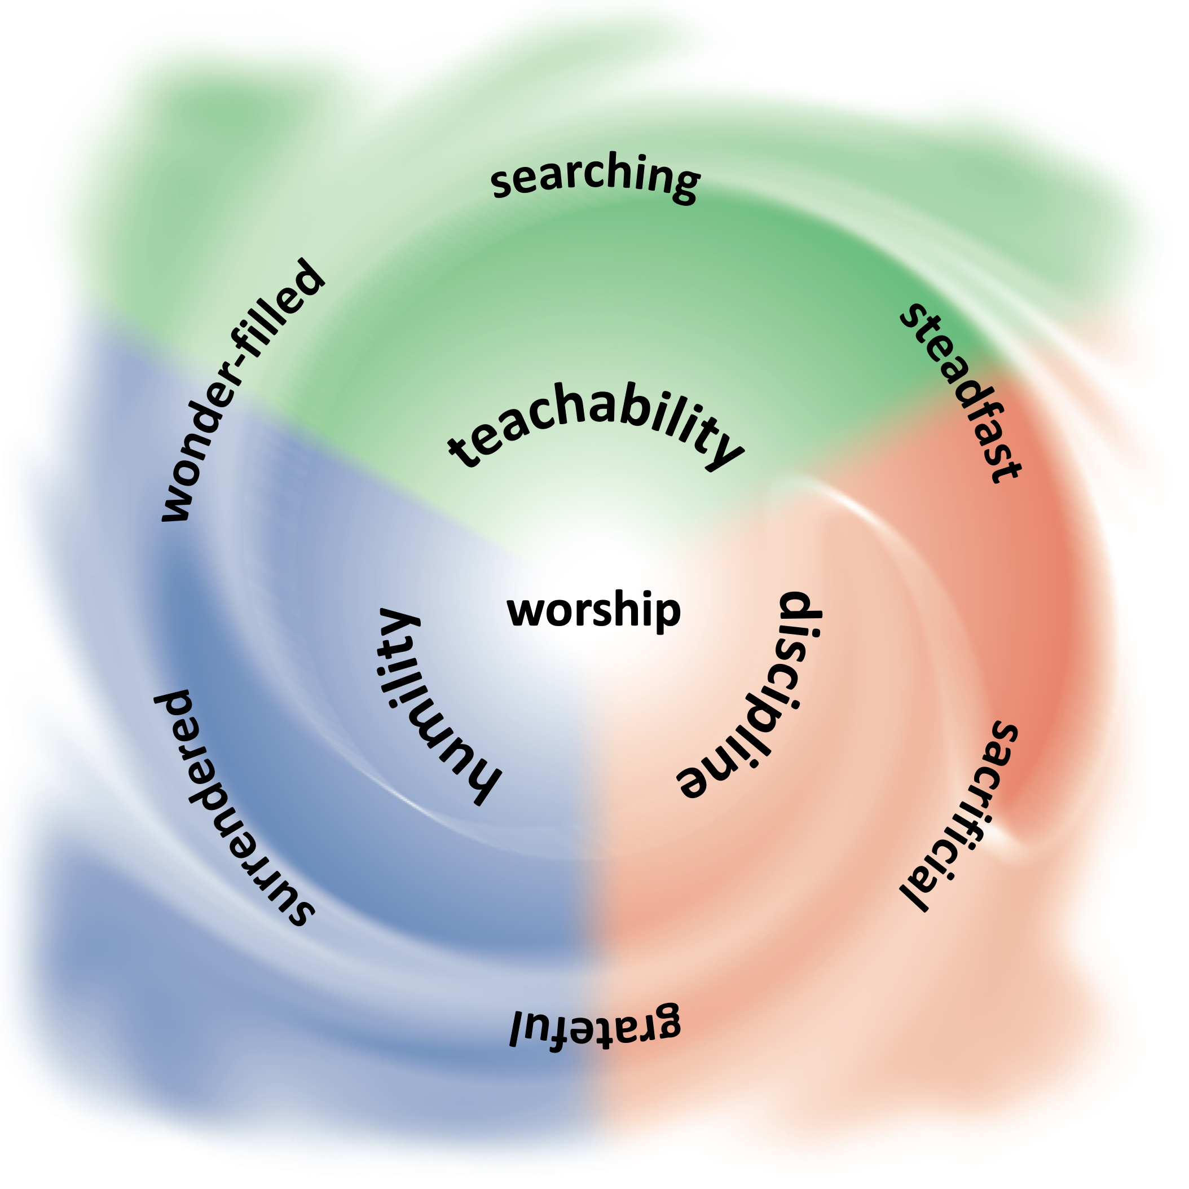
The realities behind hope

Slide 7
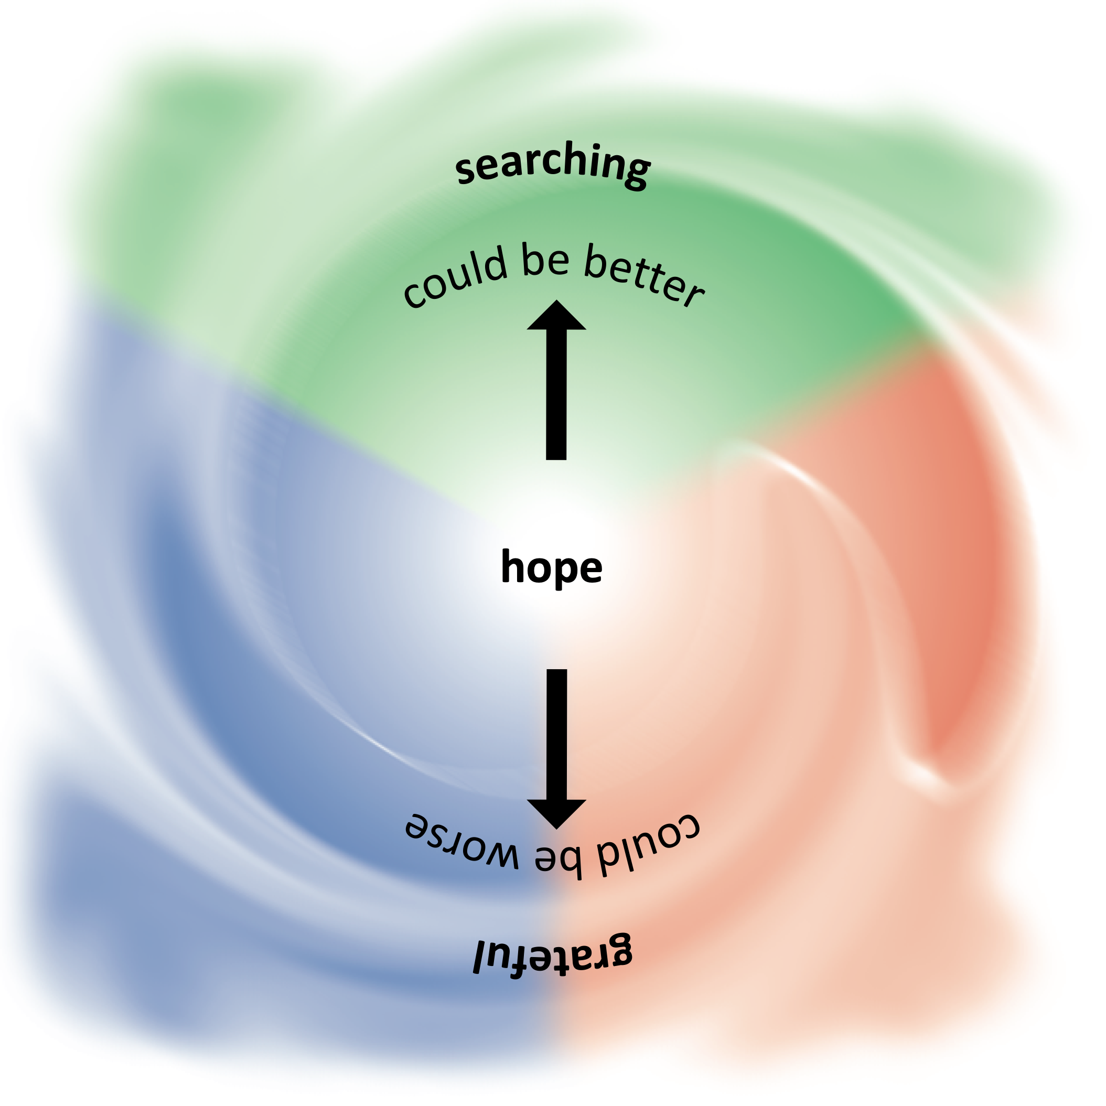
The realities behind hope

Slide 8
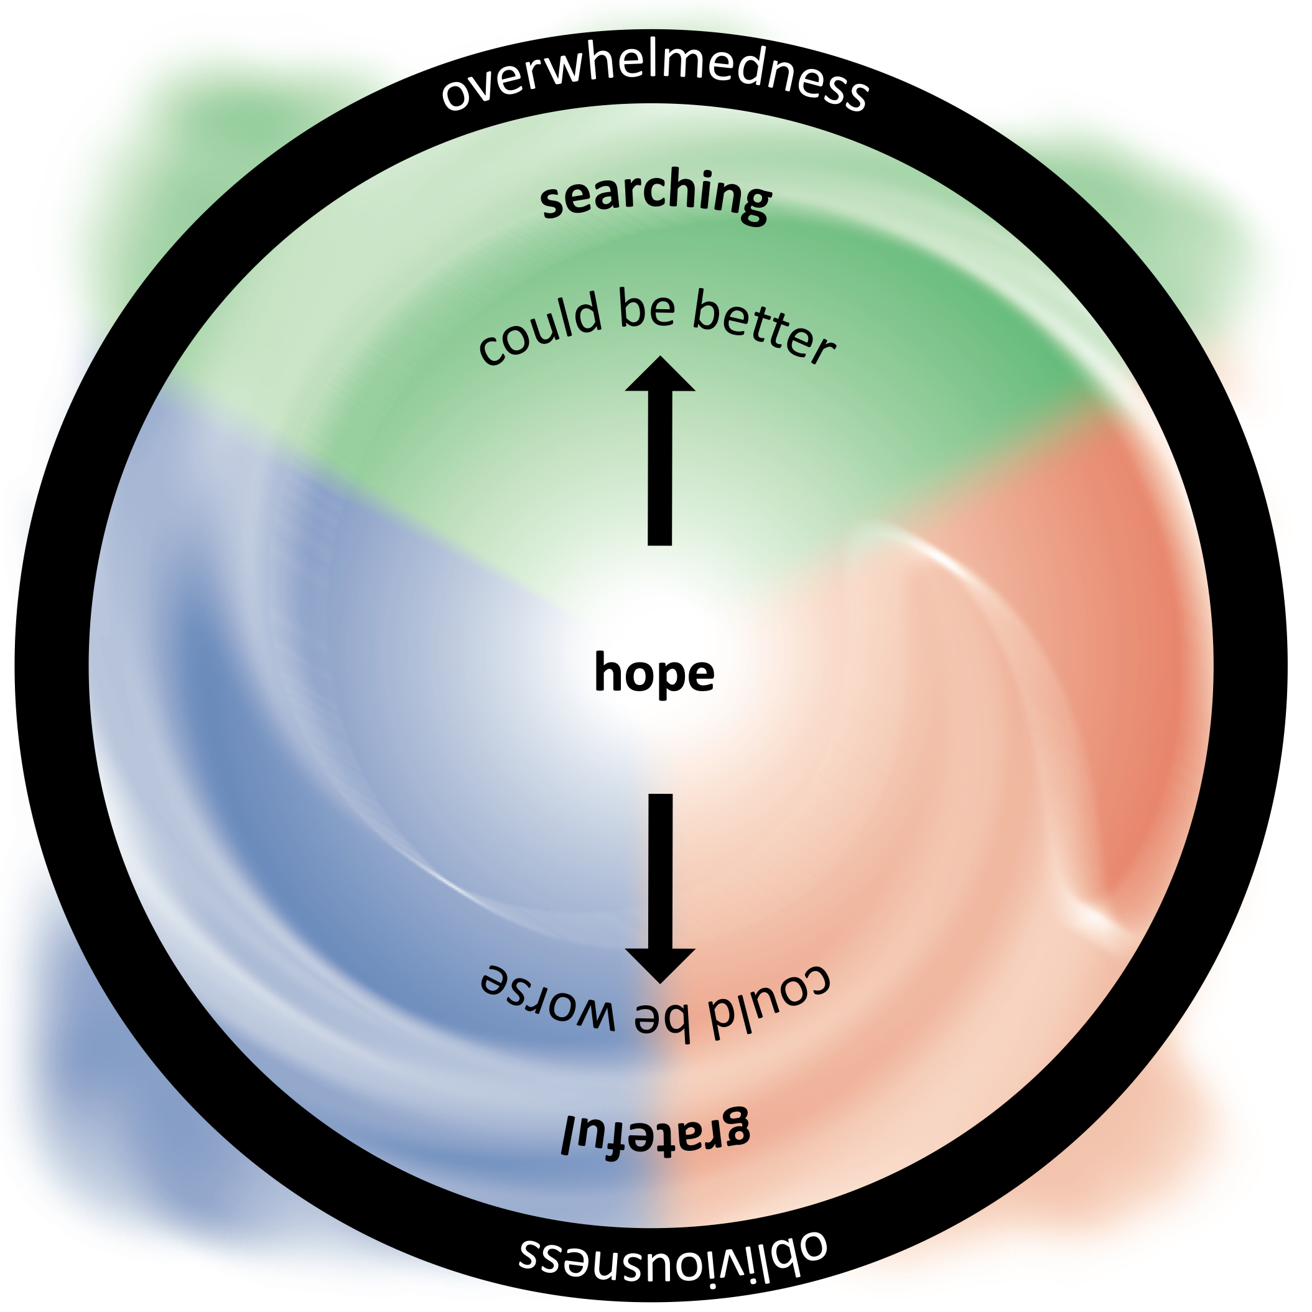
The realities behind hope

Slide 9
The realities of sickness and health
Healthy churches are remarkably immune to turbulence in the world.
Having an unhealthy church now has even more drastic consequences.
sand
ROCK
NCD Average Score

Slide 10
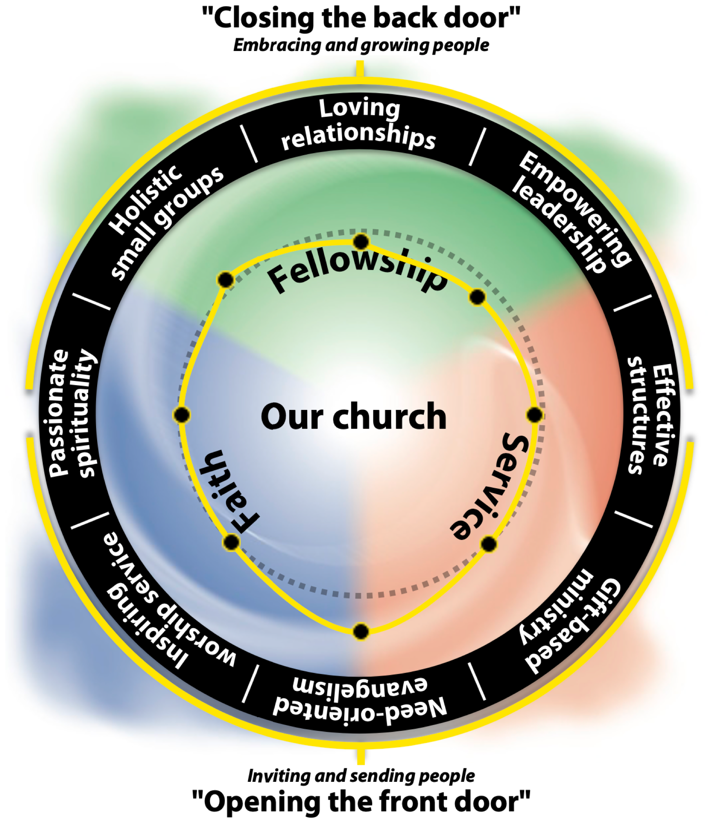
Inward AND outward realities must be addressed in church life

Slide 11
The realities behind hope
The realities of sickness and health
Inward and outward realities

Slide 12
Training materials
Programs
The model layer must complement and bring to life the principle layer.
Intensives
Strategies
Models
College Curriculums
Action plans
Manuals
Retreats
The principles will crush you if you defy them!
Principles

Slide 13
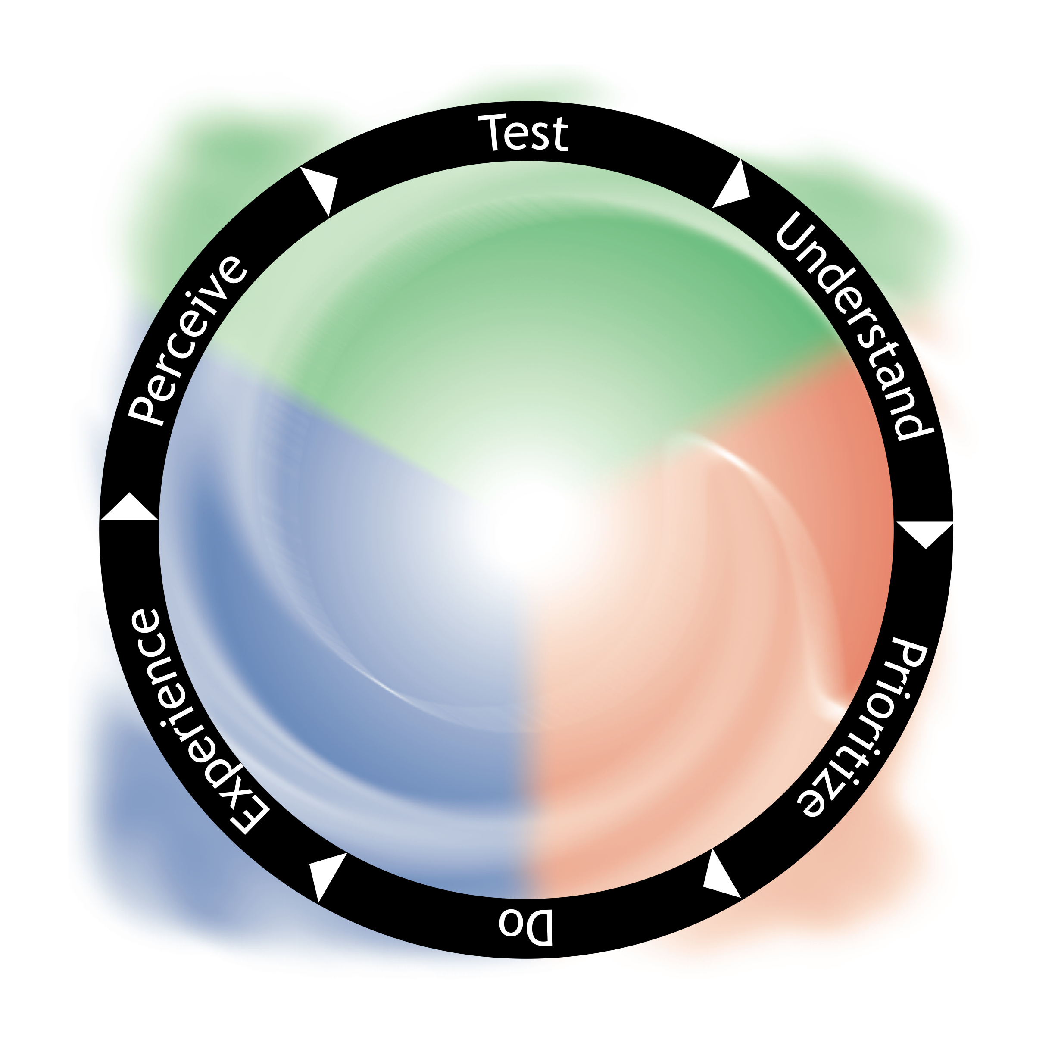
Sacrifice: An act of giving up something valued for the sake of something else regarded as more important or worthy.
Calculate results
Complete surveys
Understand results
NCD Survey Process
“For the joy set before him he endured the cross”
Allow God and others to do more stuff
Apply minimum factor principle
“Whoever loses their life for my sake will find it”
Do priority stuff

Slide 14
Applying the minimum factor principle is a call to sacrifice — to taking up your cross.
Calculate results
It is a means of putting aside irrational suffering in the church that is so often passed off as genuine sacrifice.
Complete surveys
Understand results
NCD Survey Process
Allow God and others to do more stuff
Apply minimum factor principle
Jesus’s suffering was profoundly purposeful — it was based on the minimum factor of humanity.
Do priority stuff

Slide 15
The reality of principles AND programs
The reality of sacrifice as a means to life in all its fullness

Slide 16
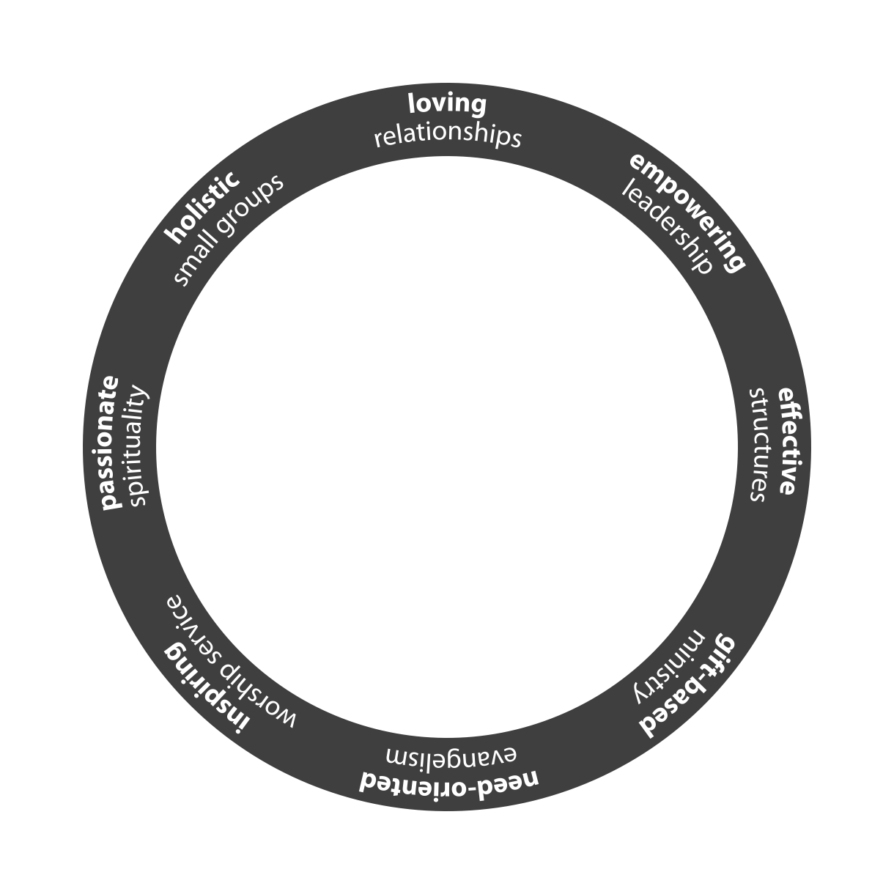
The heads, hands and hearts reality of the church
The church is the heads, hands and hearts of its people.
Serious progress cannot be made unless you help your churches expand their NCD process to address their minimum factor at the personal character level.
The Character sphere
Head, hand, heart focus
The Church sphere
Organizational focus
3colorworld.org/etests

Slide 17
The everyday reality of the principles
Even active church members usually spend less than 10% of their waking hours in church- organised activities.
Community transformation
The Community sphere
All of life focus
Community transformation will remain only a dream unless the principles of God’s Kingdom are brought to life in the everyday world of people.
The Character sphere
Head, hand, heart focus
The Church sphere
Organizational focus
myoikos.life

Slide 18
Thoughts and questions

Slide 19
Let’s speak honestly about the church
Representing reality in a world of fake news and foggy language
Adam Johnstone — NCD International

