Slide 1

Natural Church Development
NCD Norway
25 years!
«More healtier churches»
Empowering - Relevant - Liberating - Manageable - Serving - Interchurch

Slide 2

NCD Norway - NaMu Norge
«More healtier churches»
25 years in Norway
Organized as a membership association (NCD Norway)
  Led by the CEO and a cross-denominational board
  30 licensed NCD Coaches from 12 different denominations
  50 individual members (the NCD coaches +++)
  80 churches as support members (with discount benefits)
  7 denominational sub partners
1 000 NCD Surveys in 450 different churches
Our own publisher K-vekst (C-growth)

Slide 3
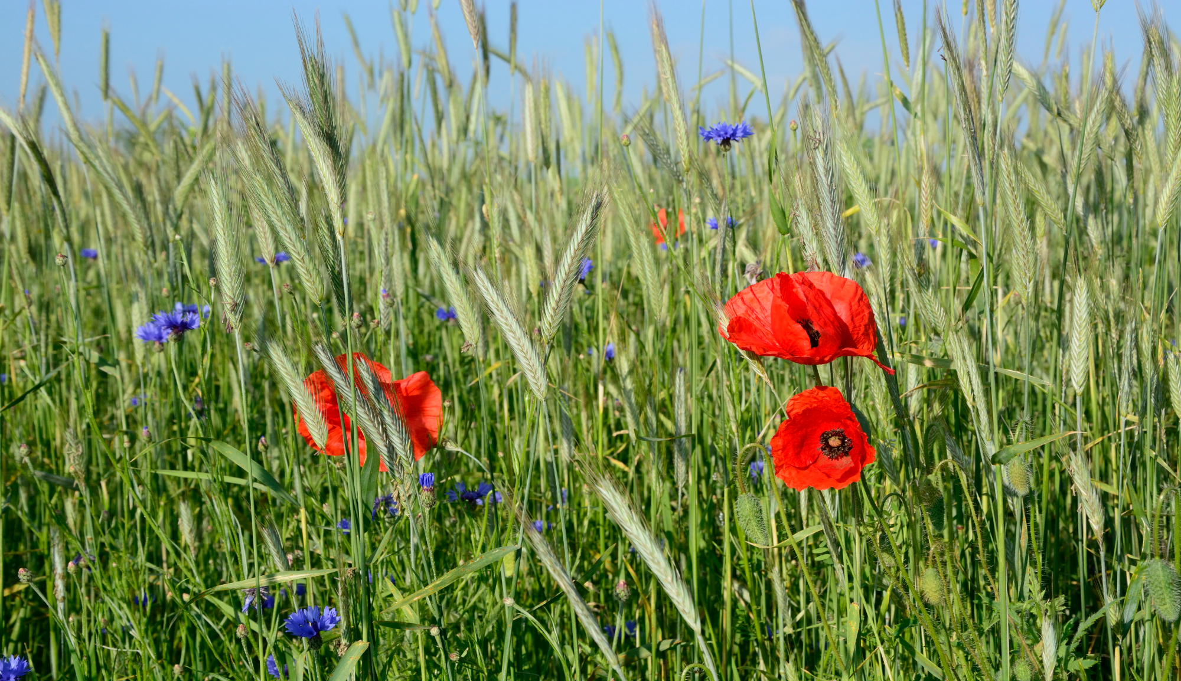
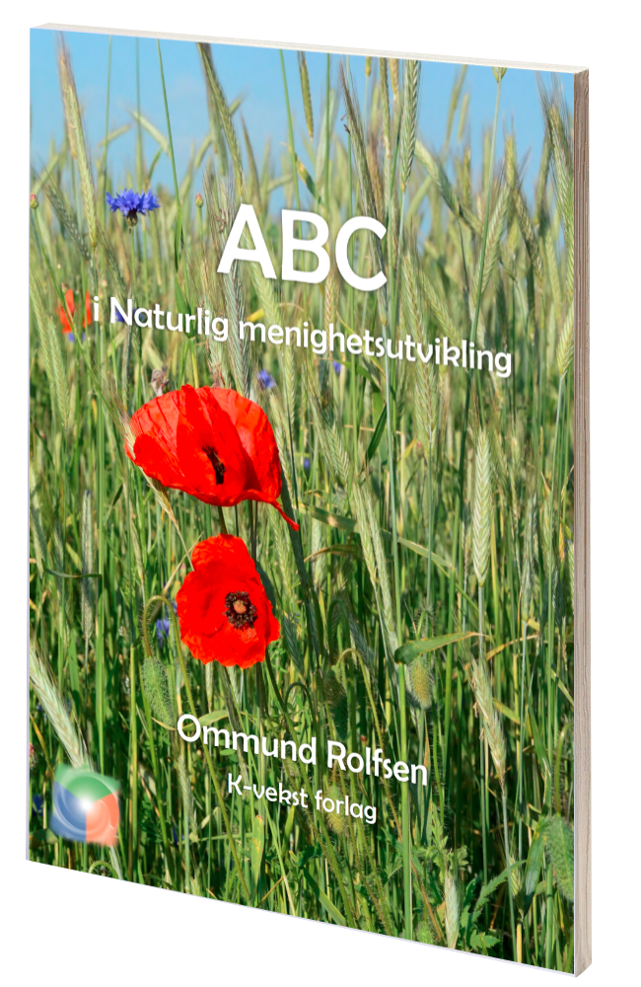

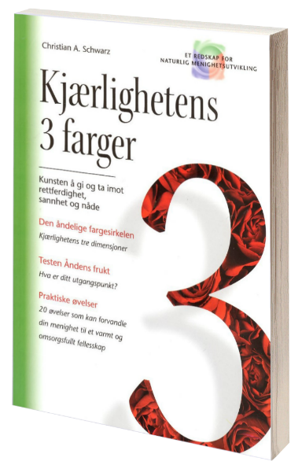

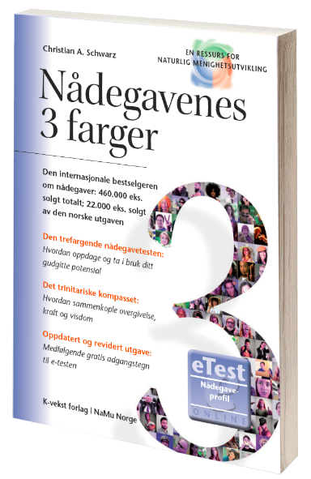

Slide 4
Courses and webinars
NCD Norway - Learning for growth
NCD coach conference every year (2 days)
NCD coach training (new cohort every 2. or 3. year)
Different courses on the 8 quality characteristics
Different denominational seminaries
Open NCD webinars (4-6 each year), ex. this year:
Rhythms that leads to growth
The spiritual guidance tradition and NCD
To give and to receive love
How to build small groups in an established setting (local example)
Spiritual styles in the local church (local example)
Notes:
Open NCD webinars (4-6 each year), ex. this year:
Passionate Spirituality in the Church of Norway
Rhythms that leads to growth
The spiritual guidance tradition and NCD
To give and to receive love
How to build small groups in an established setting
Spiritual styles in the church (local example)
The breakthrough (local example)
The Energy Concept

Slide 5

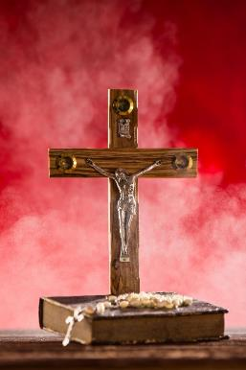

«What is my spiritual style?
A course from NCD Norway regarding our different spiritual styles

Slide 6
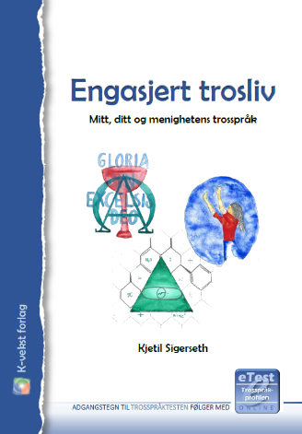

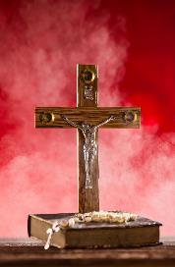

«What is my spiritual style?
A course from NCD Norway regarding our different spiritual styles
9 – 12 hours weekend course
- Lectures about the spiritual styles
- Course manual (based on The 3 C. of Y. Sp.)
- The Spiritual Style Test
- Small groups (5 people in each)
- Sharing of faith history and test result (30 min. each)

Slide 7

«A leader who empowers new leaders»
An online course from NCD Norway in Empowering Leadership

Slide 8



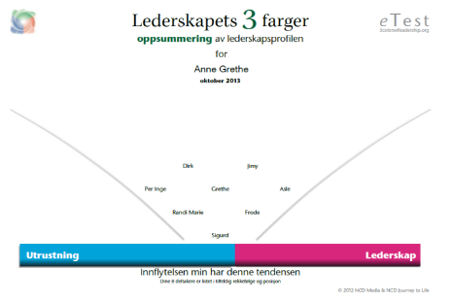

«A leader who empowers new leaders»
An online course from NCD Norway in Empowering Leadership

Slide 9
«A leader who empowers new leaders»
An online course from NCD Norway in Empowering Leadership
Online course over 6 weeks
- Video lectures (10 min. each week)
- Online learning platform (reflection forums etc.)
- Online group sessions (1 hour each week)
- The 3 Colors of Leadership (selected pages)
- The Empowerment Test (e-test)
Voluntary mentoring for 6 months
- 6 individual Spiritual Change Talk sessions (six one-hour sessions over six months)

Slide 10
NCD in Norway
Experience of working with local NCD processes over time

Slide 11
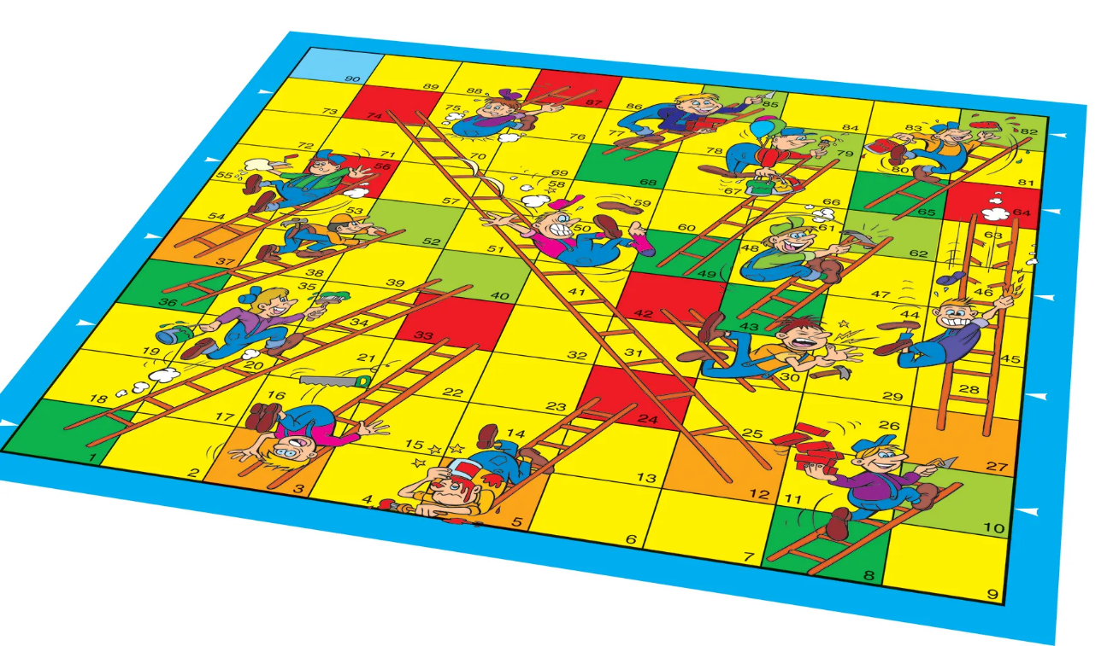
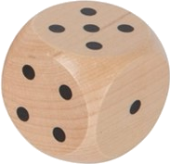
The truth about church development
Progress and decline - Control and non-control
Notes:
Ladder-game
Vi kan trille terningen, men det er også mye vi ikke har kontroll på.
Vi kan gjøre vår oppgave/jobb, så er det andre forhold som også spiller inn.

Slide 12
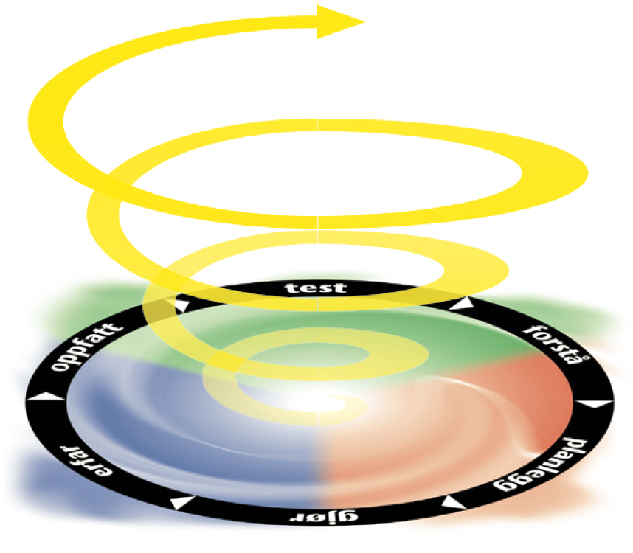
Doing it again, and again, and again
The NCD cycle
Notes:
Identifisere sterke og svake sider. Avdekke potensiale og hindringer.
Spørre 30-50 personer som kjenner menigheten godt.
Jevnlig tilstede ved menighetens gudstjenester
Med i en mindre gruppe i menigheten
Har en fast tjeneste i menigheten

Slide 13
Development over time
Example: Church of Norway (rural)
Notes:
Minimumsfaktor: VR i 2014, LG i alle etter dette
Maksimumsfaktor: IG i 2014, 2020 og 2022, BE i 2016, HS i 2018

Slide 14
Development over time
Example: Pentecostal Church (rural)
Notes:
Minimumsfaktor: NT og IG i 2008, LG i 2010, NT i 2016
Maksimumsfaktor: ET i 2008, Ul i 2010, BE i 2016

Slide 15
Development over time
Example: Pentecostal Church (City)
Notes:
Minimumsfaktor: IG i 2008, 2011, 2014 og 2022, BE i 2008 og 2011, LG i 2006, HS i 2003
Maksimumsfaktor: NT alle år

Slide 16
Development over time
Example: Church of Norway (village)
Notes:
Minimumsfaktor: IG i 2008, 2011, 2014 og 2022, BE i 2008 og 2011, LG i 2006, HS i 2003
Maksimumsfaktor: NT alle år

Slide 17
Repeating of NCD Surveys
Average change in quality scores (church health) with increasing number of church surveys
increase in quality scores
Increasing number of church surveys (P = profile number)
Notes:
Denne tabellen viser endring i kvalitetsskår for menigheter ved økende antall profiler (P1 – P7)
Norske tall pr. 01.01.2023. Totalt 1025 menighetsundersøkelser i 450 menigheter. 245 av menighetene har gjennomført 2 eller flere undersøkelser. 13 menigheter har gjennomført 7 profiler.
Menighetene som har gjennomført 7 undersøkelser har gjort dette over en periode på omlag 14 år (+/-).

Slide 18

Factors facilitating stable development
- Tailwind
Faithfulness and rhythm (again, and again, and again)
  A continuous development process
  Active and consistent use of the NCD Church Survey and the NCD cycle
Leadership that guides, involves, equips and releases
  Ability to stay focused and give space for the process
  Courage to model honesty/truth, proactive crisis management
Balance in the important things
  Prayer and work - Spirit and man - Up, in and out - The 8 quality characteristics etc.
  Focus on removing obstacles (using strengths to reduce weakness)
Openness to outside support and to new impulses
  Active use of coaching, fellowship with other churches/leaders etc.
  Willingness to change and ability to challenge fixed patterns of thought and action
Notes:
factors that promote stable development
factors that inhibit stable development
- Kontinuitet
- Navigere i urolig farvann, lede proaktivt i overgangsperioder
- Minimumsfaktor og åtte tegn på kvalitet
- Unngå å være en øy, tenke for høyt om egen fortreffelighet

Slide 19


In growing churches … there are
measurably more laugher than in non-growing ones.
This is one of the most provable
church growth principles I know.
Christian A. Schwarz
Notes:
The 3 Colors of Love page 9
The tone and atmosphere

Slide 20
Factors hindering stable development
- Headwind
Impatience
  Some can fall into the trap of wanting to take over God's tasks?
  Busyness, activity chasing, or sudden changes of track (or derailments)
Imbalance
  Unhealthy and unsustainable priorities, structure, life or theology
  Inability to provide leadership and proactive crisis management
Conflicts and lack of unity
  Supporting a culture of unity that allows for disagreement
  Unhealthy power struggles, envy and other sins that threaten community
Refusal to learn and fixed patterns of thinking
  Even more of what does not work, belief in one's own excellence (pride)
  Lack of competence to change, openness or honesty
Notes:
Gud gir vekst, TTT, ulike vekstsesonger, ikke legge merke til eller feire små tegn til utvikling
Proaktiv krisehåndtering, NaMu forsvant med presten
Manglende forankring
Moderne fundamentalisme

Slide 21
Any church,
no matter how unfavorable its present situation,
can expect considerable increase in quality and quantity.
To start a process, there is only one precondition:
a longing for God to manifest himself
more strongly in the life of a church.
Christian A. Schwarz
Notes:
Color Your World with NCD page 11

Slide 22


