Slide 1
NCD Update
Why my hope is increasing post-Covid
NCD Church Survey uptake has been increasing at 14% per month for 15 months.
We have begun collecting NCD good news stories from around the world to share.
The Inspiration process and the 4-week NCD Inspiration Coach Training is underway to help churches go deeper with Inspiring Worship Service.

Slide 2
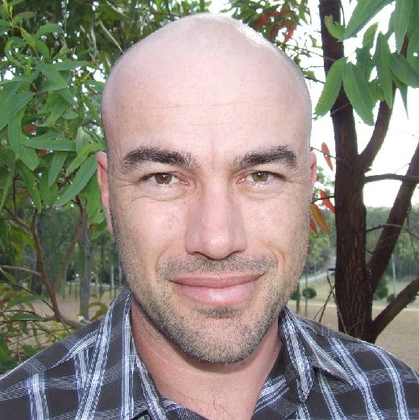
NCD Quality Characteristics:
matters of life and death
Adam Johnstone - September 2022

Slide 3
NCD applicability
Everywhere
✓
The widest spectrum of:
cultures
denominations
religious starting points
age groups
✓
✓

Slide 4
NCD applicability
In every moment?
Do the principles of NCD apply in every single moment?
If so, what are the implications of that? What does it mean practically?
How might an every-moment understanding of NCD principles impact the speed and consistency of improving the health of groups and individuals?

Slide 5
Jesus asked them, “Which is lawful on the Sabbath: to do good or to do evil, to save life or to kill?”
But they remained silent.
The one who is the way, the truth and the life was making a statement about the way of true life that was so convicting that it silenced them. But more than that, it was so convicting that they wanted to kill him for pointing it out.

Slide 6
…for doing good or doing evil?
Some implications
Living in accordance with the way of true life—the principles that govern God’s Kingdom —is a matter of life and death.
There is no “middle ground” for any human being—if you’re not doing good, you are doing evil.
The life and death dynamics of our every action and inaction apply in every moment of life.
You risk silence and retribution if you point out the every-moment implications of Kingdom principles, but your ministry will be very limited if you don’t.
Living with that every-moment life-or-death approach is precisely why healthy churches and healthy Christians are healthy!

Slide 7
Doing good or evil
Related to each NCD Quality Characteristic
As we go through, remember which of the life or death quality characteristic statements felt, for whatever reason, most convicting for you personally. Note it down.

Slide 8
Empowerment
(empowering leadership)
In every moment, as a human with inescapable influence, you are either empowering those around you or oppressing them, even if only to the smallest degree.
Where is my power going?

Slide 9
Gift-activation
(gift-based ministry)
In every moment, you are either helping to activate your own and other’s gifts or shutting them down, even if only to the smallest degree.
What is my greatest contribution?

Slide 10
Passion
(passionate spirituality)
In every moment, your passion is either being fuelled or snuffed out, even if only to the smallest degree.
How am I fuelling my fire?

Slide 11
Effectiveness
(effective structures)
In every moment, the time, treasure, and talent available to you is either being used to make the world better or misused, making it worse, even if only to the smallest degree.
How well am I using all I have?

Slide 12
Inspiration
(inspiring worship service)
In every moment, you are either inspiring those around you or draining life from them, even if only to the smallest degree.
What happens when I enter the room?

Slide 13
Community
(holistic small groups)
In every moment, you are either bringing about common-unity or destroying it, even if only to the smallest degree.
How well am I playing with others?

Slide 14
Wholeness
(need-oriented evangelism)
In every moment, you are either filling your world with life or filling it with emptiness, even if only to the smallest degree.
What am I filling my life with right now?

Slide 15
Love
(loving relationships)
In every moment, you are either loving those around you or damaging them, even if only to the smallest degree.
What form of love do I need to give?

Slide 16
Demands and Opportunities
embracing the way of true life
The every-moment opportunities provided by God’s Kingdom principles
Empowerment
Gift-activation
Passion
Effectiveness
Inspiration
Community
Wholeness
Love
The every-moment demands of God’s Kingdom principles
Grace
Truth

Slide 17
Discussion
every moment in your life and ministry
Which of the quality characteristic every-moment statements, for whatever reason, felt most convicting for you personally? Why?
How would an every-moment mindset towards their minimum factor help the churches you work with?

Slide 18
You don’t “apply” NCD principles
You either defy the principles of the way of true life (and suffer the inevitable consequences)
or
you align yourself with the way of true life and experience life in all its fullness.

Slide 19
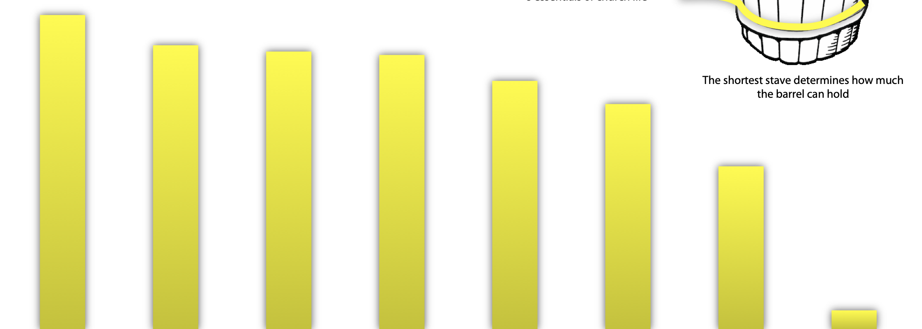
on Earth as it is in Heaven
Effectiveness
Empowerment
Love
Inspiration
Gift-activation
Passion
Wholeness
Community
destruction
oppression
damage
suffocation
stuntedness
apathy
erosion
disintegration
on Earth as it is in Hell

Slide 20
NCD Quality Characteristics:
matters of life and death
thoughts and questions?
Adam Johnstone - September 2022

