Slide 1
NCD
and
Mission
NCD AND MISSION
Friends or foes?

Slide 2
OVERVIEW
Introduction
Personal
Church and Mission
Missional and NCD
Mission-shaped Church
Characteristics of
NCD and Mission-shaped
To what exten does NCD lead to a Mission-Shaped Church?
Conclusion
Questions/Comments

Slide 3
Introduction

Slide 4
Church and Mission

Slide 5
“An unchurchly mission is as much a monstrosity as an unmissionary Church”

Slide 6
"…we cannot conceive of the missio Dei without 'church’”
Notes:
Martyn Atkins

Slide 7
The Kingdom of God is near
There can be no Kingdom without a church - those who have acknowledged God's rule - and there can be no church without God's Kingdom; but they remain two distinguishable concepts: the rule of God and the fellowship of men and women
George Elton Ladd, A Theology of The New Testament
Mark 1:15

Slide 8
"The Church is the Church only when it exists for others"

Slide 9
“when the Church ceases to be a mission, then she ceases to have any right to the titles by which she is adorned in the New Testament”

Slide 10
“How far does [the Church] correspond to its name? How far does it exist in a practical expression of its essence? How far is it in fact what it appears to be? How far does it fulfil the claim which it makes and the expectation which it arouses?”
Karl Barth, quoted by Engen in God’s Missionary People

Slide 11
UP
Worship
IN
OUT
Fellowship
Mission
OF
Notes:
Mission Shaped Church, Bishop Martin Cray
A Church for Every Context, Martin Moynagh

Slide 12
NCD
and
Mission
NCD AND MISSION
Friends or foes?
Notes:
?

Slide 13
touted strategies for church growth…only work in limited cases
Michael Moynagh
A succession of programmes have come and gone “without being able to deliver on their promises, unable to reverse the downward numerical trend’’
Eddie Gibbs
Notes:
Scepticism toward church growth programmes/ or actually just Programmes
NCD is not a programme, should not be sold as a programme
It is a concept, a way of thinking, it is a help to engage in a focussed and practical with the universal principles of God, partnering with God, so that He can grow his Church and through it extend his Kingdom

Slide 14
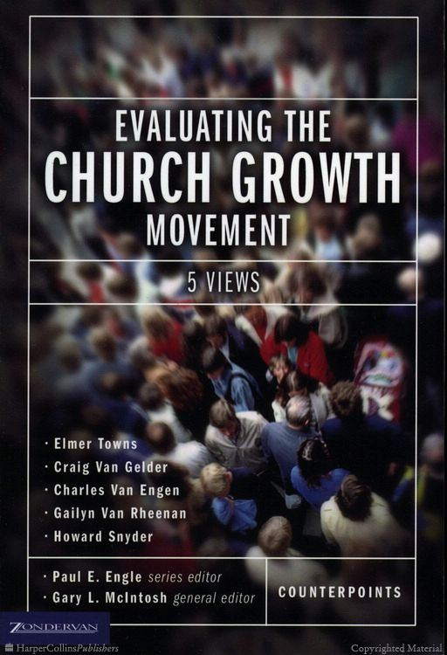
“church health can focus too narrowly on the church and miss the fact that the church exists not for itself but for God’s mission in the world”

Slide 15
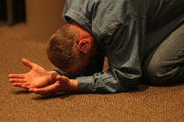
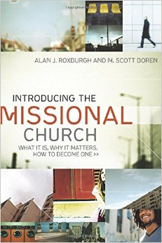
“belief that internal renewal or health leads to missional life is false”
Notes:
References NCD in footnotes

Slide 16
NCD can “move the church toward introversion and irrelevance, which can increase the illness of the church rather than its health”

Slide 17
NCD AND MISSION
Does NCD lead to
a Mission-shaped Church?

Slide 18
How far does engaging with NCD help a church to correspond to its name? How far does it develop the church into a practical expression of its essence? Does NCD help the church be what it appears to be? How far does NCD help the church to fulfil the claim which it makes and the expectation which it arouses?

Slide 19
What is a
Mission-shaped Church?

Slide 20
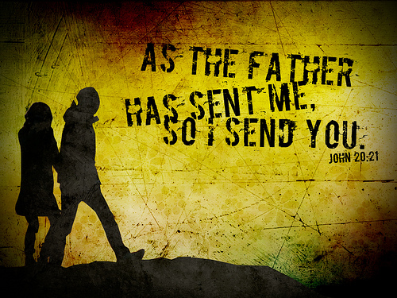

Slide 21
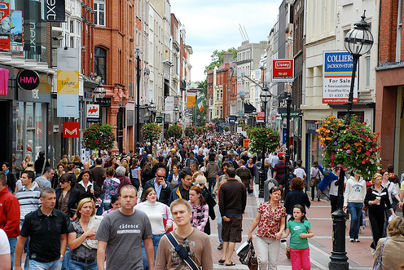
Six indicators of a misson-shaped church
Living Faith
Community Lifestyle
Discipleship Focus
Member Mobilisation
Neighbourhood Engagement
Adaptable Structures

Slide 22
Six indicators of a misson-shaped church
Living Faith
A faith that builds not only on acceptance of belief and imitation, but participation and experience of the presence and work of the Holy Spirit.

Slide 23
Six indicators of a misson-shaped church
Community Lifestyle
Seeks to build up an open, welcoming and hospitable community of faith, with a distinct Christian lifestyle, where the members interact and develop each other beyond the boundariess and programmes of the physical church

Slide 24
Six indicators of a misson-shaped church
Discipleship Focus
Calling people to faith in and obedience to Christ. Equipping people to live out their Christian life Monday to Saturday. Emphasis on personal transformation and development of spiritual life.
Notes:
“A focus on Christ means a focus on numbers, since Jesus calls his followers to “make disciples of all nations”

Slide 25
Six indicators of a misson-shaped church
Member Mobilisation
Takes serious that all believers are called to ministry. Seeks to help them discover and develop their unique gifting and calling. Trains and empowers them to minister – within or without the church

Slide 26
Six indicators of a misson-shaped church
Neighbourhood Engagement
Aware of needs and movements in the local community. Engaged in meeting needs and involved, either as a fellowship, through individuals or small groups of believers, in doing works of healing, reconciliation, deliverance, peace-making and justice.

Slide 27
Six indicators of a misson-shaped church
Adaptable Structures
Seeks to let shape, expressions, forms and activities be influenced by the culture(s) it is sent to. Willing to question what is “non-negotiable” and to change what is not to become relevant to the surrounding culture.

Slide 28
Notes:
Questions or comments?

Slide 29
NCD AND MISSION
Does NCD lead to
a Mission-shaped Church?

Slide 30
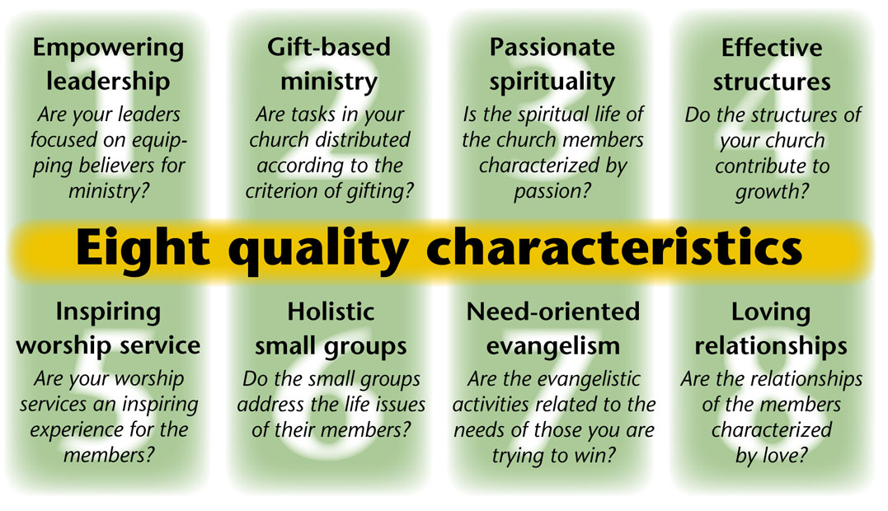

Slide 32
Passionate Spirituality

Slide 33
Effective structures
OUT
IN
UP
OF

Slide 34
Holistic small groups

Slide 35
Need orientated evangelism

Slide 36
Loving relationships

Slide 37
Does NCD “move the church toward introversion and irrelevance, which can increase the illness of the church rather than its health”
Is the “belief that internal renewal or health
leads to missional life” really false?

Slide 38
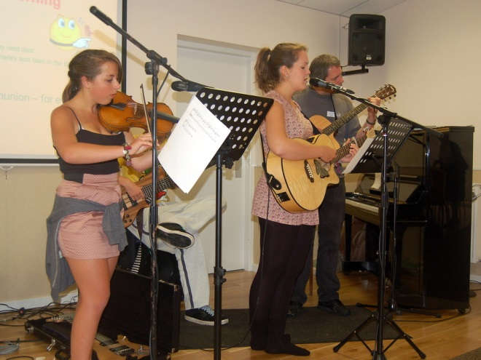
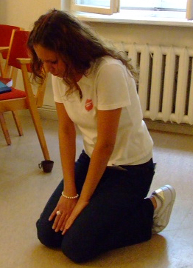
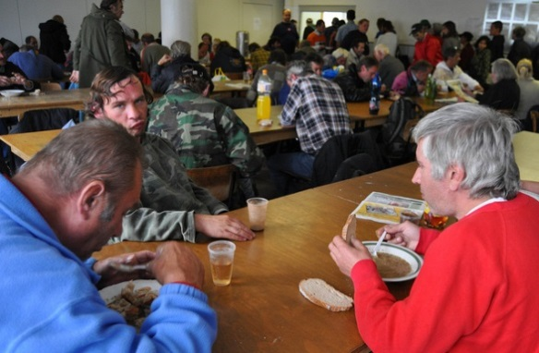
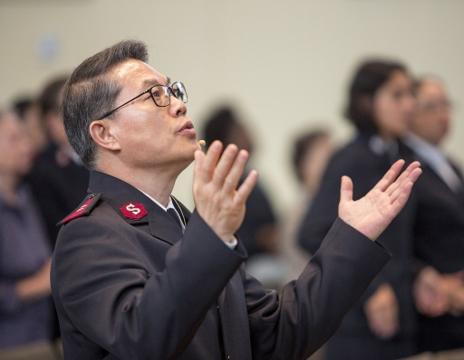
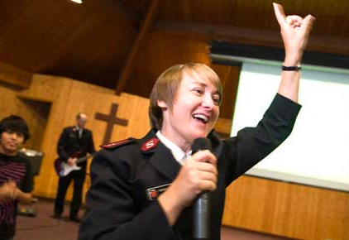
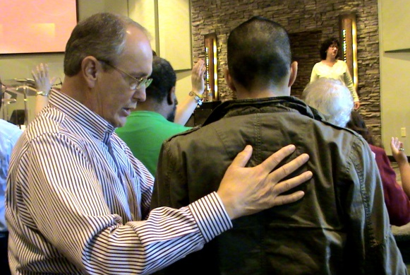
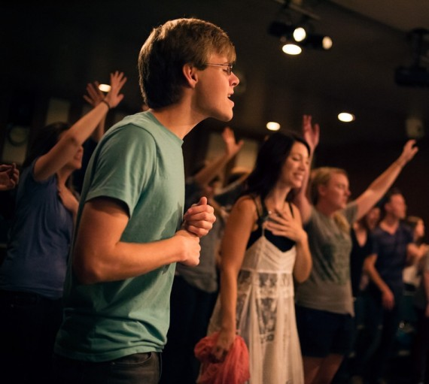
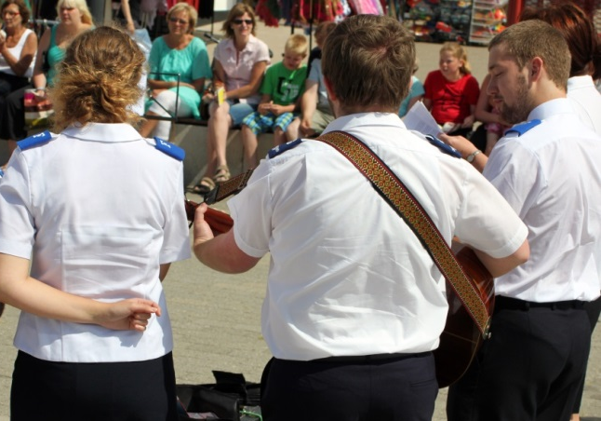
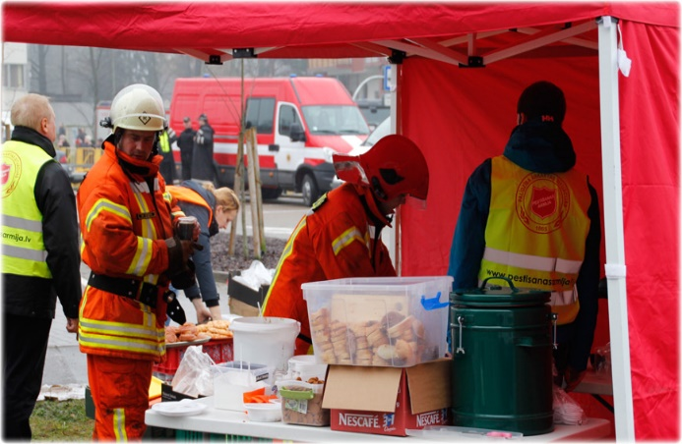

Slide 39
Six indicators of a misson-shaped church
Living Faith
Community Lifestyle
Discipleship Focus
Member Mobilisation
Neighbourhood Engagement
Adaptable Structures
Notes:
Also found pain and power struggles

Slide 40
‘’If anything [NCD] has promoted focus outwards, we used to be so insular’’
‘’My experience…is that [NCD] has turned this church from being in on itself to totally out and open’’
‘’NCD has totally influenced me. It has changed me as a person, made me more aware of a lot of things; NCD definitely has changed the church. It has changed me personally, from looking out instead of in, it has given me focus’’

Slide 41
‘’This study…seems to show that engaging with NCD does make a church more mission-shaped.
The churches had been turned from inward looking to outward focussed, from insular to open and welcoming. There was evidence of new and creative community engagement and in one instance conscious and committed work towards church planting in a neighbouring town.
In all churches there was new spiritual life and a focus on developing and equipping the congregation for living as disciples outside the walls of the church.‘’
‘’When a church implements a Natural Church Development approach, then mission-shaped development happens all by it-self’’

Slide 42
Become a Church for others
- the natural way

