Slide 1
Webinar: How to Handle the Global Participation Shift

Slide 2
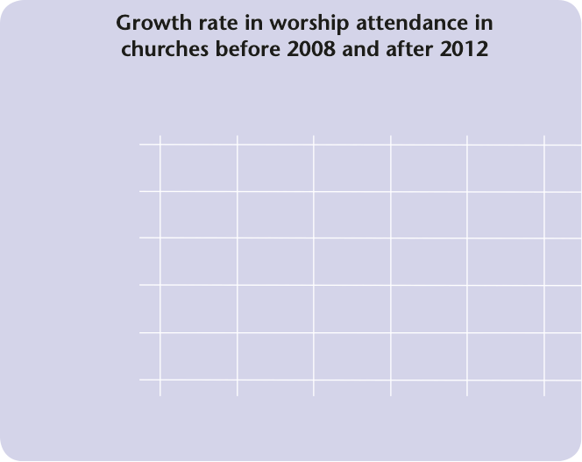
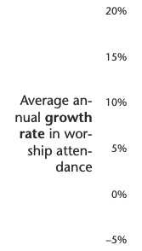
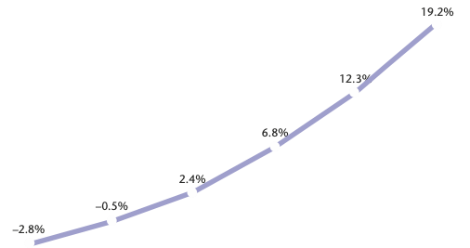
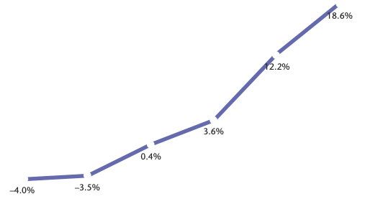
Example #1: contextual developments

Slide 3
1. Working on church quality is the most effective contribution to sustainable growth
2. The participation shift has a dramatic impact on churches with low or medium quality
3. If the quality of a church is high, the participation shift has no influence.
4. Liturgical and sacramental churches are less affected by the participation shift.

Slide 4
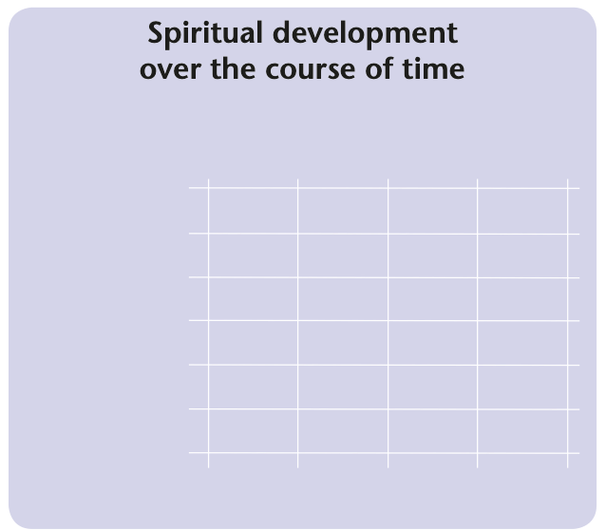
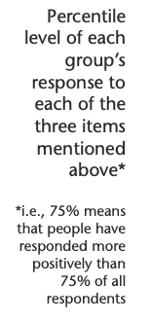
Example #2: internal developments

Slide 5
Poll
What is your spontaneous reaction to the decrease of spiritual engagement over time?

Slide 6
Break-out time
Groups of 2-3: What should be done in response to the two trends shown?

Slide 7
Practical conclusions
1. Reclaim the biblical treasure of God’s energy

Slide 8
A Key Concept in the New Testament
Noun “energy”: ἐνέργεια or ἐνέργημα
Adjective “energy-filled”: ἐνεργής
Verb “to energize”: ἐνεργέω
10x
3x
21x

Slide 9
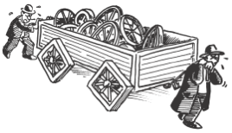
Missing the biblical key

Slide 10
5 Blessings of the biblical energy paradigm
1. Key to intrinsic motivation

Slide 11
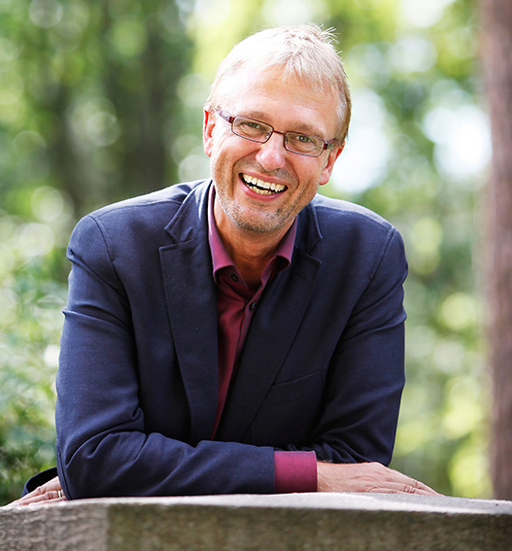
Christian
Emmelsbüll, Germany
Adam
Brisbane, Australia

Slide 12
5 Blessings of the biblical energy paradigm
1. Key to intrinsic motivation
2. Key to dealing with the reality of evil

Slide 13
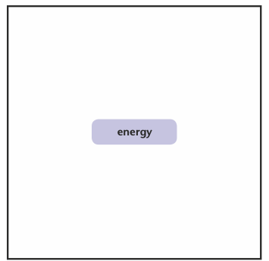
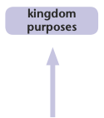
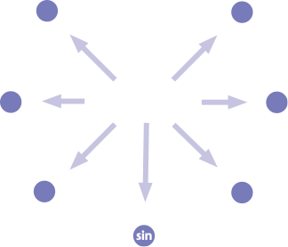

Slide 14
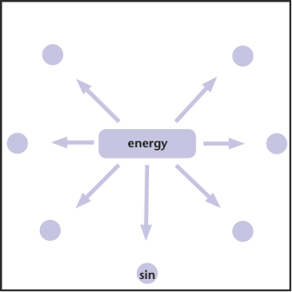
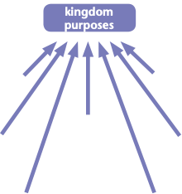

Slide 16
5 Blessings of the biblical energy paradigm
1. Key to releasing intrinsic motivation
2. Key to dealing with the reality of evil
3. Key to “all by itself” growth
4. Key to leadership and coaching
5. Key to defining a spiritual common ground with non-Christians

Slide 17
dunamis versus energeia
potency
potential
power
act
actuality
results

Slide 18
Why energeia must not be rendered “power”
Aristotle coined energeia as a counterword to dunamis
The New Testament purposefully uses two distinct terms

Slide 19
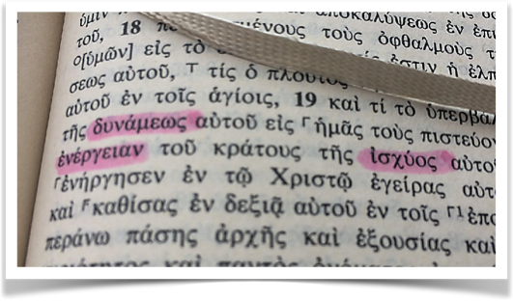
E.g., Ephesians 1:19
... greatness of his power (dunamis) ...
according to the working (energeia)
of his mighty power (ischus).

Slide 20
Why energeia must not be rendered “power”
Aristotle coined energeia as a counterword to dunamis
The New Testament purposefully uses two distinct terms
3. While energeia relates to a common ground that Christians and non-Christians share, dunamis usually doesn’t

Slide 21
Practical conclusions
1. Reclaim the biblical treasure of God’s energy
2. Abandon the “us/them” divide

Slide 22
Common ground (e.g.,
experience of God’s energy)
Purely immanent interpretation of one’s experiences
Biblical interpretation of one’s experiences
Person A
Person B

Slide 23
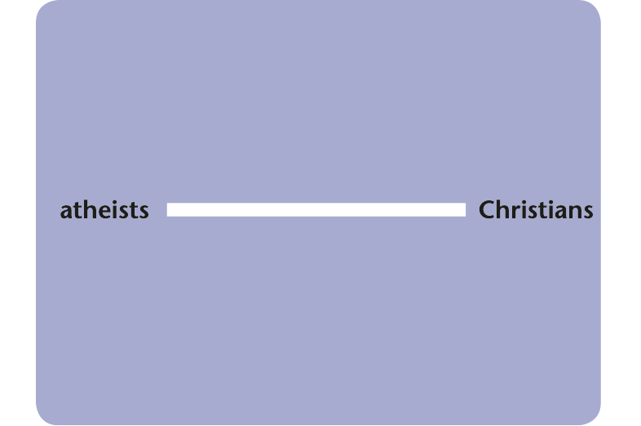
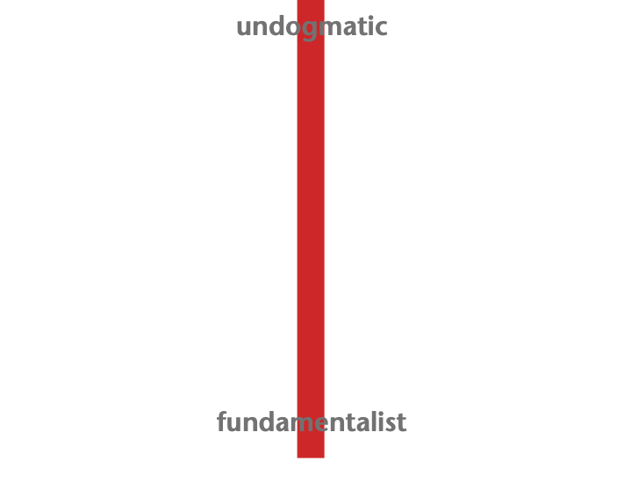

Slide 24
Practical conclusions
1. Reclaim the biblical treasure of God’s energy
2. Abandon the “us/them” divide
3. Identify the common ground of people with different persuasions

Slide 25
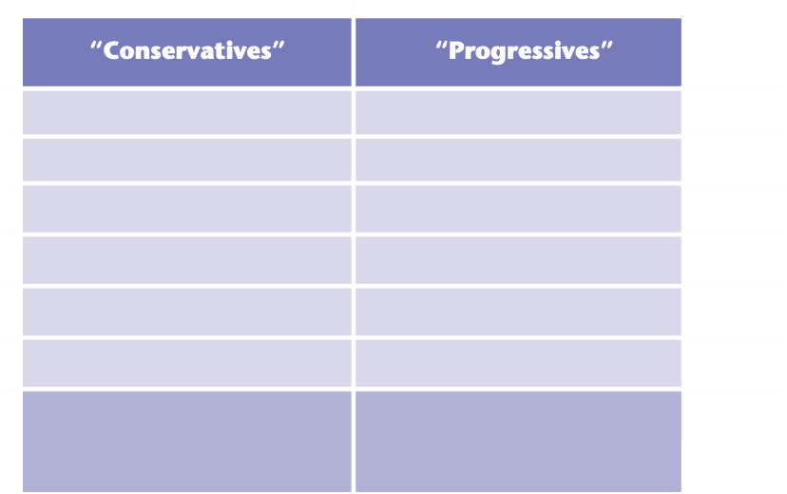
focus on unchanging substance
focus on changing aspects
purity
adaptation
fighting degeneration
working for progress
exclusiveness
inclusiveness
homogeneity
diversity
conserving
advancing
reform as: “back to the (biblical) roots”
reform as: “getting rid of (unnecessary) dogmatic baggage”

Slide 26
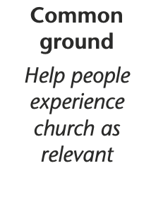
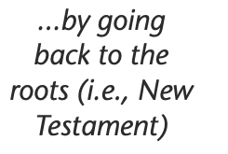
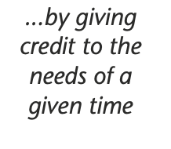

Slide 27
Motto:
Adaptation to the challenges of our time
by rediscovering neglected biblical truth

