Slide 1
Restorative Practice
June 1, 2022

Slide 2
Agenda:
Welcome & Check-in
Review Restorative Principles
Case Studies:
Listening Circle
Facilitated Conflict Circle
Consulting
Links to NCD 8QCs & Questions
Check-out
2

Slide 3
The Ministry of Reconciliation
2 Corinthians 5:18-21 (NIV)
All this is from God, who reconciled us to himself through Christ and gave us the ministry of reconciliation: that God was reconciling the world to himself in Christ, not counting people’s sins against them. And he has committed to us the message of reconciliation.
We are therefore Christ’s ambassadors, as though God were making his appeal through us. We implore you on Christ’s behalf: Be reconciled to God. God made him who had no sin to be sin for us, so that in him we might become the righteousness of God.

Slide 4
What is Restorative Practice?
Social science out of Restorative Justice
Improve & repair relationships
Between people and communities
Increase social capital
Repair harm
Restore relationships through conversation
What is FaithCare?
RP division of Shalem Mental Health Network
Shalem started 60+ years ago
Canadian (Dutch) Reformed Church
Network of family therapists

Slide 5
Past
Future
What happened?
How to move forward together?

Slide 6
5. Discernment & direction-setting by giving voice
1.
Build healthy relationships between members
Restorative Practice
4.
Address and discuss the needs of the church community
2.
Reduce, prevent and improve harmful behaviour
3.
Resolve conflict, repair harm and restore positive relationships

Slide 7
Relationship/Leadership Styles
HIGH
TO
WITH
authoritarian
restorative
adversarial
stigmatising
authoritative respectful
integrative
Realistic Expectations
Accountability
Boundaries
Limits
FIRM
NOT
FOR
neglectful
permissive
indifferent
passive
protective
easy/undemanding
LOW
FAIR
HIGH
Support, Encourage, Nurture
Adapted from Social Discipline Window - Paul McCold and Ted Wachtel – 2000
Source: IIRP Canada

Slide 8
Fair Process Principles
Engagement:
involving individuals in decisions that affect (impact) them by asking for their input and allowing them to refute the merit of one another’s ideas and assumptions.
Explanation:
everyone involved and affected should understand why final decisions are made as they are. Confidential aspects of a decision must be respected.
Expectation Clarity:
decisions are clearly understood, so that everyone understands their implications and what is expected of them personally as a result of the decisions.

Slide 9
RESTORATIVE QUESTIONS
What happened, from your perspective?
How have you and others been affected?
What’s been the hardest thing for you?
What do you need to move forward?
What are you willing to contribute to move forward?
9

Slide 10
RESTORATIVE QUESTIONS
What happened, from your perspective?
How have you and others been affected?
What’s been the hardest thing for you?
What do you need to move forward?
What are you willing to contribute to move forward?
10

Slide 11
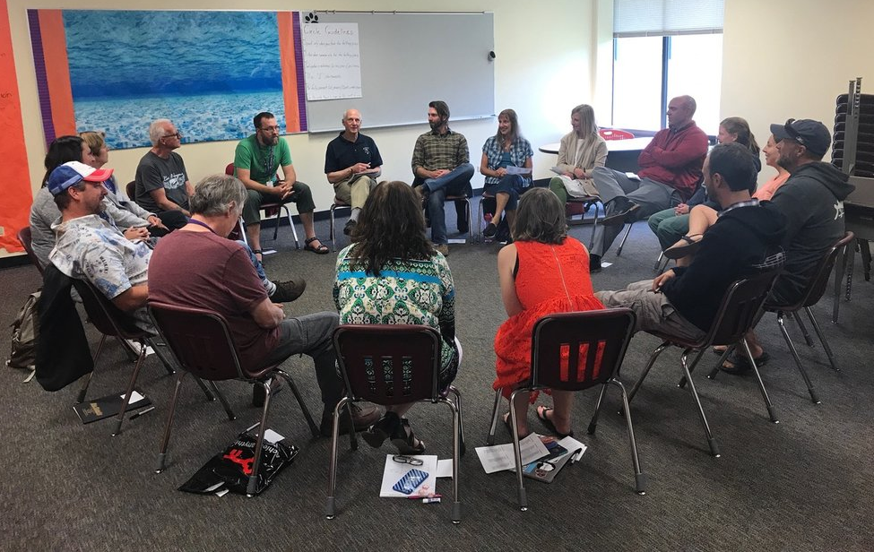

Slide 12
Case Studies:
Listening Circles
Facilitated Conflict Conversation
Getting to a vision and plan
Our role is to facilitate the church’s conversation, not lead it. This is different than consulting, or even coaching.

Slide 13
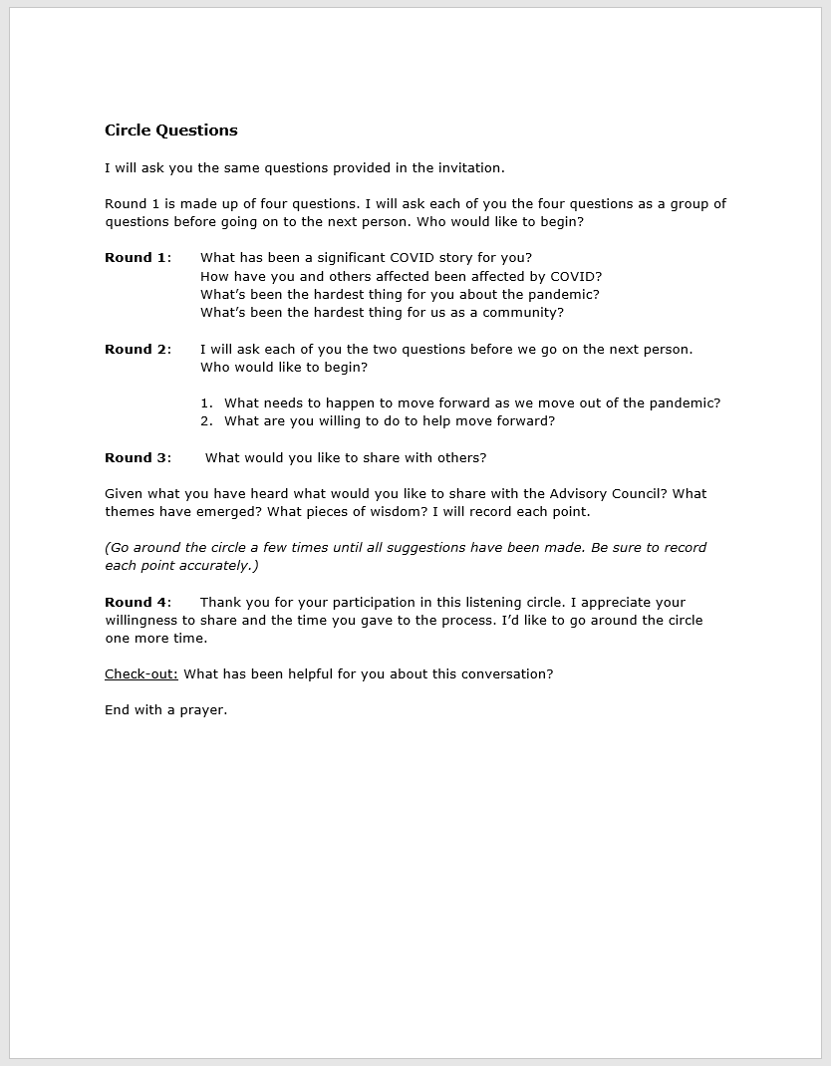
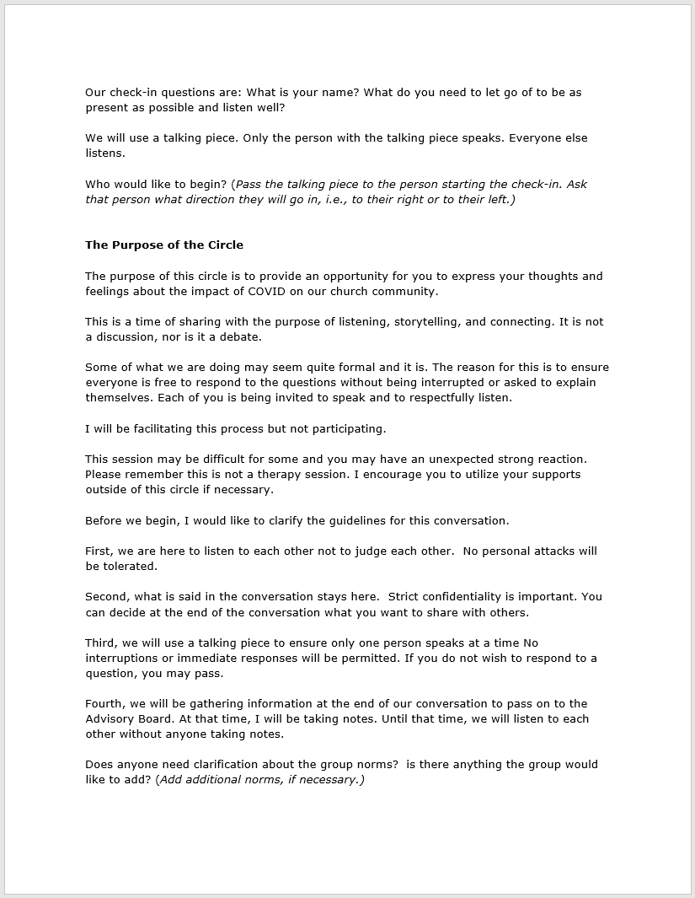
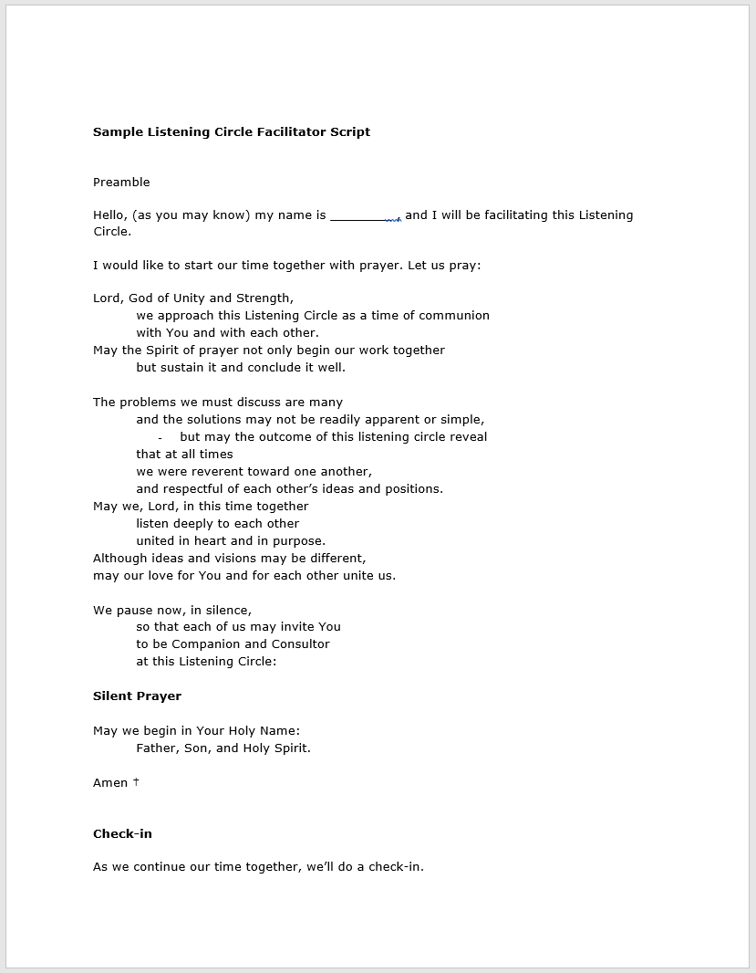

Slide 14
Break-out Groups:
Round 1:
What has been a significant COVID story for you?
How have you and others been affected by COVID?
What’s been the hardest thing for you about the pandemic?
What’s been the hardest thing for NCD as a community?
Round 2:
What needs to happen to move forward as we move out of the pandemic?
What are you willing to do to help move forward?

Slide 15
Facilitated Conflict Conversation
Christian School
Board/Teachers – build/rebuild trust
Board/Parents – posture of listening
Teacher/Students; School/Community

Slide 16
Getting to a vision and plan
Large, deeply conflicted church
Conflict over decision not to merge
Autocratic decision making
Restorative Processes:
Listening Circles to heal
Facilitated conversations to deal with harm and how to move forward
Gathered how to move forward statements across a year
Bundled the moving forward statements into three areas
Circle Working Groups to plan, prioritize and implement

Slide 17
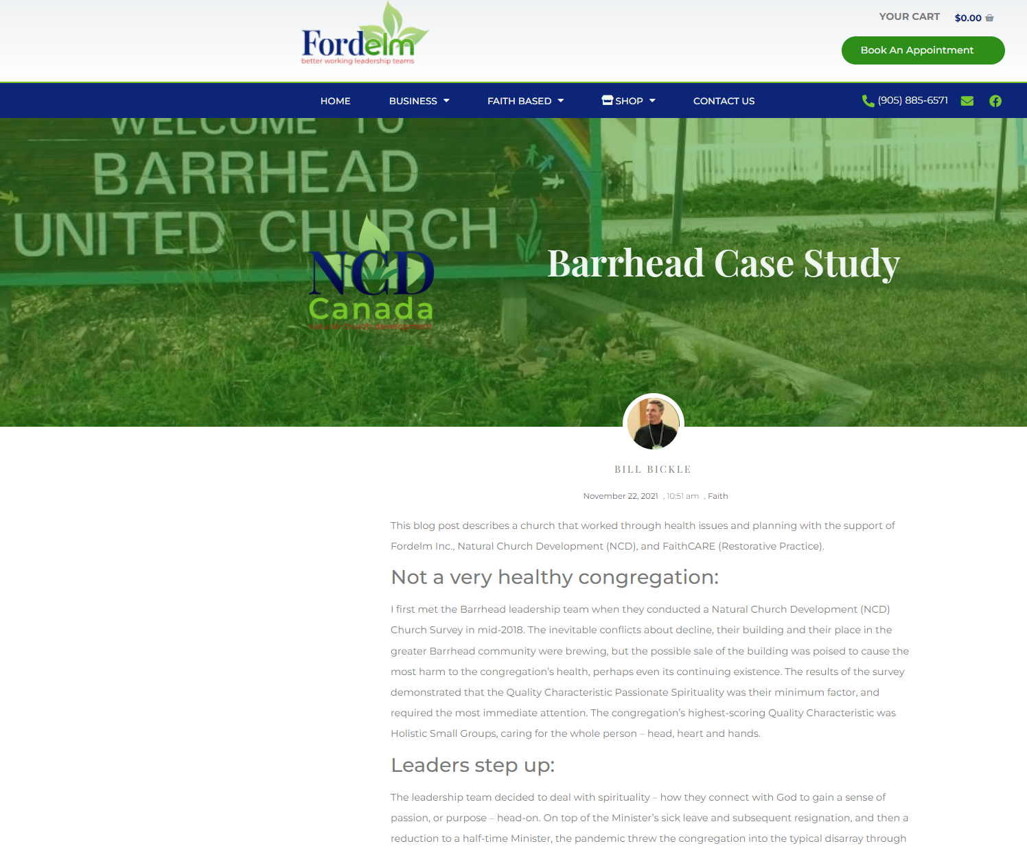
Barrhead:
Started with an NCD Survey (Mim Factor PS)
Action Plan to deal with PS
Sale of church building – potential for conflict
Listening Circles to address needs
Fair Process in Decision Making (sold building)
https://fordelm.com/barrhead-case-study/

Slide 18
16 (GBM) I know what value my work has in the overall work of our church
17 (EL) I know that someone in our church will hold me accountable for meeting the commitments I make
24 (ES) My contributions to church are reviewed regularly
26 (GBM) I feel that my church supports me in my ministry
31 (EL) Our leaders are good at explaining things
40 (LR) I know of people in our church with bitterness toward others
49 (HSG) I am a member of a group in our church where it is possible to talk about personal problems
51 (EL) The leaders of our church prefer to do the work themselves rather than collaborate with others
67 (ES) I know the goals we are working towards as a church
79 (GBM) I clearly understand what is expected from me when fulfilling my tasks in our church
80 (LR) If I have a disagreement with a member of our church, I will go to them in order to resolve it
90 (HSG) In my small group we trust each other

Slide 20
Accountability
Affirming
Compassion
Creativeness
Everyday-faith
Faith-stretching
God-consciousness
Good Organization
Hope
Inspiration
Intimacy
Joy
Learning
Multiplication
Nurturing
Pastoral Care
Prayer
Reconciling
Releasing
Relevance
Self-awareness
Teamwork
Vision
Welcoming

Slide 21
Breakouts:
How is RP a link to Loving Relationships, Effective Structures and/or Holistic Small Groups?
What are potential disconnects/risks between NCD and RP?

Slide 22
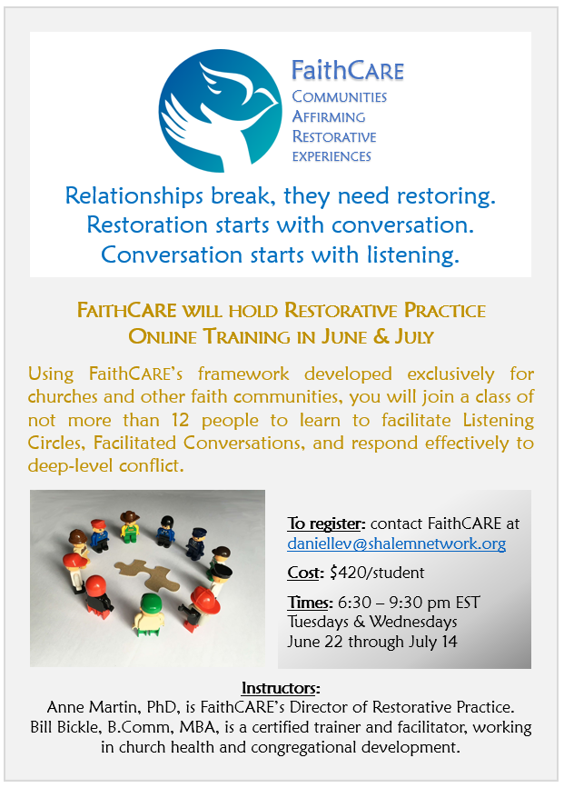
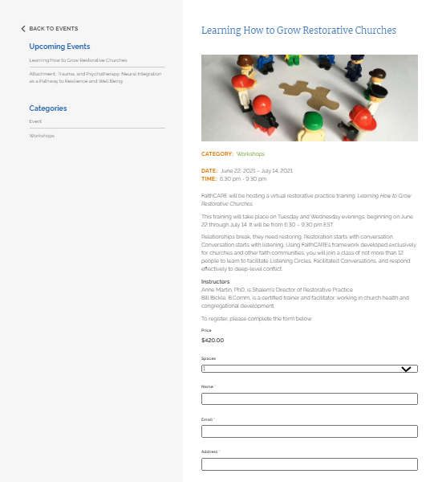
Online Training Winter 2022/2023
Dates & Times: TBD
Learning How to Grow Restorative Churches - Shalem Mental Health Network (shalemnetwork.org)

