Slide 1
Webinar: Strengthening churches now and beyond Covid-19
Start: 6:00pm Central European time (Germany)

Slide 2
Excerpt from a letter to church members,
April 2020
... therefore our church life will virtually come to a standstill until further notice. ...
All scheduled meetings and events are suspended. ...
The church profile that we planned for April will be cancelled. We will come back to it as soon as we have a chance to get together again physically ...

Slide 3
3 min. breakout time
Meet in groups of 2-3
Which is the #1 benefit (for church development) that you have personally experienced in the context of the Corona crisis?

Slide 4
Poll
Have the churches within your area of responsibility suffered from the restrictions due to Covid-19?
1. Yes, strongly.
2. Yes, a bit.
3. No, just the opposite.

Slide 5
The situation
1. In this time window, people may not be able to attend physical meetings, such as committees, worship services, small groups, etc.
2. Many people are now more receptive toward revising routines of their lives.
3. It is an ideal time for leaders to strategically invest in the health of people.
4. People can invest in their own qualitative growth.
5. We will be able to see the results of that investment once church life will switch to “normal.”

Slide 6
3 Examples for health-enducing measures without the necessity of a single physical contact
1. Three-Color eTests targeted at personal growth
2. NCD Church Survey
3. Study groups on NCD eBooks

Slide 7
Goal
Not “emergency care,” but strategic investment in qualitative growth

Slide 8
3 Examples for health-enducing measures without the necessity of a single physical contact
1. Three-Color eTests targeted at personal growth
2. NCD Church Survey
3. Study groups on NCD eBooks

Slide 9
Notes:
Baptists
Opposite denomination in all aspects
Can learn most from - and other way around
Strongest Scripture-driven, weakest, sacramental
Where is gap: doctrinal, rational, not explain
One NOW! training: Anglican together with a Baptist

Slide 10
Notes:
Baptists
Opposite denomination in all aspects
Can learn most from - and other way around
Strongest Scripture-driven, weakest, sacramental
Where is gap: doctrinal, rational, not explain
One NOW! training: Anglican together with a Baptist

Slide 11
Notes:
Baptists
Opposite denomination in all aspects
Can learn most from - and other way around
Strongest Scripture-driven, weakest, sacramental
Where is gap: doctrinal, rational, not explain
One NOW! training: Anglican together with a Baptist

Slide 12
Notes:
Baptists
Opposite denomination in all aspects
Can learn most from - and other way around
Strongest Scripture-driven, weakest, sacramental
Where is gap: doctrinal, rational, not explain
One NOW! training: Anglican together with a Baptist

Slide 13
Notes:
Baptists
Opposite denomination in all aspects
Can learn most from - and other way around
Strongest Scripture-driven, weakest, sacramental
Where is gap: doctrinal, rational, not explain
One NOW! training: Anglican together with a Baptist

Slide 14
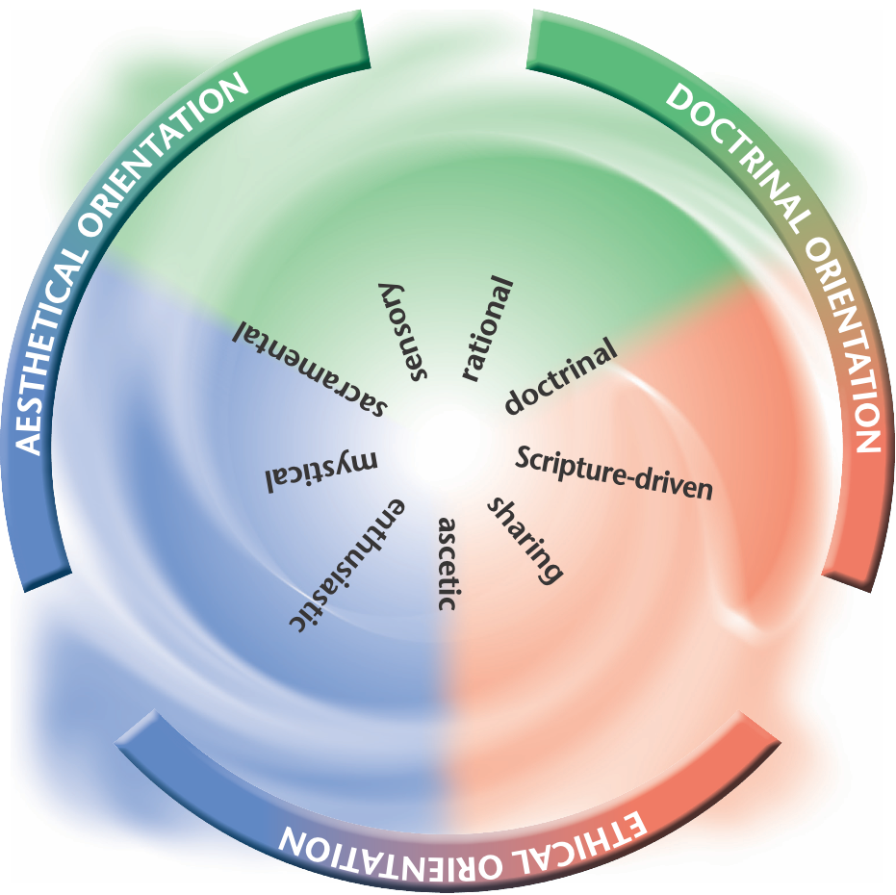
Spiritual Style Profile:
Anglicans
5
4
1
3
Purple figures = above average
2
9
Anthracite figures = below average
7
8
6
Notes:
Anglicans: 10.16
Like Catholic sacramental, then mystical, unlike Catholics doctrinal/rational
(Catholics not doctrinal? Average believer)
Sharing low, Scripture driven low
Observations: Proud what they are not Baptists
What is your approach to Scripture

Slide 15
Spiritual Style Profile:
Baptists
8
7
9
3
Purple figures = above average
Anthracite figures = below average
6
1
5
2
4
Notes:
Baptists
Opposite denomination in all aspects
Can learn most from - and other way around
Strongest Scripture-driven, weakest, sacramental
Where is gap: doctrinal, rational, not explain
One NOW! training: Anglican together with a Baptist

Slide 16
SharinG
What is the strength, what is the growth area of your own denomination/movement?
What explains these one-sidedness (historically, theologically)?
How do representatives of your denomination tend to speak about groups that have their strengths in the opposite area?
What is your policy toward your members that have a spiritual style different from your predominant styles?
Do you believe that you need to grow in the opposite segment, or do you see your predominant styles as superior to the others?
How could growth in your lowest style work in the context of your tradition/structure/theology?
Notes:
When dealing with denominational leaders, questions to discuss
point 3, 4
Questions YOU have
Discuss Anglican adaptation

Slide 17
3 Examples for health-enducing measures without the necessity of a single physical contact
1. Three-Color eTests targeted at personal growth
2. NCD Church Survey
3. Study groups on NCD eBooks

Slide 18
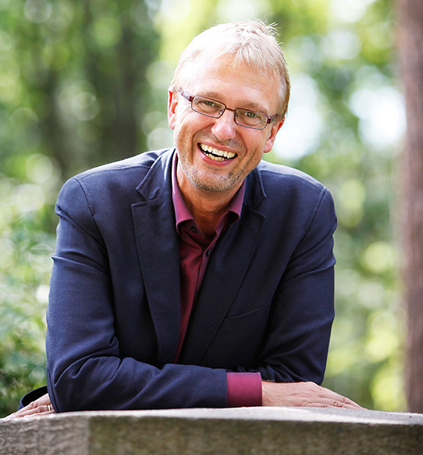
Christian
Emmelsbüll, Germany
Adam
Brisbane, Australia

Slide 19
3 Examples for health-enducing measures without the necessity of a single physical contact
1. Three-Color eTests targeted at personal growth
2. NCD Church Survey
3. Study groups on NCD eBooks

Slide 21
Impulse questions for every chapter of the book:
1. What in this chapter is new for us?
2. To what areas of our ministry does it apply?
3. What could be done to improve the situation?
4. What resistance can be expected?
5. Which ways are there to potentially harness the energy behind the resistance?

Slide 22
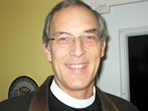
Christian
Emmelsbüll, Germany
John Paul
Sackville, New Brunswick, Canada

