Slide 1
The lightness of becoming
How transformation happens “all by itself”
NCD Webinar November 10, 2021

Slide 2
The Energy Trilogy
An interdisciplinary approach, covering:
exegesis
church history
systematic theology
philosophy
linguistics
psychology
neuroscience

Slide 3
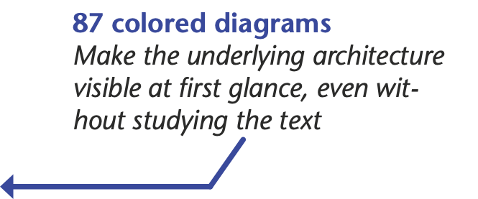
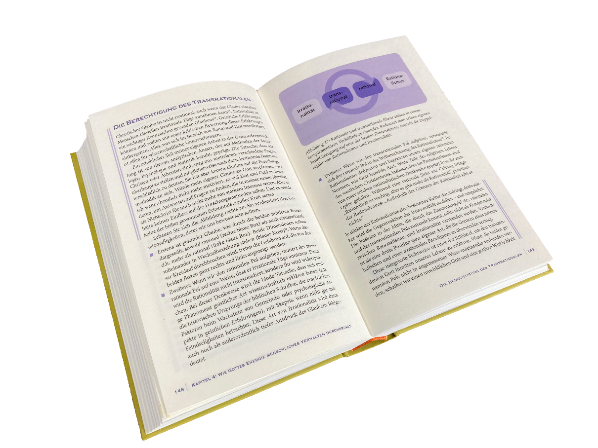
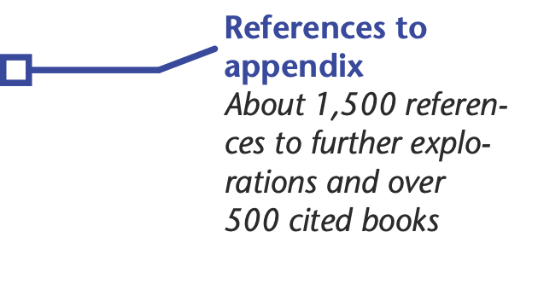
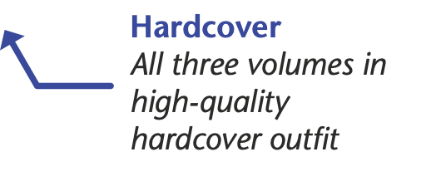
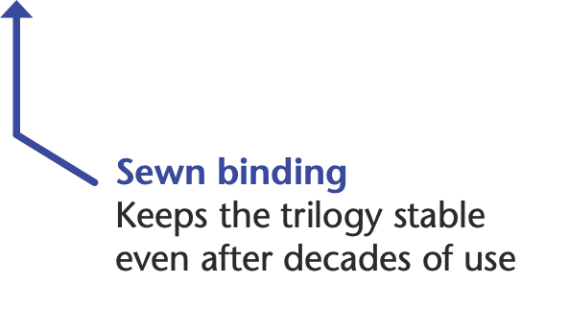
Special features of the Trilogy

Slide 4
Alternatively available as eBook:
3colorworld.org/books/energy-trilogy

Slide 5
Two parts of the webinar:
Part 1: Five unique features of the biblical energy paradigm
Part 2: Practical steps of implementation

Slide 6
Five unique features of the biblical energy paradigm
An unrecognized biblical treasure

Slide 7
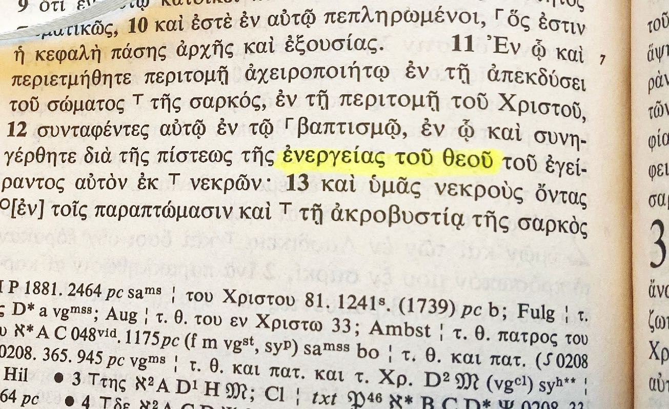
“enérgeia toú theoú”
i.g., Philippians 2:12

Slide 8
A Key Concept in the New Testament
Noun “energy”: ἐνέργεια or ἐνέργημα
Adjective “energy-filled”: ἐνεργής
Verb “to energize”: ἐνεργέω
10x
3x
21x

Slide 9
Five unique features of the biblical energy paradigm
Matches latest neurobiological insights

Slide 10
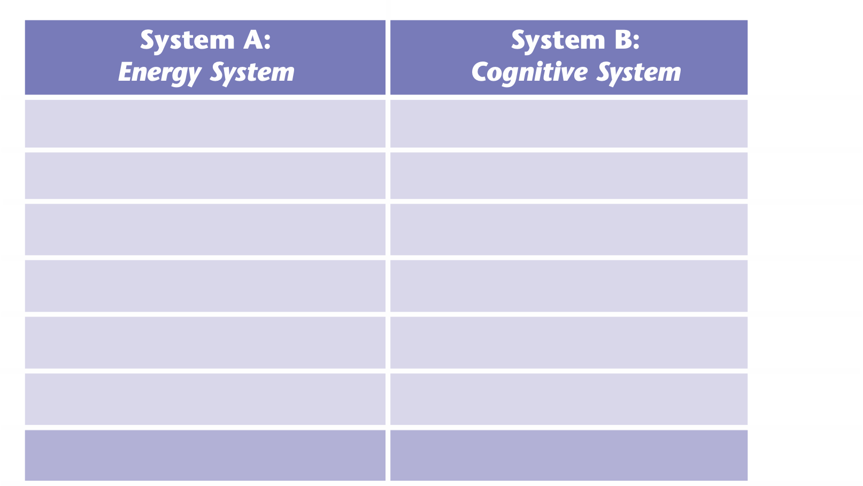

Slide 11
Example
Philippians 2:13
For it is God who is the energizer (ἐνεργῶν | energón | KJV: who works) in you both to will and to energize (ἐνεργεῖν | energeín | KJV: to do) in order to fulfill his good pleasure.

Slide 12
Example
Philippians 2:13
For it is God who is the energizer (ἐνεργῶν | energón | KJV: who works) in you both to will and to energize (ἐνεργεῖν | energeín | KJV: to do) in order to fulfill his good pleasure.

Slide 13
Example 5
Philippians 2:13
For it is God who is the energizer (ἐνεργῶν | energón | KJV: who works) in you both to will and to energize (ἐνεργεῖν | energeín | KJV: to do) in order to fulfill his good pleasure.

Slide 14
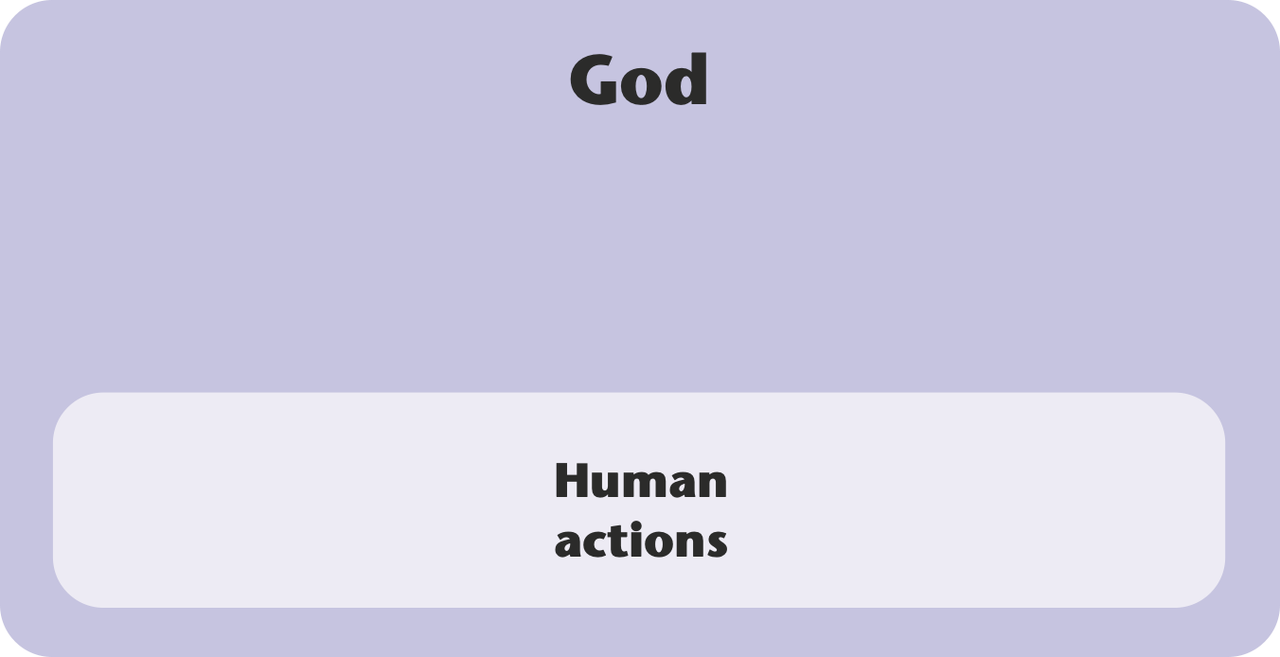
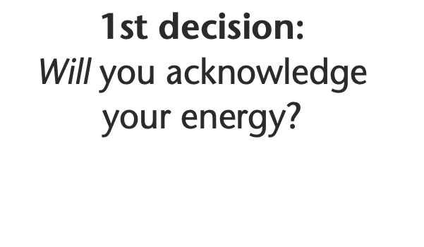
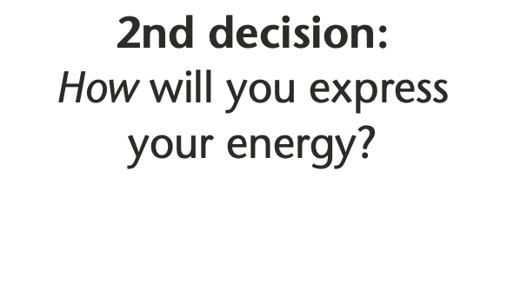

Slide 15
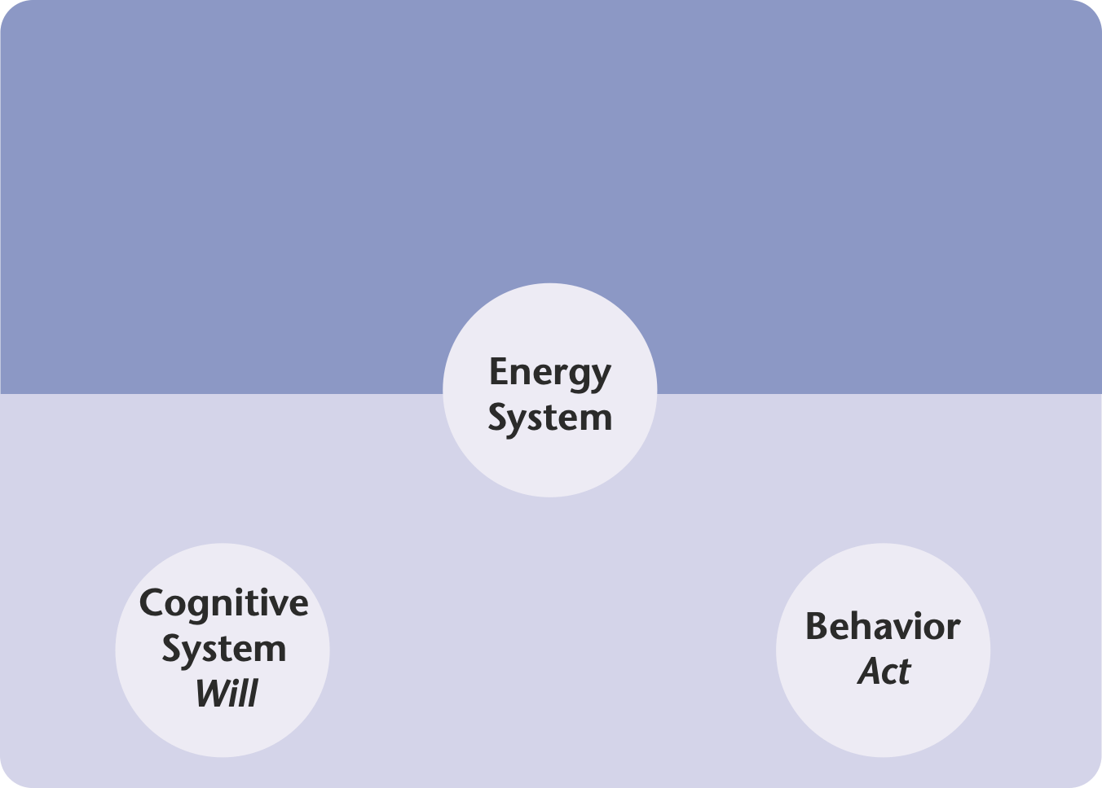
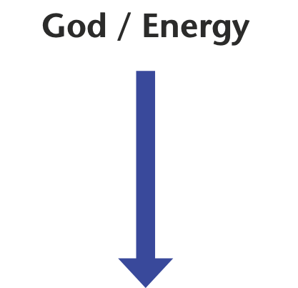

Slide 16
Five unique features of the biblical energy paradigm
Releasing intrinsic motivation

Slide 18
Five unique features of the biblical energy paradigm
Applying to Christians and non-Christians alike

Slide 19
Common ground (e.g.,
experience of God’s energy)
Purely immanent interpretation of one’s experiences
Biblical interpretation of one’s experiences
Person A
Person B

Slide 20
Transpersonal
not: personal minus
but: personal plus

Slide 21
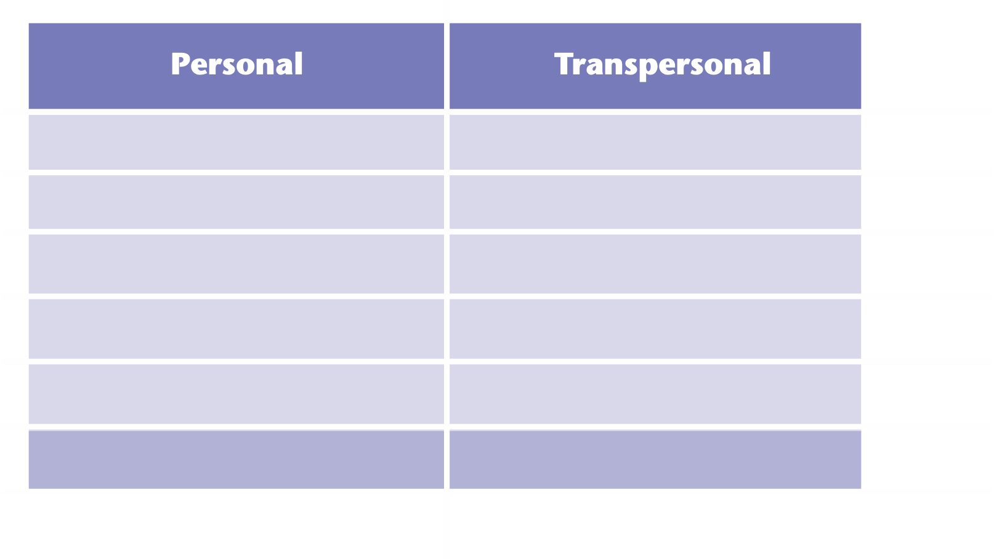

Slide 22
Five unique features of the biblical energy paradigm
Moving beyond the cognitive and rational

Slide 23
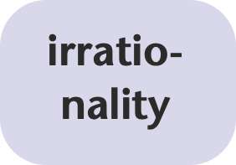
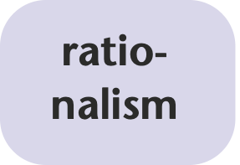
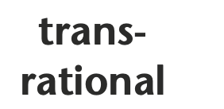
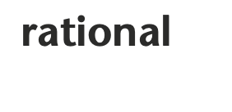

Slide 25
Five unique features of the biblical energy paradigm
The key to “all by itself” growth

Slide 28
What is, for your personally, the most promising feature of the biblical energy paradigm?
Poll
1. Biblical foundation
2. Neurobiological compatibility
3. Release of intrinsic motivation
4. Both for Christians and non-Christians
5. Transrational dimension

Slide 29
Share with the people in your group (randomly assigned) what fascinates you most about the feature you opted for. What are (or could be) the benefits of that specific feature? (5 min.)
Group work
1. Biblical foundation
2. Neurobiological compatibility
3. Release of intrinsic motivation
4. Both for Christians and non-Christians
5. Transrational dimension

Slide 30
Please, type your question into the chat window, or activate your microphone to ask a question
Q&A

Slide 31
Part 2
The Energy Synchronization Process (ESP)

Slide 32
