Slide 1
Using NCD to develop health in an organization
Ron Hamilton, Conference Minister
Conservative Congregational
Christian Conference
February 23, 2022

Slide 2
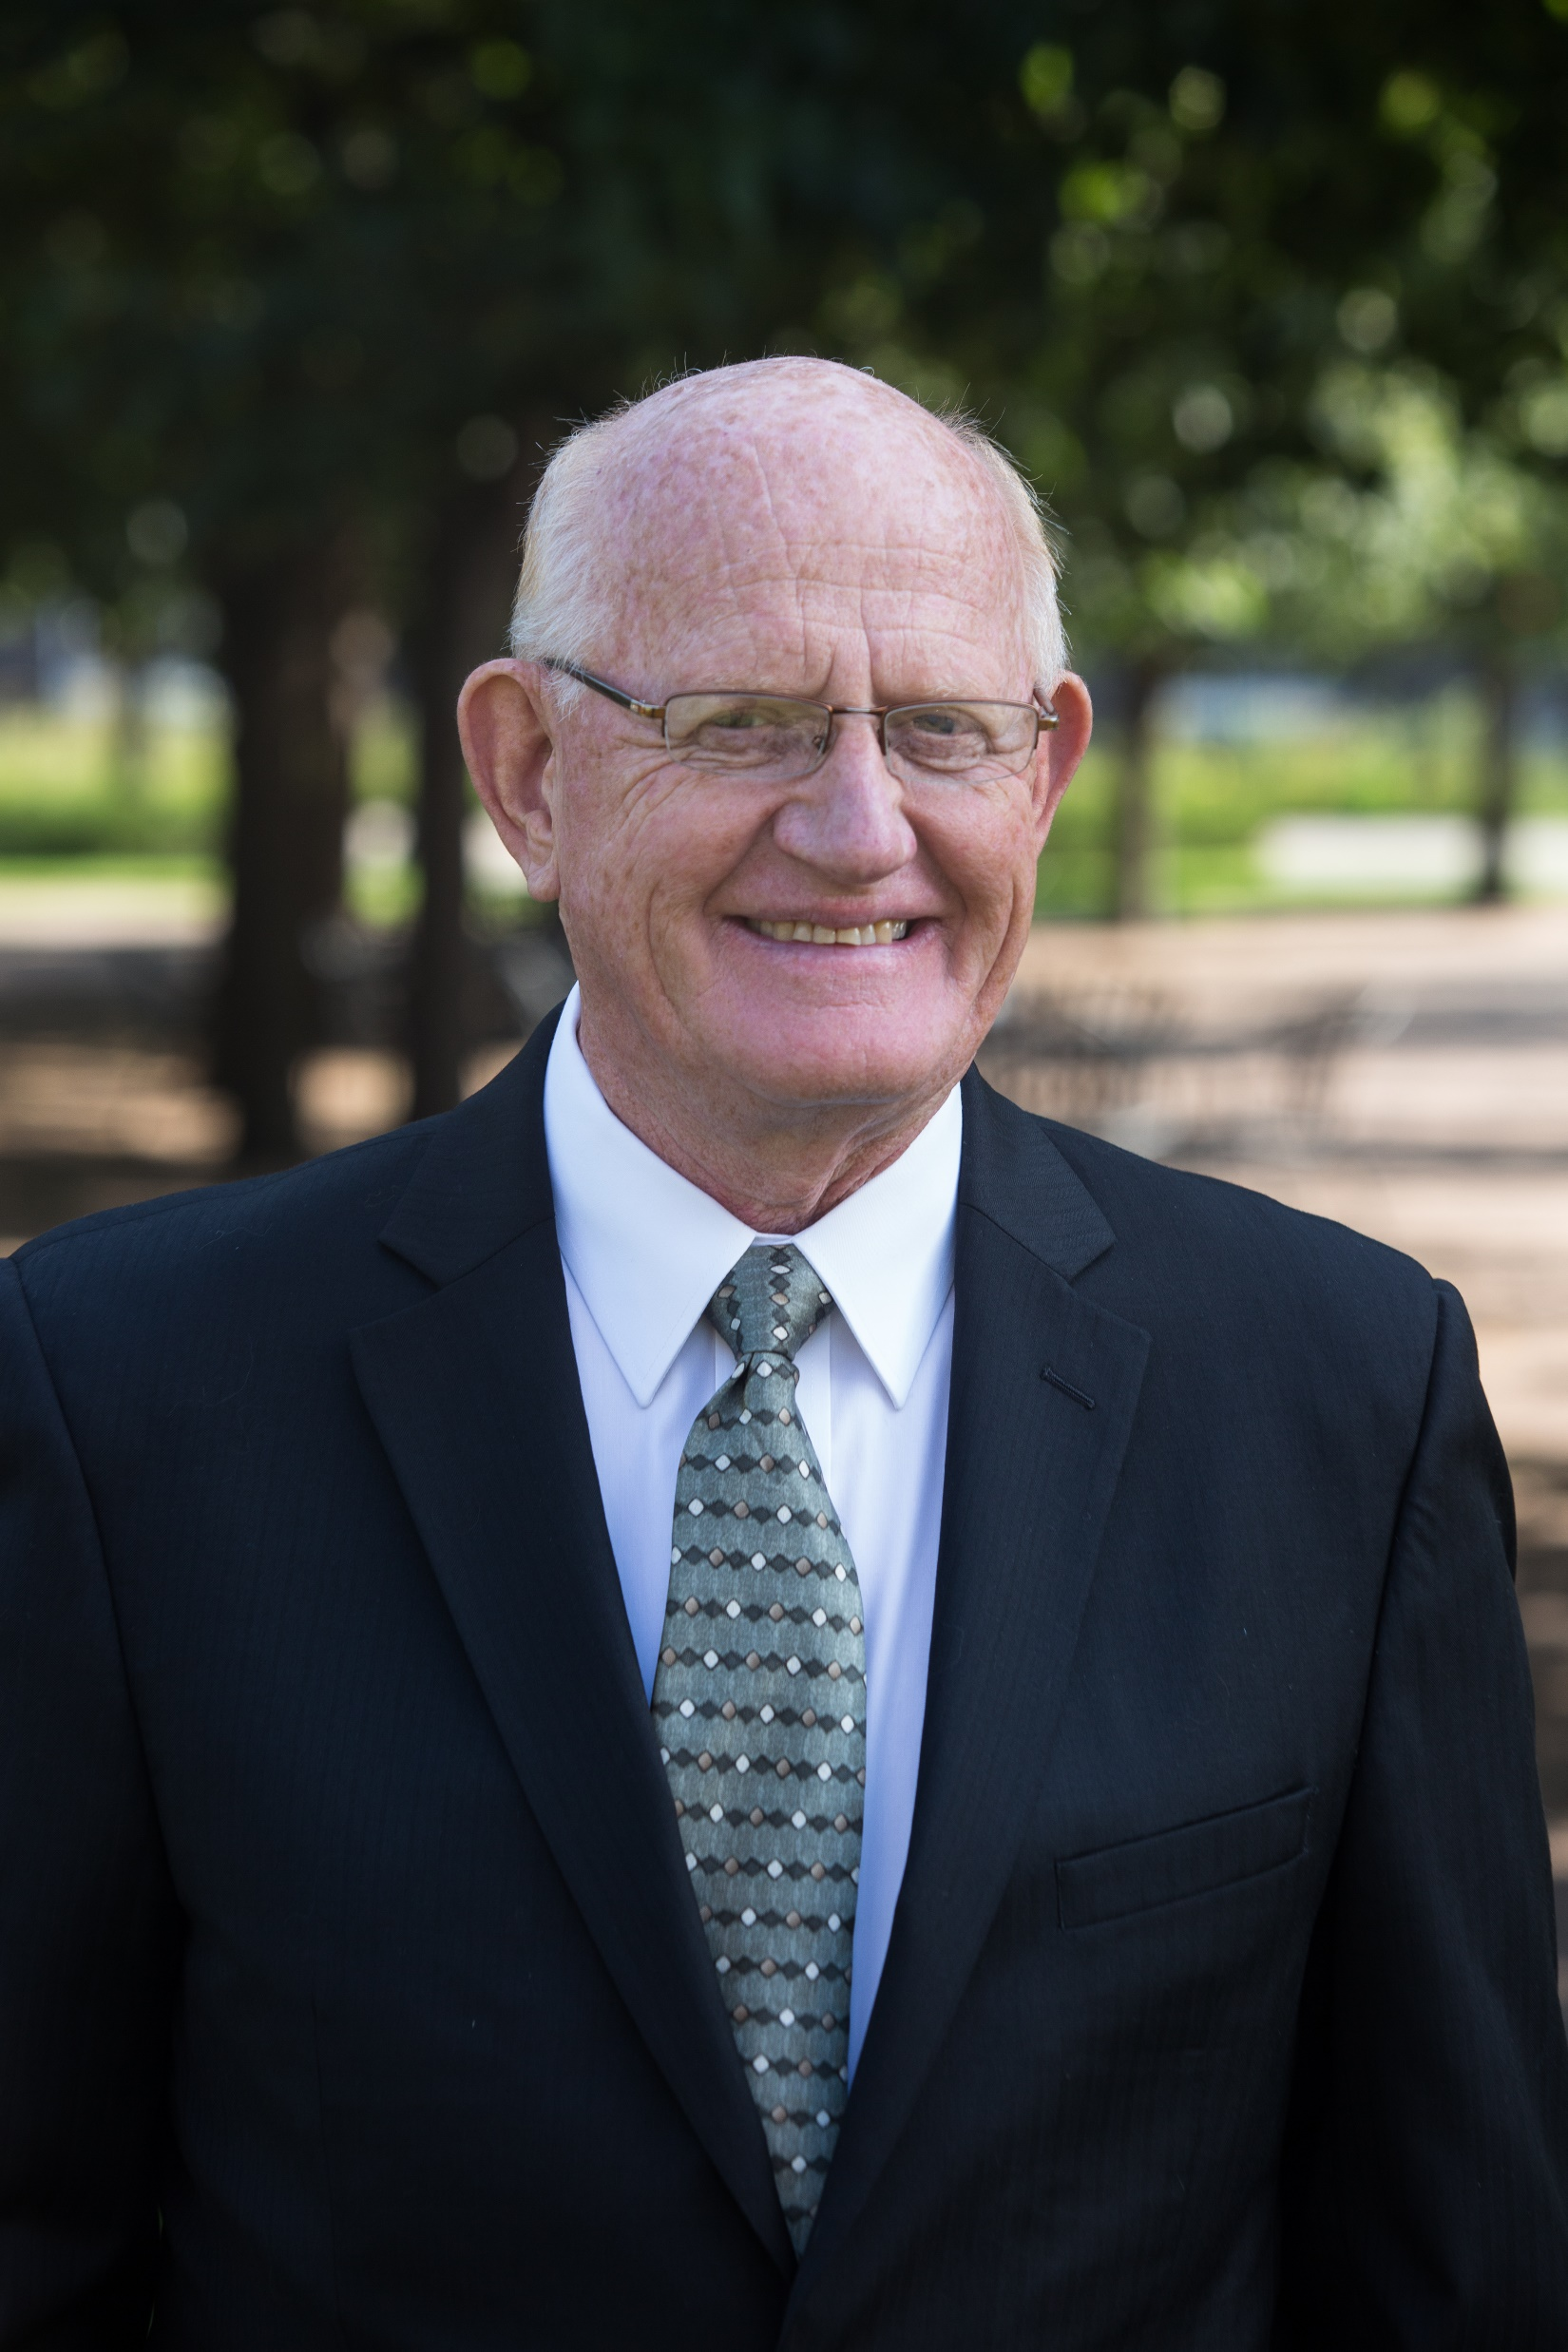
Personal Introduction
Ron Hamilton

Slide 3
Personal Introduction
Third generation pastor who loves the church
Served 3 churches
Holdingford, MN (rural)
New Haven, MI (near urban)
Woodbury, MN (suburban church plant)

Slide 4
Personal Introduction
B. A. – Houghton College (Mathematics)
M.Div. – Bethel Theological Seminary (Biblical theology)
D.Min. – Fuller Theological Seminary (Church Growth and Renewal)

Slide 5
Personal Introduction
Took a course in NCD at Fuller Seminary from Bob Logan in 2001
Implemented NCD survey cycle at Woodbury Community Church (3 surveys in 5 years)
Served as an NCD coach to churches and cohorts of churches in Minnesota, Wisconsin, and Iowa

Slide 6
Development of the CCCC Way of Life
Looking for help at a time of transition in 2007. We consulted with the Praxis Center for Church Development
Helped us think about organic ministry
Learned to think of the church as an organism and not an organization
Adopted NCD as our assessment tool

Slide 7
The CCCC Way of Life
Our Passion
To live in obedience to Jesus as we love God, love others and as we go, make disciples.

Slide 8
The CCCC Way of Life
Our Pathway – Seven Guiding Values
A Culture of Believing Prayer and Intercession
Healthy Pastors
Healthy Disciple-making Churches
Healthy Church Multiplication
A Community That Lives Out Shared Life and Shared Mission
A Culture of Peacemaking and Reconciliation
A Membership Reflective of the Harvest Field’s Diversity

Slide 9
The CCCC Way of Life
Our Priorities
Church Development
Church Multiplication
Conference Care

Slide 10
The CCCC Way of Life
NCD is imbedded in all of this
We use NCD as our tool for evaluation
We use the quality characteristics as the evaluative tool for church health

Slide 11
The CCCC Way of Life
NCD is imbedded in all of this
Empowering leadership
The define the effectiveness of our ministry by healthy ministry at the local level
We prioritized healthy pastors who would lead their churches.

Slide 12
The CCCC Way of Life
NCD is imbedded in all of this
Gift-based ministry
Teach gift-based ministry in our Church Development and Church Multiplication processes
Regional and national meetings include training for our pastors and church leaders

Slide 13
The CCCC Way of Life
NCD is imbedded in all of this
Passionate Spirituality
Our passion is driven by love for God
We prioritize prayer and intercession as a leading value of our ministry
Teach passionate spirituality in our Church Development and Church Multiplication processes

Slide 14
The CCCC Way of Life
NCD is imbedded in all of this
Effective structures
We have simplified our ministry around our ministry priorities of church development, church multiplication and conference care
Teach effective structures in our Church Development and Church Multiplication processes

Slide 15
The CCCC Way of Life
NCD is imbedded in all of this
Inspiring worship
Teach inspiring worship in our Church Development and Church Multiplication processes
Inspiring worship is vital to our regional and national meetings

Slide 16
The CCCC Way of Life
NCD is imbedded in all of this
Holistic small groups
Teach holistic small groups in our Church Development and Church Multiplication processes
We are developing community pastor groups in develop healthy pastors

Slide 17
The CCCC Way of Life
NCD is imbedded in all of this
Need-oriented evangelism
Teach need-oriented evangelism in our Church Development and Church Multiplication processes
Value of membership reflective of the harvest field’s diversity

Slide 18
The CCCC Way of Life
NCD is imbedded in all of this
Loving relationships
Teach loving relationships in our Church Development and Church Multiplication processes
Value of culture of peacemaking and reconciliation

Slide 19
The CCCC Way of Life
NCD is imbedded in all of this
Growth forces - interdependence
Making disciples is the priority of each of ministry priorities
The directors and ministry teams of Church development, Church multiplication, and Conference care work closely together to develop our ministry

Slide 20
The CCCC Way of Life
NCD is imbedded in all of this
Growth forces - multiplication
Multiplication is an expected outcome of healthy churches
We have developed the Nineveh Network to develop our work of Church multiplication
Our ministry directors and leaders attend our church multiplication conferences

Slide 21
The CCCC Way of Life
NCD is imbedded in all of this
Growth forces – transformation
We channeled the energy to keep our ministry alive ten years ago to develop our current ministry
We challenge a “maintenance mentality” is our traditional church ministries

Slide 22
The CCCC Way of Life
NCD is imbedded in all of this
Growth forces – sustainability
We develop long-term plans to maintain our current energy for ministry
We have a five-year transition team to work on key elements of change in leadership in the future

Slide 23
The CCCC Way of Life
NCD is imbedded in all of this
Growth forces – symbiosis
Our ministry priorities of church development, church multiplication and conference care have joined in a work assist struggling and dying churches
Our governing Board works to encourage our ministry priorities

Slide 24
The CCCC Way of Life
NCD is imbedded in all of this
Growth forces – fruitfulness
We measure our success by the health of our churches and pastors rather than any statistical growth

Slide 25
The CCCC Way of Life
NCD and a healthy culture in an organization
Think and plan organically
Pay attention to the growth forces
Evaluate quality on a regular basis using the eight quality characteristics of NCD

Slide 26
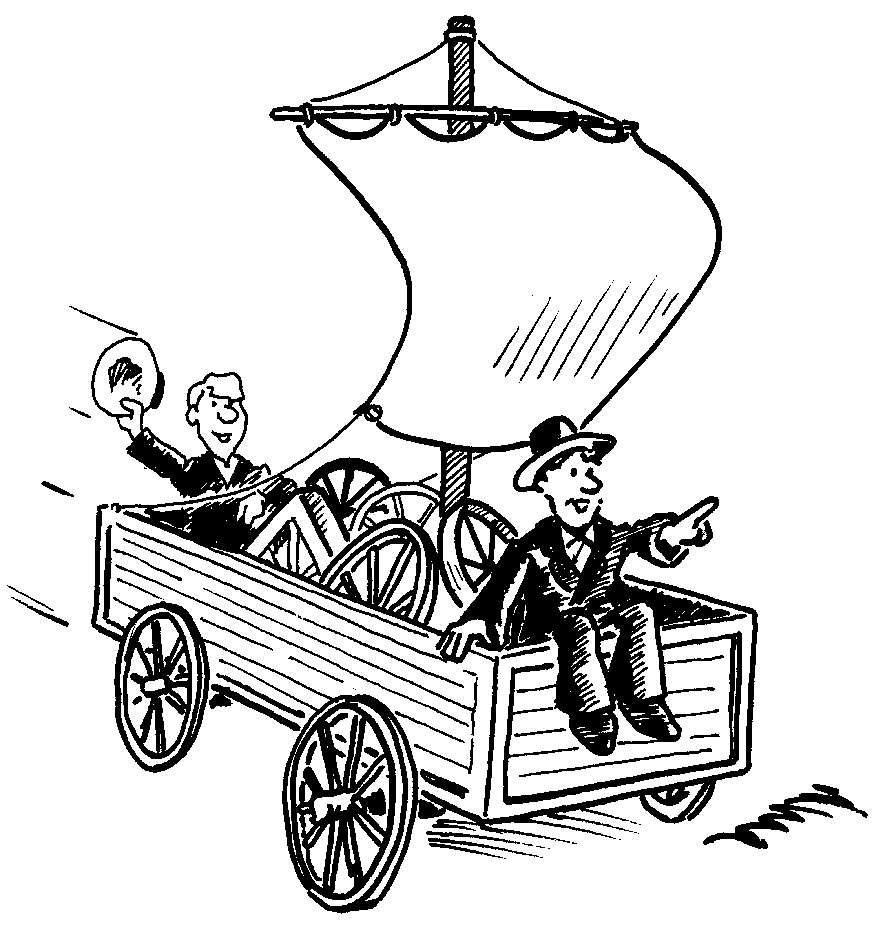
The CCCC Way of Life

