Slide 1

Using NCD with Churches in Crisis
NCD Coach Community Webinars
Dr. John Kimball
Director of Church Development, Conservative Congregational Christian Conference (USA)

Slide 2
The Conservative Congregational Christian Conference
Founded in 1948
300+ Churches Throughout the USA
900+ Pastors, Missionaries, Chaplains & Christian Workers
Partnering with NCD America since before 2007
Broad Church Health Spectrum
  10% In Crisis
  20% Close to Crisis
  50% In Plateau
  15% Healthy
  5% Flourishing
Strong Emphasis on Church Planting

Slide 3

Church Development in the CCCC
Healthy Churches
(Assess and Improve)
NCD Survey Cycle
Eight Quality Characteristics & Growth Forces
Alignment and balance of Three Colors
Addressing issues exposed by Themes
Plateaued Churches
(Assess and Retool)
Full Vista Assessment
Biblical Peacemaking
Biblical Ecclesiology
Disciple Making Pathways
Leader Development
Values, Vision & Mission
Intercession & Evangelism
Notes:
My own role in the CCCC -- since 2007 -- is Director of Church Development...

Slide 4
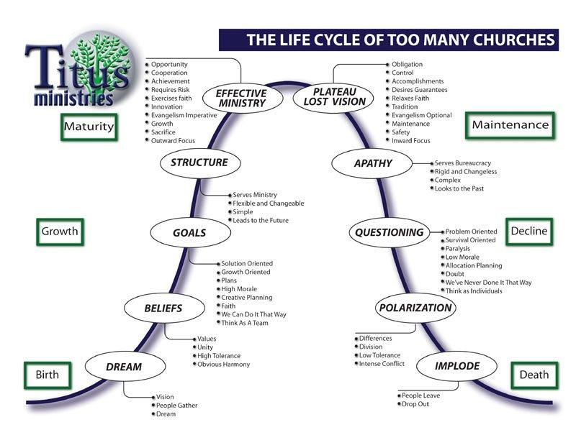
A Church’s Life Cycle
© 2007 Titus Ministries. Used with permission.
CHURCH DEVELOPMENT
TURNING POINT
CHURCH MULTIPLICATION
CONFERENCE CARE - LEGACY
Turn-around Likely
Turn-around Unlikely
Turn-around Impossible
Notes:
So four years ago, the leadership of the CCCC were meeting and realized that we had a growing percentage of churches that were in danger of closing and we really had no way to circumvent that.
Around the table - ID'd over 30 churches ready to close. 10% of our denomination.
We use this diagram to help our churches discern where they are on the life cycle -- but ironically, it was this diagram that showed us what we were missing.

Slide 5
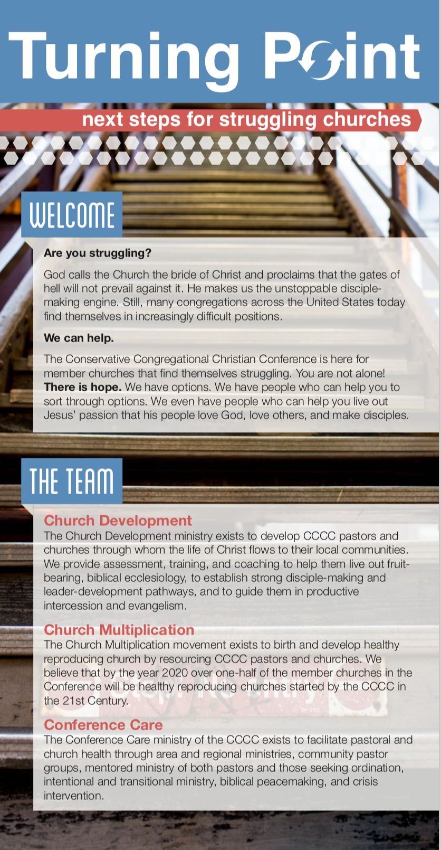
TURNING POINT: A Strategic Partnership Between the Ministries of Church Development, Church Multiplication and Conference Care
Notes:
This is a two-year-old process – and one of those years was 2020! (COVID) So there is still much to learn.
We have worked with about a dozen churches actively and about one-third of those are at some point in the directed development process.
I will talk about one church that has completed the cycle. And one church that is "in process"...

Slide 6
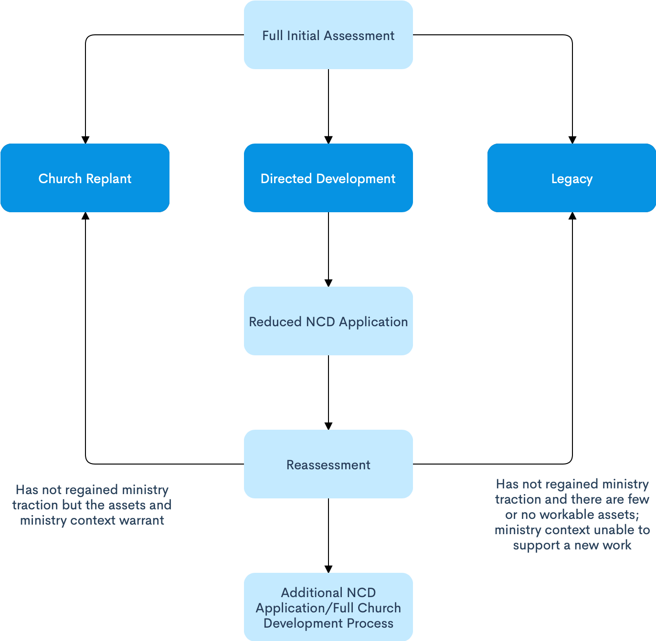
Turning Point
Notes:
We have trained "Interventionists" who are ready to go on site with a church and do a full assessment. NCD may be part of that, but they are also looking into the demographics of the community, the church's building and property -- are they in good condition? The financial health of the church, the energy level of the pastor and the congregation, and more...

Slide 7

“Directed Development”
Using a limited NCD Approach to Determine the Future of a Church

Slide 8

“Directed Development”
Initial NCD Survey and Results Guides
Trained NCD/Turning Point Directed Development Coach Assigned
Review of Results Guides
Mutual Discernment of 1 or 2 Primary Action Steps – Keeping it as simple as possible
Creation of Appropriate Church Health Team
Implementation with Coaching
Ongoing Assessment of Fruit

Slide 9

Non-Negotiables
Full Prayer Participation (emphasizing intercession)
Pastoral and Leadership Demonstration of Engagement
Congregational Involvement
Ministry Partnership

Slide 10

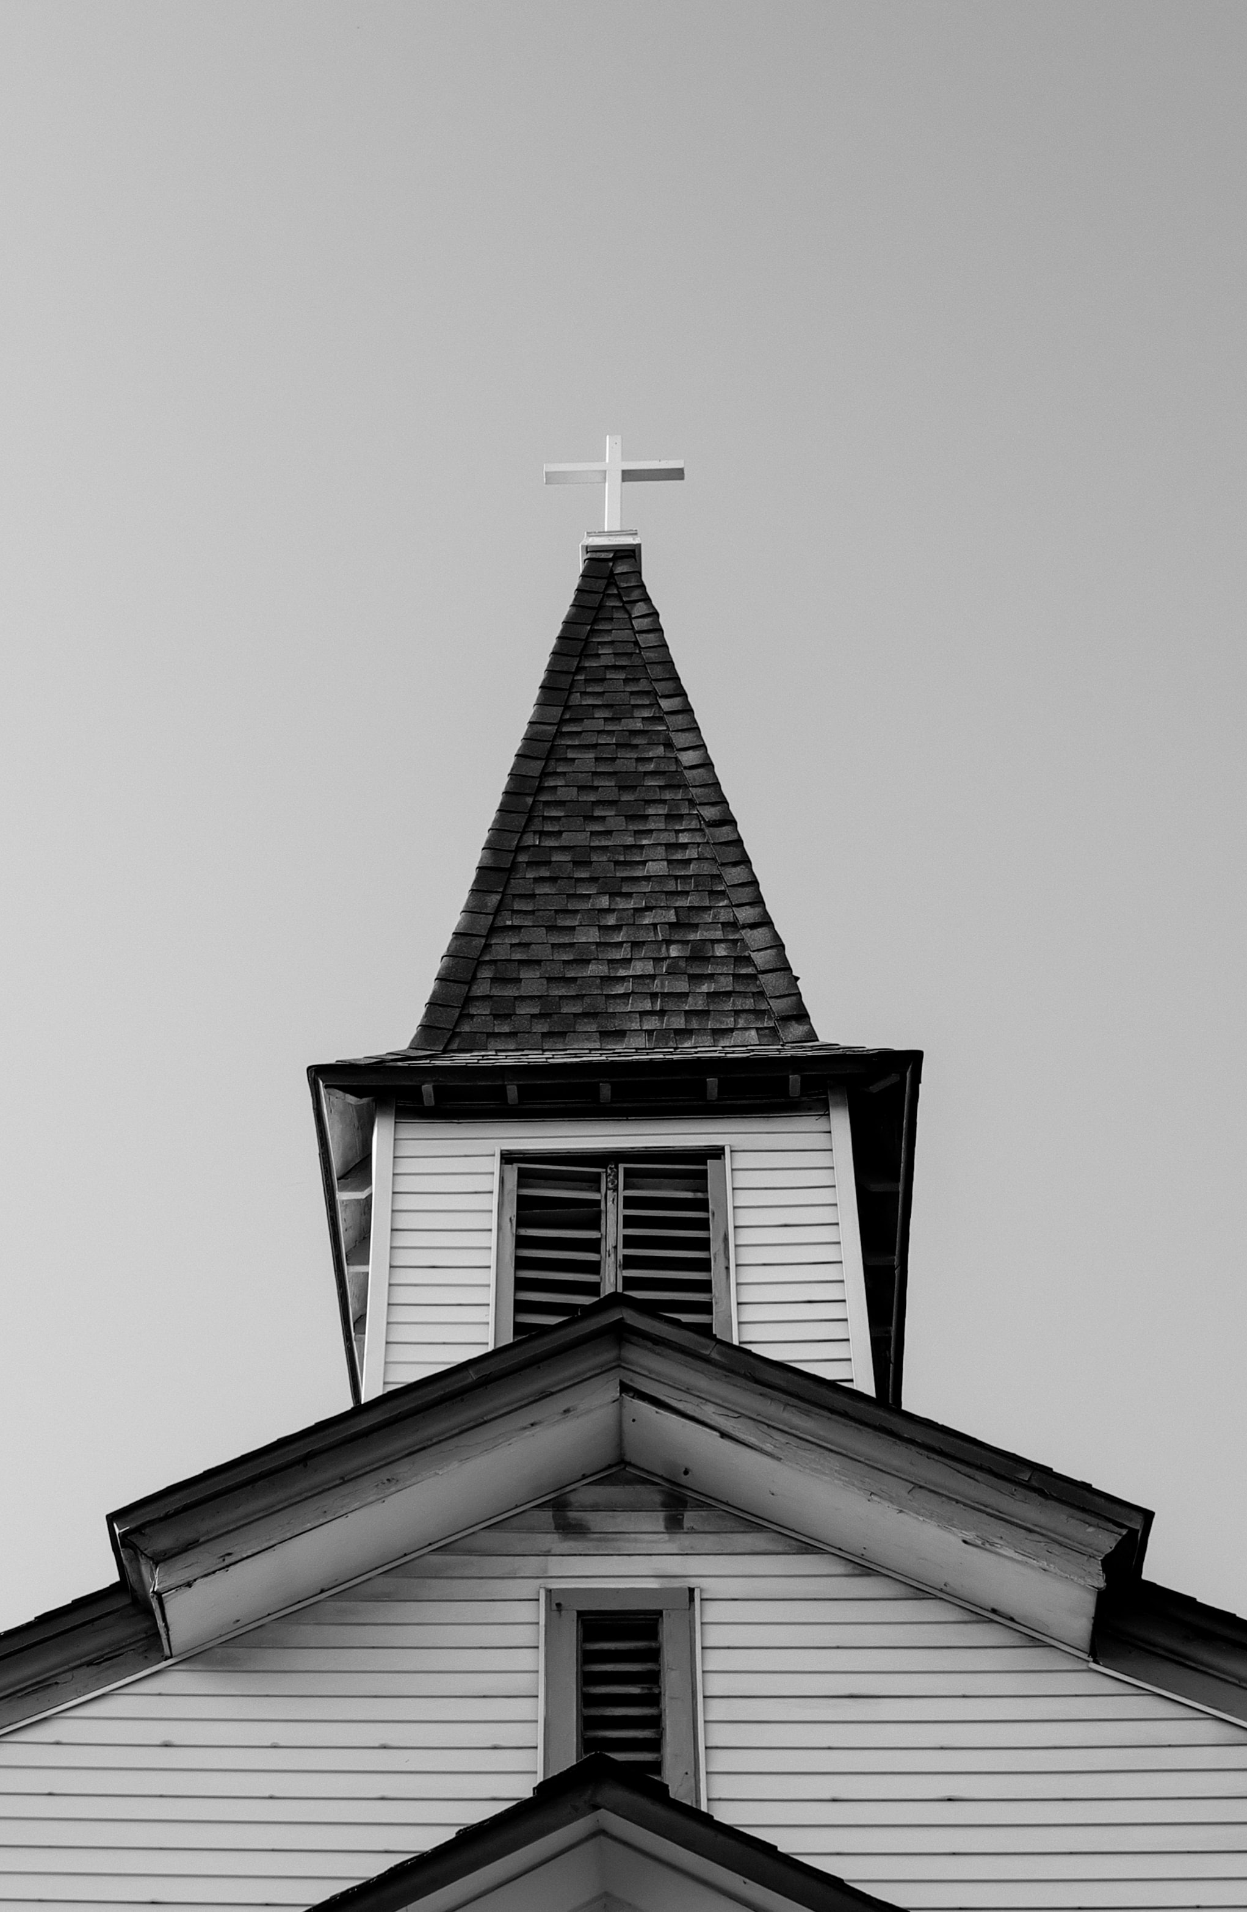
Church One
Small Town/Village
175 Years Old
12 in Attendance
Declining for years
Average Age: 71
“Exited” Pastor
They asked for help because they were in serious decline for many years and had lost nearly half of their congregation to conflict…

Slide 11
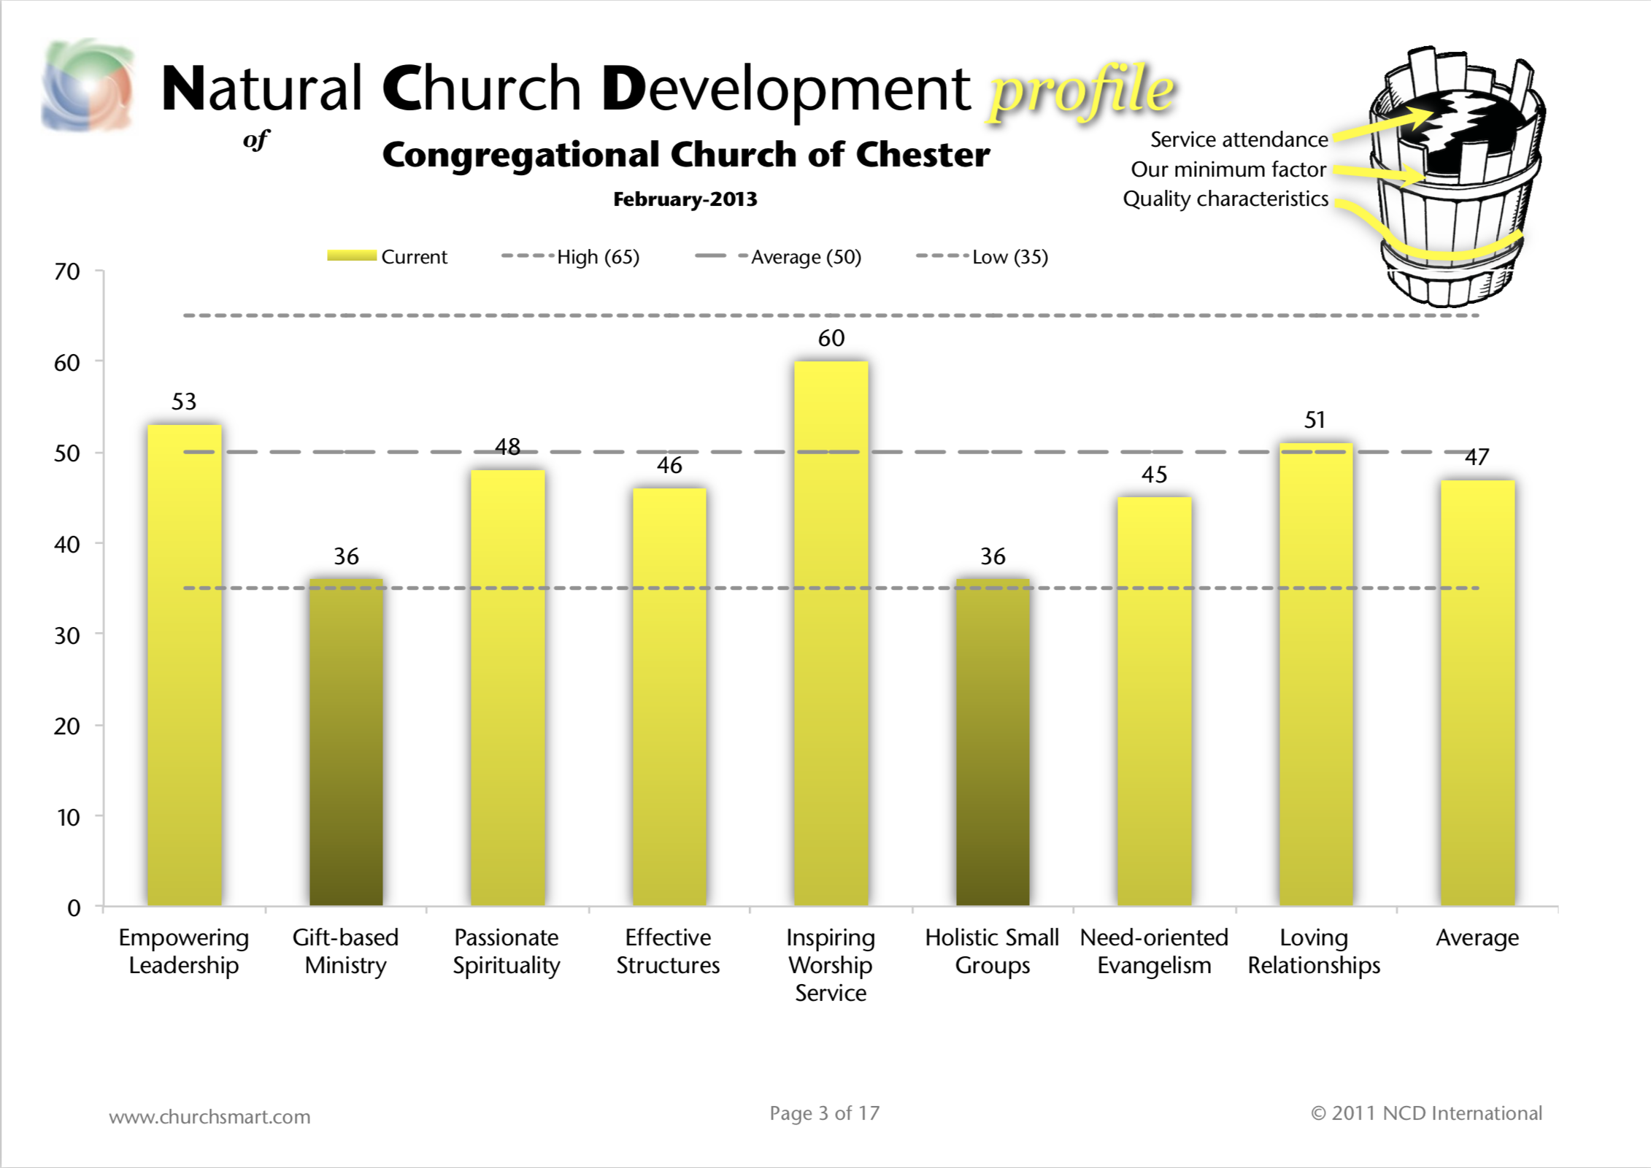
Church One
Notes:
These results were not what we were expecting – especially given their very difficult pastoral departure. But we learned some things that made these scores make sense…

Slide 12
Church One
Brought in a Transitional Pastor
Fostered Healing & Peacemaking
Appointed Leaders
Results showed the value of her investment

Slide 13
Church One

Slide 14
Church One
Notes:
They really needed us to scale things back a lot – we decided to slowly work through the key questions (Bob Logan) from the NCD Insights Report (MAY NEED TO EXPLAIN)… It worked!

Slide 15
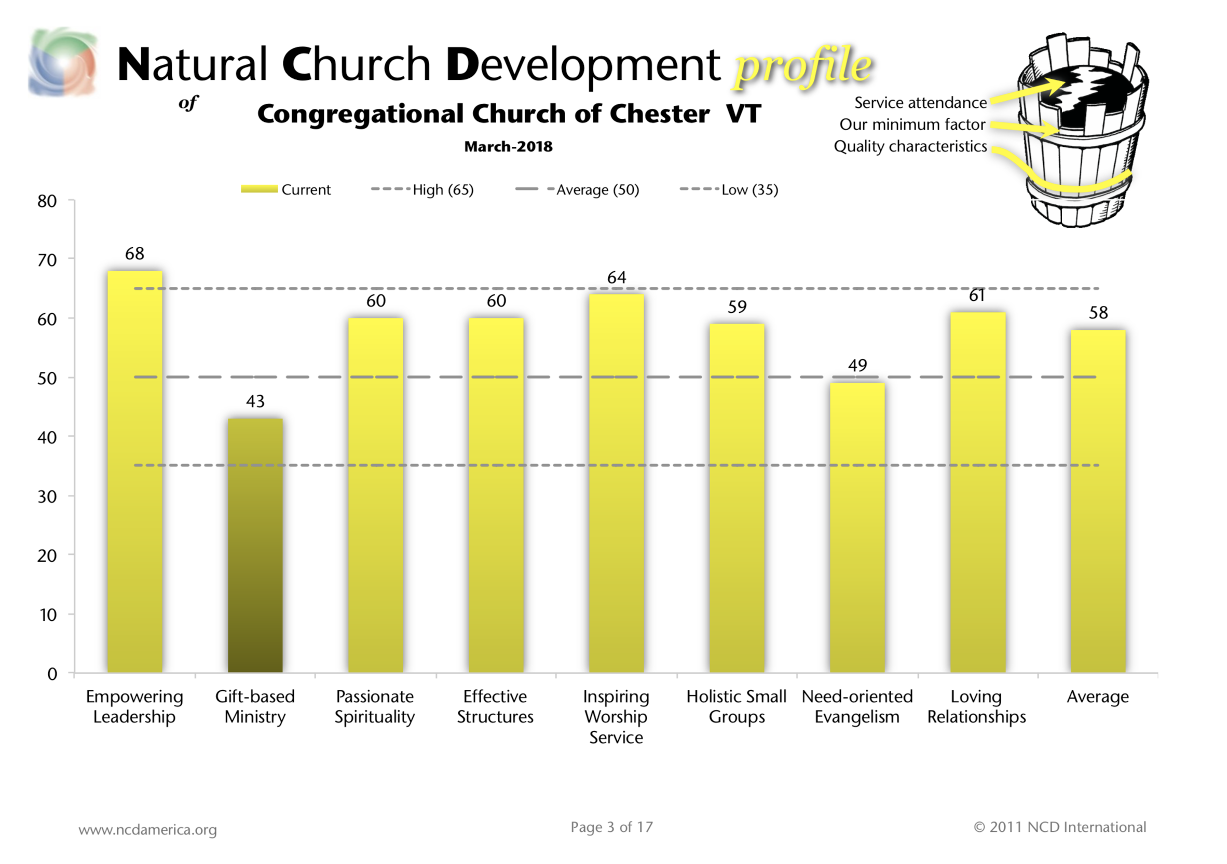
Church One
Notes:
Great Improvement – especially in Holistic Small Groups where we had been working…

Slide 16
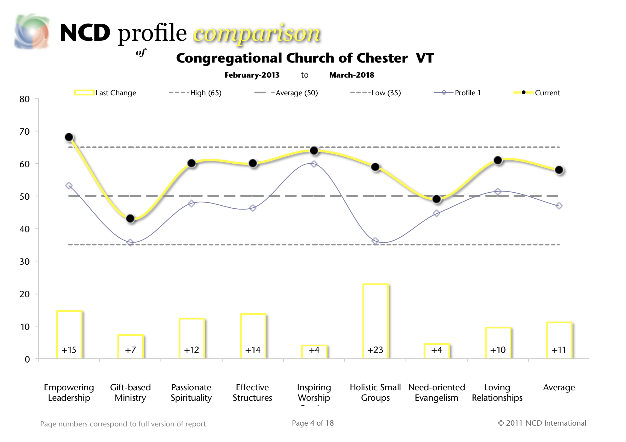
Church One
Notes:
Here you can see the difference.

Slide 17
Church One
Morale improved
Began with 12 people, ended with 35
Dramatic increase in Holistic Small Groups
Began actively supporting missions and church planting
Renovation of their building
Stepped into the full Church Development Process
Notes:
Tell the story about their endowment… They had begun to trust God.

Slide 18
Church Two
Urban/City
200+ Years Old
40 in Attendance (Pre-COVID)
Declining for years
Average Age: 65
Long-term Pastor Retired
They approached us because their pastoral search committee realized things were not as good as they had hoped…

Slide 19
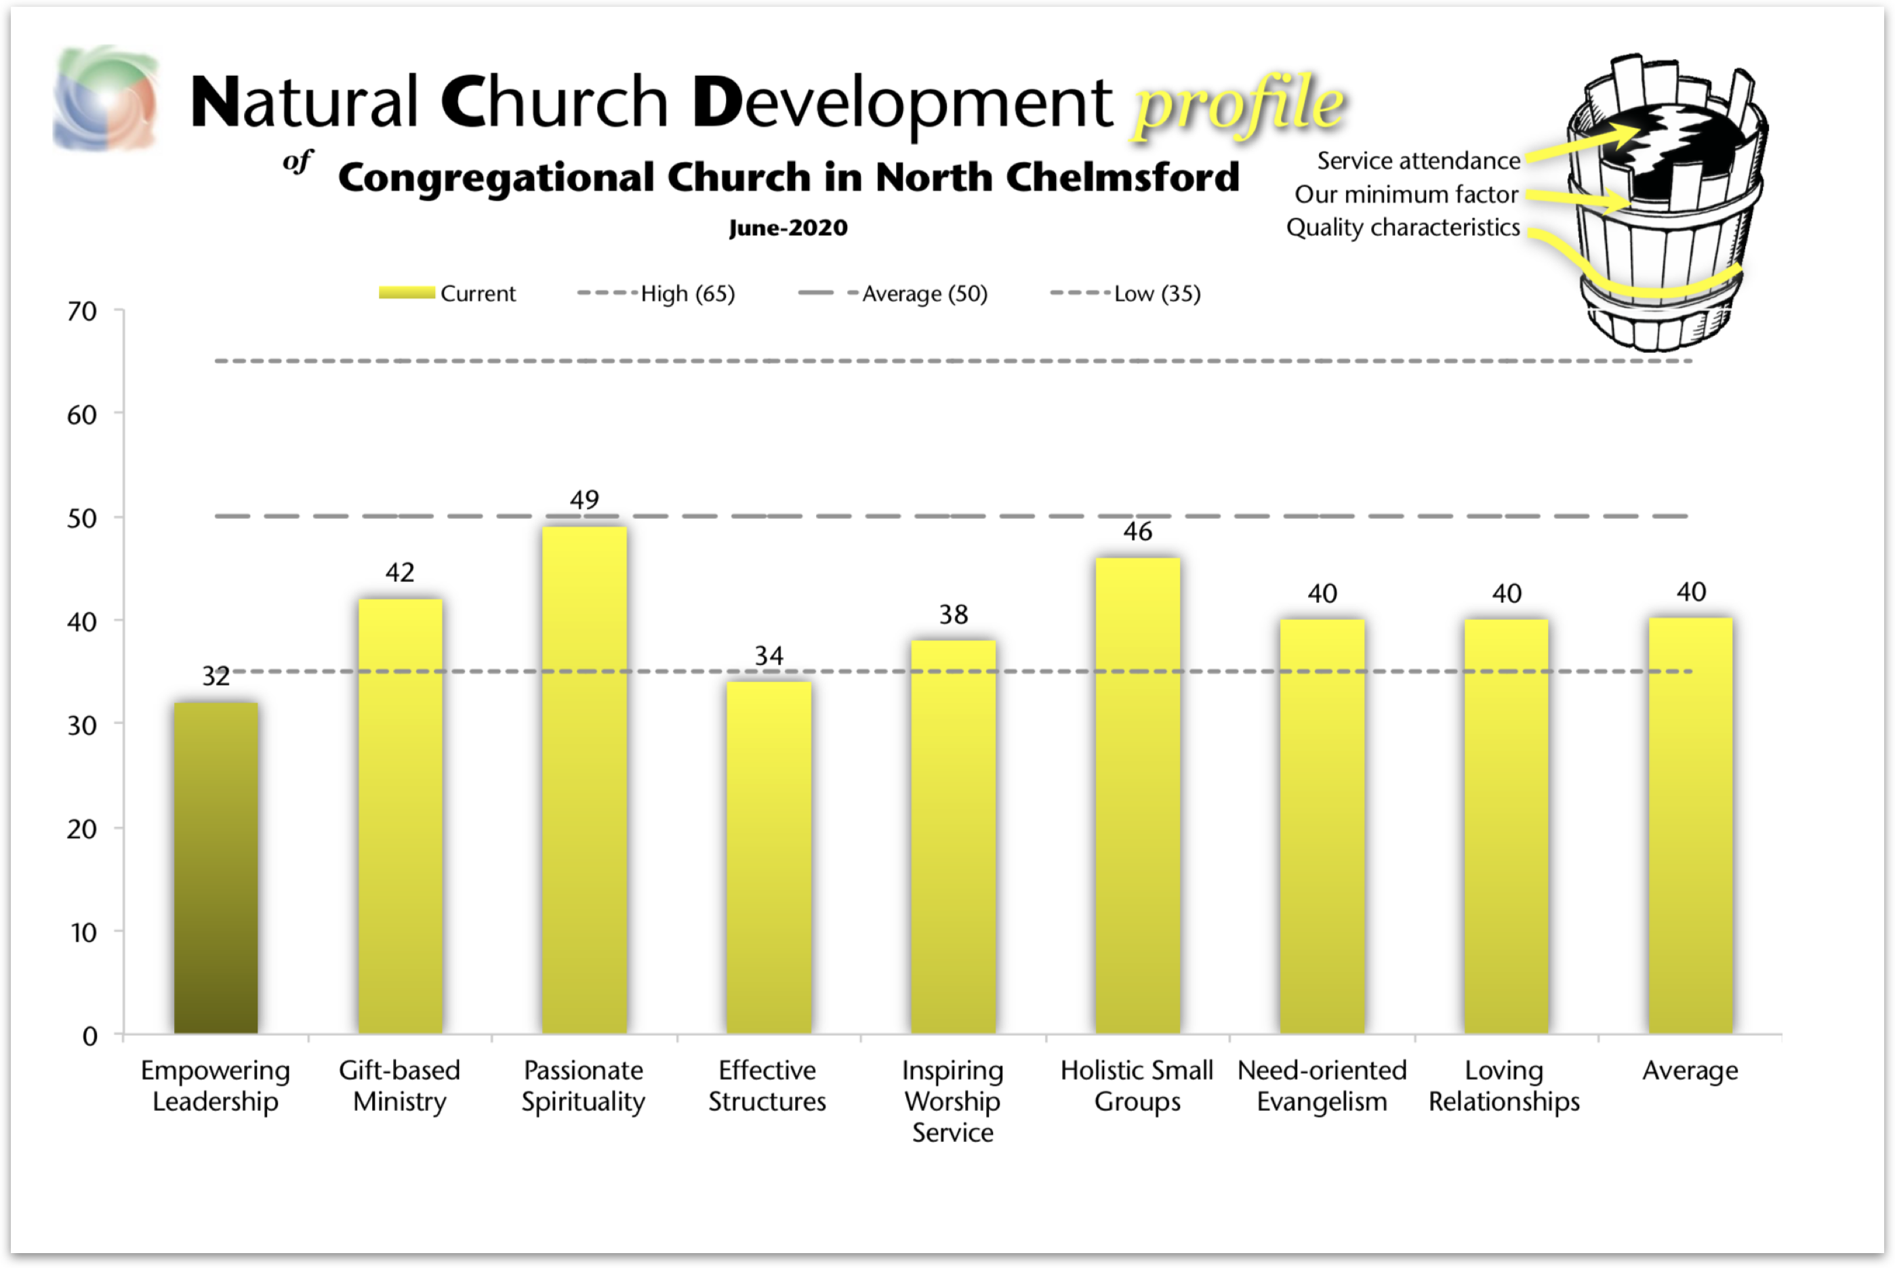
Church Two
Notes:
Empowering leadership didn’t seem to make sense to us – their pastor was long-term and well loved. But as we began to dig, we learned a lot…

Slide 20
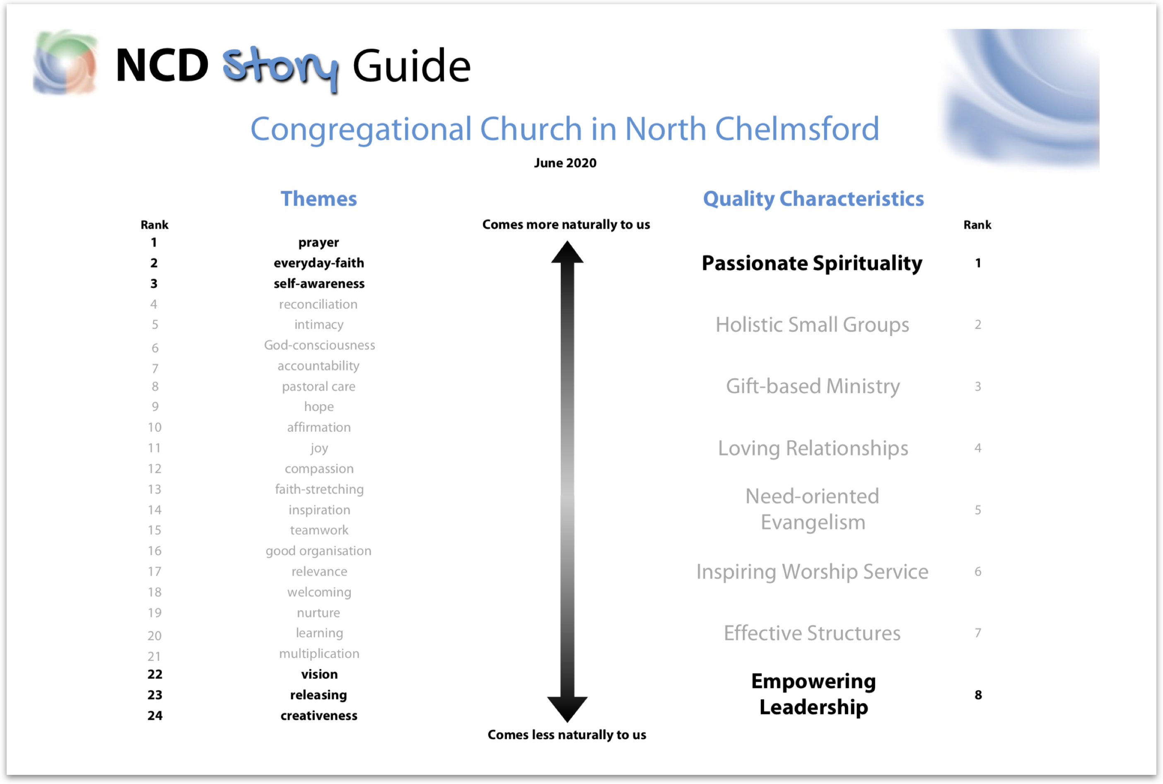
Church Two
Notes:
When we got into the story guide and began unpacking it with the pastoral search committee, all of a sudden things became clear.

Slide 21
Church Two
“We’re not sure our leaders actually want the church to grow…”

Slide 22
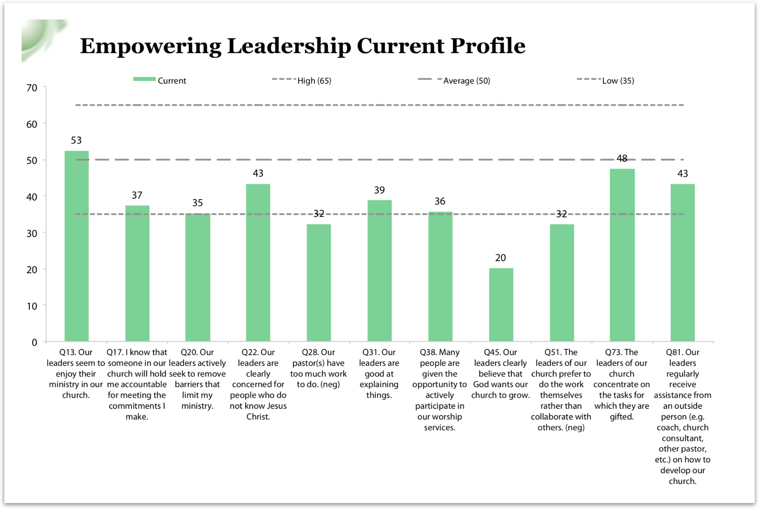
Church Two
Notes:
The pastor was doing everything – capped the growth, but also discouraged growth because if the church grew, he could no longer handle the ministry by himself. He was actually killing the church. We are in the midst of working with this congregation. COVID interrupted our work – this congregation has not yet returned to “Present” Sunday worship. They do have a Church Health Team identified, and my next conversation will be to begin discerning how intense their process should be.

Slide 23
Each Church is Unique
Unique level of energy: Some can take on more, some less
Unique vision: Some desire to see health and growth, others sadly do not
Unique communities: Some can reconnect, others cannot
Unique outcome: Some of the churches that started the process still ended up realizing it was too late
Notes:
So we’ve only been doing this process for about two years. And with COVID-19, this year has had very little application beyond what my team and I could do using Zoom. So we have several churches that are still in the early stages. We also have other churches where the restrictions of COVID-19 has probably brought them to the point of legacy. And we’ll be seeing that unfold in the next year.

Slide 24
Question & Answer
Using NCD with Churches in Crisis

