Slide 1
NCD Research
Webinar March 20, 2019
Petr Cincala

Slide 2
Best Practices of Congregations in USA
Findings from USA NCD Database (2008-2018)

Slide 3
Data by Denominations

Slide 4
2009-2018 Profiles

Slide 5
Data by the Average Scores

Slide 6
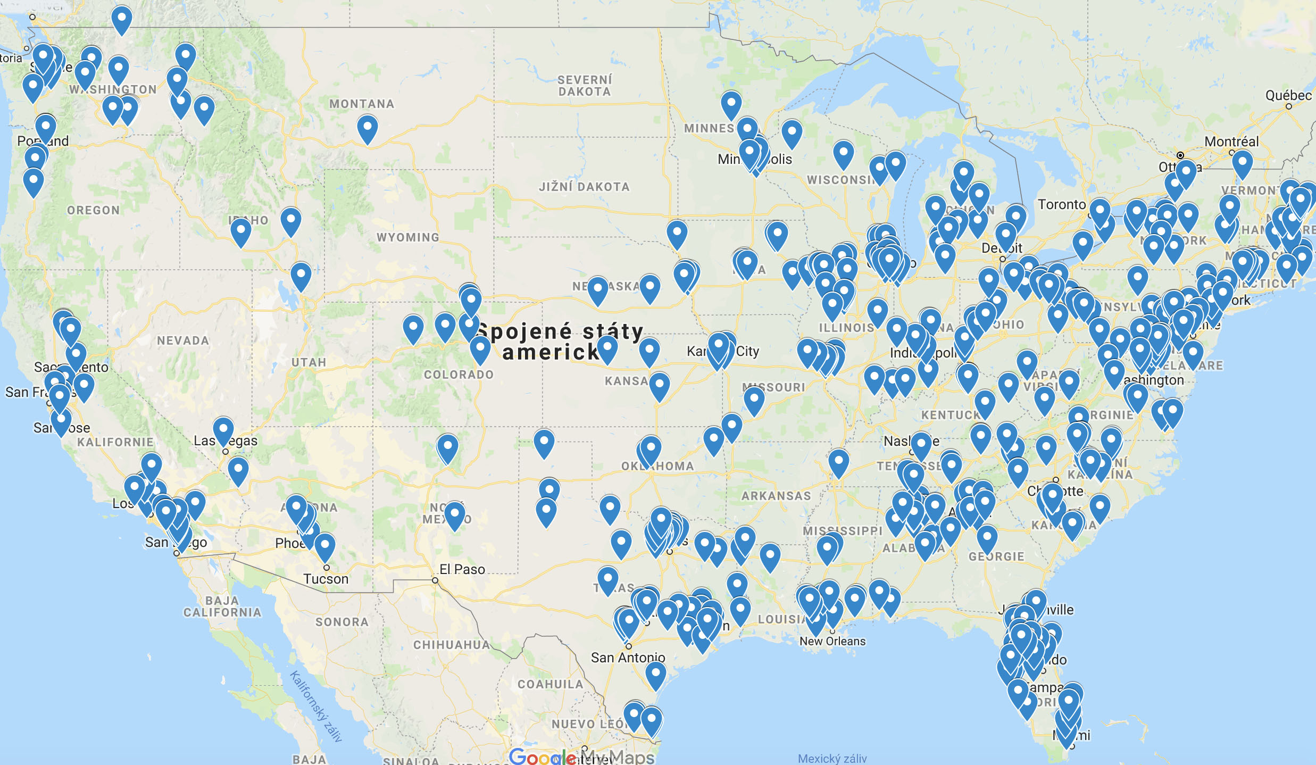
Distribution of “Healthy” Congregations (2014-2019)
2014-2019: 193 congregations with all 8 qualities 65+

Slide 7
Minimum/Maximum Scores
Scores (points) | Minimum | Maximum
Empowering Leadership | -21 | 107
Gift-based Ministry | -29 | 115
Passionate Spirituality | -6 | 104
Effective Structures | -11 | 105
Inspiring Worship | -23 | 97
Holistic Small Groups | -15 | 101
Need-oriented Evangelism | -2 | 114
Loving Relationships | -24 | 116

Slide 8
Minimum/Maximum Scores
Frequency (%) | Minimum Factor | Maximum Score
Empowering Leadership | 8.9% | 11.9%
Gift-based Ministry | 10.0% | 19.2%
Passionate Spirituality | 17.6% | 12.0%
Effective Structures | 8.9% | 5.6%
Inspiring Worship | 18.3% | 10.3%
Holistic Small Groups | 19.4% | 13.0%
Need-oriented Evangelism | 8.1% | 16.2%
Loving Relationships | 8.7% | 11.8%

Slide 9
Healthy Scores
Frequency (%) | 65+ Score
Empowering Leadership | 25.1%
Gift-based Ministry | 25.3%
Passionate Spirituality | 20.3%
Effective Structures | 22.0%
Inspiring Worship | 19.5%
Holistic Small Groups | 17.8%
Need-oriented Evangelism | 24.9%
Loving Relationships | 25.2%

Slide 10
Min/Max Difference

Slide 11
65 Hypothesis Confirmed?

Slide 12
65 Hypothesis Confirmed

Slide 13
65 Hypothesis Confirmed

Slide 14
Congregations by Size

Slide 15
Congregational Growth by Size

Slide 16
Congregational Health by Size

Slide 17
Presence of Age Groups

Slide 18
Presence of Age Groups

Slide 19
Congregational Growth by the Presence of Age Groups

Slide 20
Congregational Health by the Presence of Age Groups

Slide 21
Congregational Health by the Presence of Young Adults

Slide 22
Congregational Size by the Presence of Age Groups

Slide 23
Pastor’s Age

Slide 24
Pastor’s Age and Congregational Growth

Slide 25
Pastor’s Age and Congregational Health

Slide 26
Pastor’s Age and Congregational Size

Slide 27
Leadership Style

Slide 28
Leadership Style by Size

Slide 29
Congregational Growth by the Leadership Style

Slide 30
Congregational Health by the Leadership Style

Slide 31
Congregational Size by the Leadership Style

Slide 32
So what?
Questions, comments, implications

